Slide 1
Technology and Configuration Management
Stephen Farlett
Sr Mgr – Risk and Technology
April 18, 2023

Slide 2
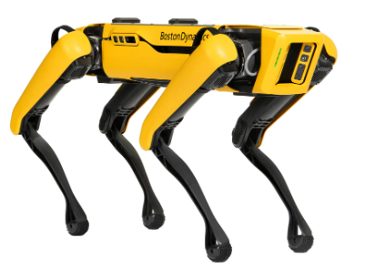
Innovation, Technology, and Nuclear Requirements
Principle 1
Just because you can, doesn’t mean you should (internet refrigerator)
Principle 2
Avoid grabbing a technology and looking for a problem to hit with it (SPOT)
Principle 3
Try to find a balance between doing nothing because it is hard to change in nuclear (50.69) and chasing technology because it is cool (do you know the reliability of touch screens?)
Principle 4
Do not neglect the people side of implementation (vibration sensors, online monitoring)
Notes:
Discussion will only focus on driver 1
Internent Refrigerator – is a smart refrigerator that can adjust temp/humidity etc and know how much food is in the refrigerator

Slide 3
Wireless vibration sensors
Notes:
Discussion will only focus on driver 1

Slide 4
Wireless Vibration Sensors
Round 1
Team to develop vibration sensors inhouse
Team included IT, Engineering, CMO/PdM; the project was a joint effort with nuclear and non nuclear
Testing was conducted at various sites to determine signal penetration through concrete
Device was a small RasberryPI chip with an accelerometer
Data would be sent via 900 MHz signal and could be monitored by anyone in the company
Set up included some filtering, integration, and diagnostic calculations (Peak-Peak, RMS, and Crest Factor)
Deadlines and production challenges led the move to Round 2
Notes:
Discussion will only focus on driver 1
Root Mean Square
RMS (Root Mean Square) frequency of a spectrum is a single number that represents the overall level of energy across a frequency range. Basics of RMS (Root Mean Square) frequency in Vibration Analysis: It is challenging part to collect vibration data in vibration management and analysis of data collected.

Slide 5
Wireless Vibration Sensors
Round 2
Off the shelf sensor was selected that could be programmed by TVA
Cost was less than $100
Intent was gross detection, so work like a “check engine” light and let team know to come perform full vibration analysis
2018 TIP Award winner
Sensor detected temperature and vibration (limited vibration information)
Project did include Design Change Packages that were generic in nature and not specific to this sensor
Overall, project was not successful because the measurement was not fine enough and the project lacked site support
There was at least one case where a pump failed but the sensors had not detected any vibration changes
Notes:
Discussion will only focus on driver 1

Slide 6
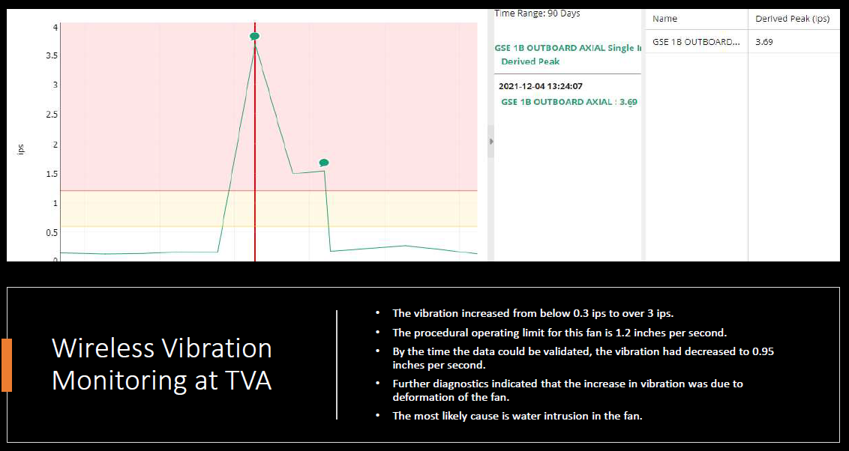
Wireless Vibration Sensors
Round 3
Lessons from Rounds 1 and 2 were applied
Design output from Round 2 allowed Round 3 to be implemented. Sequoyah issues a site specific ECP.
System has ability to generate automated emails on alarm conditions
Alarm options include spectral envelope alarms
First weekend the sensors were in service, there was a valid alarm (team was initially concerned it was a false alarm)
Notes:
Discussion will only focus on driver 1
We currently have 331 assets being monitored by the wireless vibration system at SQN. The system provides for in depth remote vibration analysis with customized trigger values for auto notifications.

Slide 7
Wireless Vibration Sensors
Notes:
Discussion will only focus on driver 1

Slide 8
Wireless Vibration Sensors
Round 3
Notes:
Discussion will only focus on driver 1

Slide 9
Wireless Vibration Sensors
Round 3
The system allows additional types of sensors to be added (acoustic and others)
By learning from lessons of each iteration, the options improved each time
By making design output relatively generic in nature, we were able to adjust when better technology options were available
Notes:
Discussion will only focus on driver 1

Slide 10
TVA Sequoyah Engineering Change Package
ECP SQN-22-006 Online Wireless Vibration Monitoring
Permits installation of accelerometer sensors (MON-10411) with a wider vibration frequency range that wirelessly transmit data through the IT network to desktop software for data trending & analysis. This wider frequency range is desired so that bearing fault frequencies can be adequately analyzed.
Permits installation of data acquisition devices (MON-10467) to monitor existing hard-wired accelerometers and wirelessly transmit data through the IT network to desktop software for data trending & analysis.
Permits installation of network gateways (MON-10496) to receive wireless communications from the sensors and data acquisition devices and forward that data via hardwired connections to the IT network.
The data gathered by this vibration monitoring equipment is used for trending analysis and information gathering and is not fed back into any plant system.
Notes:
Previous ECPs TVA-18-024 & SQN-18- 094

Slide 11
Design Characteristics
EMI/RFI
Frequency
Wireless Communication
Cyber Security
Digital
Power Requirements
Heat Load
Combustible Loading
Environmental Conditions (including radiation)
Seismic Qualification of Vibration Sensors, Data Acquisition Devices, and Gateways
Seismic Qualification of Attached Equipment & Supports
Notes:
The vibration sensors will be affixed to both safety and non-safety related equipment using neodymium magnets. The sensors installed in Seismic Cat. 1 structures are required to be seismically qualified for position retention to ensure they do not negatively impact nearby Safety Related equipment and the attached equipment will need to be qualified for the additional added weight. For this reason, ECP is augmented quality.
The fleet wide standard specification CEB-SS-5.10 for seismic qualification of electrical, mechanical, and I&C devices is used to evaluate the mounting of the sensors, data acquisition devices, and gateways. The mounting evaluation of the vibration sensors consider a peak seismic acceleration value of 19.5 G (See Figure 3.2 from CEB-SS-5.10 for 3% damping required for design by analysis) as they are mounted on vibrating equipment, and the ZPA seismic acceleration of 3 G is used for the gateways as they will be mounted to rigid plant supports and structures with no expected amplification. (See Seismic Qualification of Attached Equipment & Supports below and Special Implementation Instructions.)

Slide 12
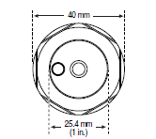
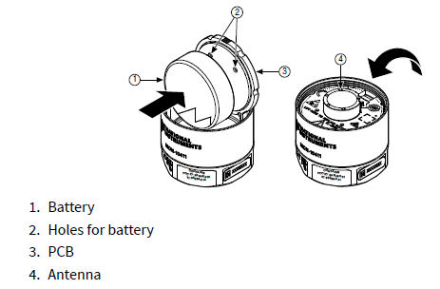
MON-10411 Accelerometer Sensor

Slide 13
MON-10467 Data Acquisition Device

Slide 14
MON – 10496 Network Gateways

Slide 15
Nuclear PM&D Center
PM&D HIT conducted in January
15 full time members and 17 part time members from Engineering (Systems, Component, CEG, and Design), Operations, T&I, and Power Ops PM&D
Benchmarking from Power Ops, Transmission, and five nuclear fleets
Survey indicated that knowledge of nuclear PM&D is inadequate
Actions from PM&D include model updates, review of out of service sensors, development of metrics, communication plan, and staffing improvements
Model updates in progress
Communication to include briefings and training
Notes:
Discussion will only focus on driver 1
PM&D – Preventative Monitoring & Detection

Slide 16
Advanced Pattern Recognition

Slide 17
Current Status
Over 1,000 active models
3 Good catches including one with estimated $2M savings
Meetings currently in progress with PM&D engineer and SMEs
Updated models reviewed with site SMEs and greatly improved
Requests from sites are increasing
Notes:
Good Catches – Gland Seal Steam Exahaust Fan, 1B and 2B Bus Duct Clg Fan vibrations issues

Slide 22
Summary
Cross functional teamwork is the key for all innovation efforts
Obtaining buy in and alignment with IT and Engineering is particularly critical
There is value in a minimal viable product, then learning and growing from there
The cultural part of an effort is as critical as the technical aspects

