Slide 1
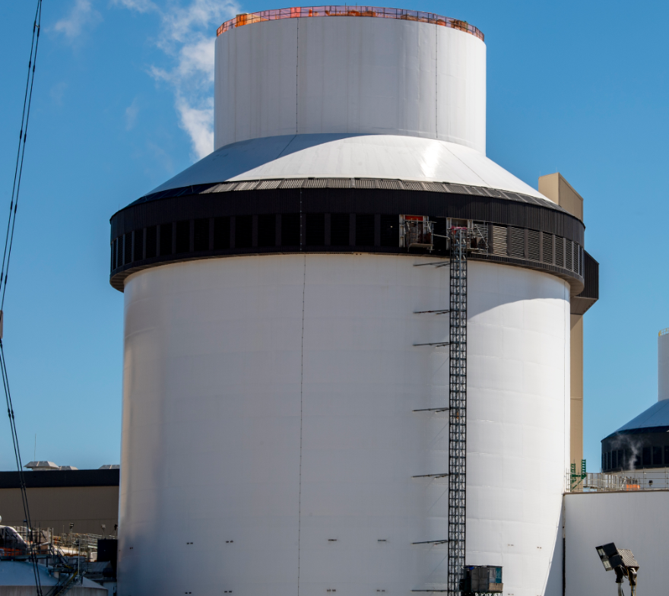
Plant Vogtle 3 & 4 Update
CMBG Conference - July 2024
Presented by: Cory Murray & Andrew Neal

Slide 2
Vogtle 3 & 4 Quick Facts
Two units
1,110 MW
each
Technology Westinghouse AP1000
Location
Waynesboro Georgia
Workforce
▸ 9,000+ workers at peak
▸ 800 current permanent jobs for operation
Vogtle 1-4
▸ Is the largest nuclear energy facility in the U.S.
▸ Powers 1+ million homes and businesses
Operating life
Expected 60-80 years

Slide 3
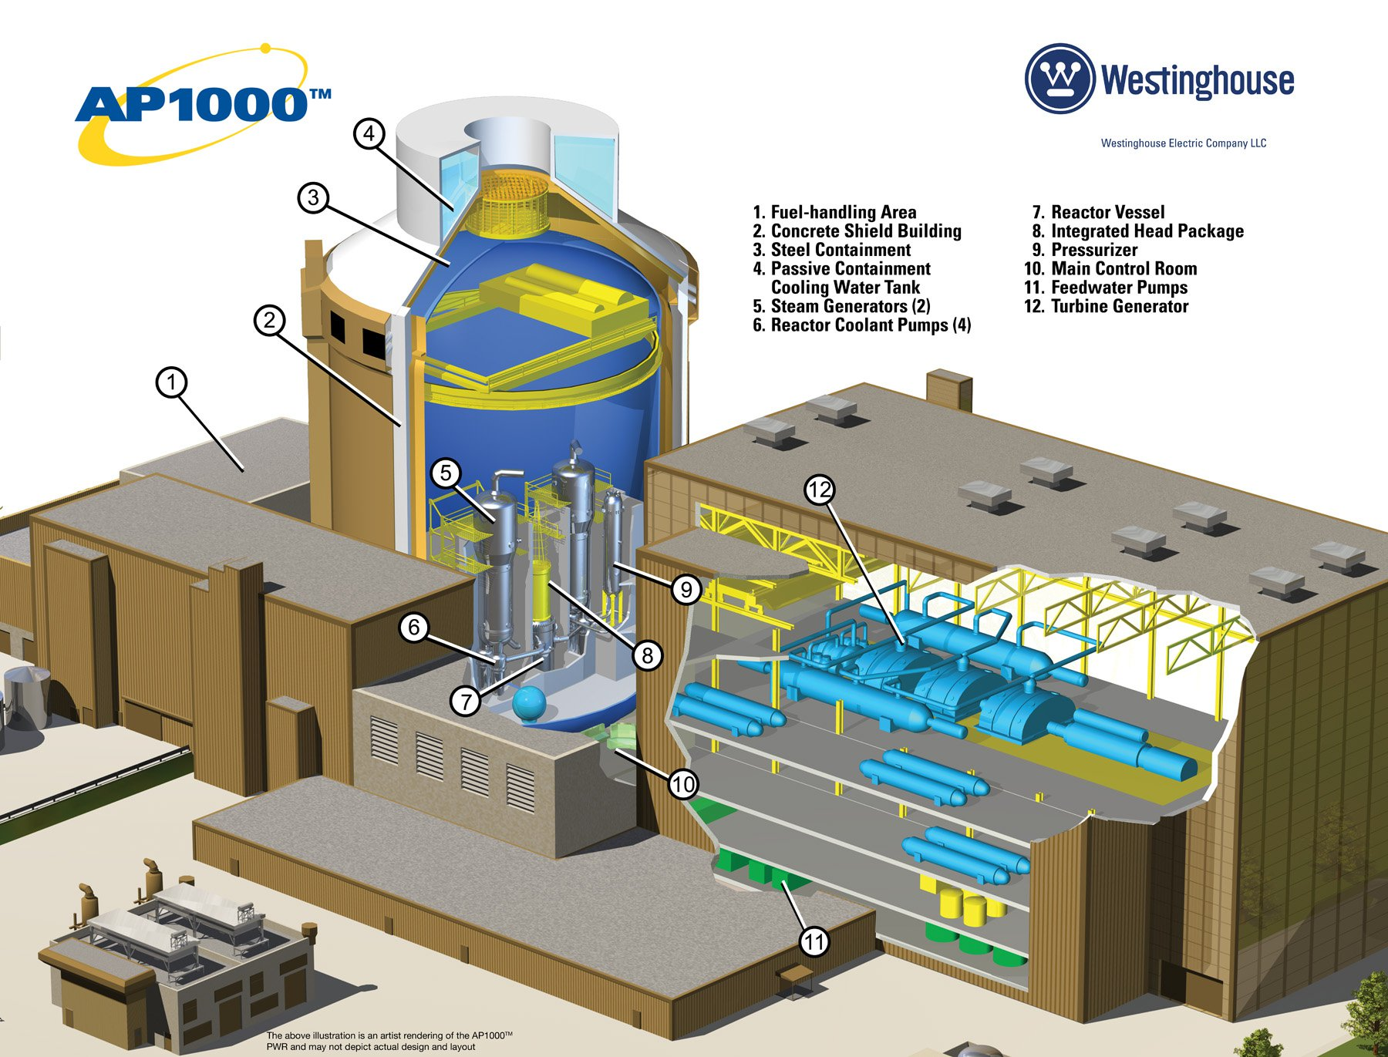
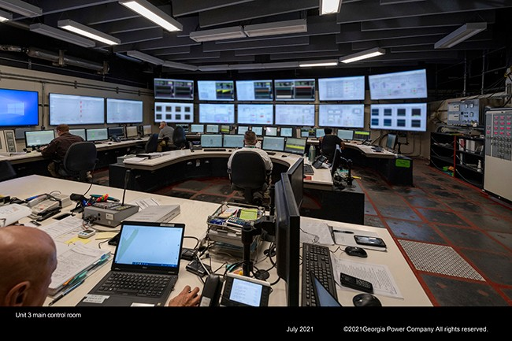
Westinghouse AP1000 Technology
The AP1000® Plant is a two-loop pressurized water reactor (PWR) that uses a simplified, innovative and effective approach to safety.
Plant simplifications yield fewer components, cable and seismic building volume, all of which contribute to considerable savings in capital investment, and lower operation and maintenance costs.
AC electrical power is not required for safe shutdown.
Operator action not required for 72 hours to maintain core and containment cooling.

Slide 4
Unit 3 Commercial Operation Declaration: July 31, 2023
Unit 3 Design Authority Turnover: October 13, 2022
Unit 4 Design Authority Turnover: July 11, 2023
Unit 4 Commercial Operation Declaration: April 29, 2024

Slide 5
Recent Major Milestones
Unit 3
April
Unit 3 successfully synchronized and connected to the electric grid, producing electricity for the first time
July
Entered commercial operation
May
Unit 3 reached 100 percent energy output for the first time
October
Successful standup online work management process
March
Initial Criticality is achieved
2023
2024
May
Hot Functional Testing completed
August
Fuel load
completed
February
Initial Criticality is achieved
April
Unit 4 reached 100 percent energy output for the first time
Entered commercial operation
March
Hot Functional Testing started
March
Successfully synchronized and connected to the electric grid, producing electricity for the first time
July
Received 10 CFR 52.103(g) finding from NRC
Design Authority Turnover
Unit 4

Slide 6
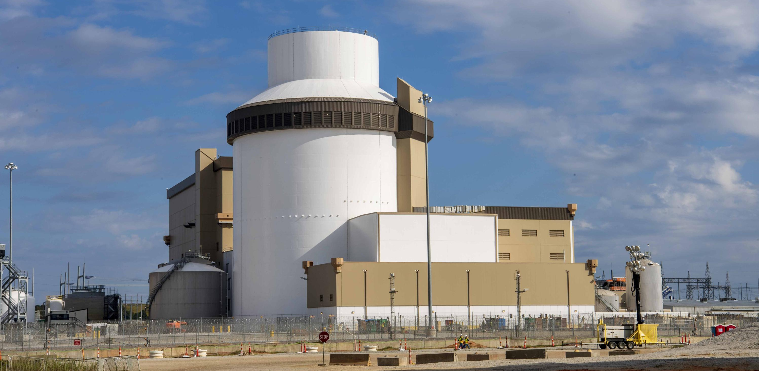
Vogtle 3&4 Commercial Output
Both units are fully connected to the grid operating at full power.
Collectively powering around half a million homes.

Slide 7
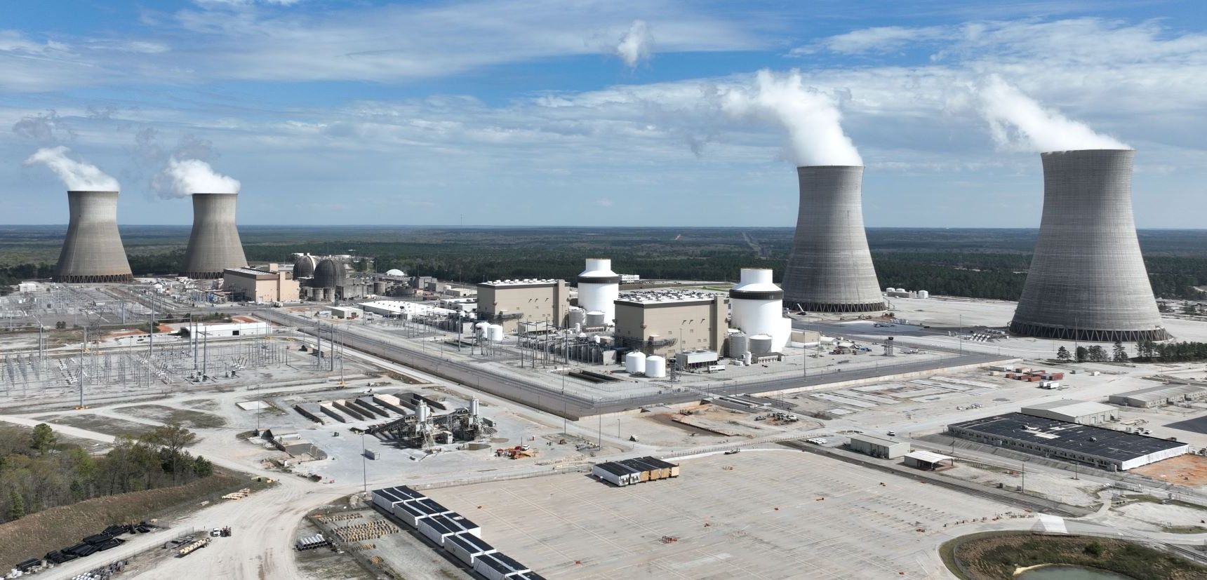
Next Steps for Vogtle 3&4

Slide 8
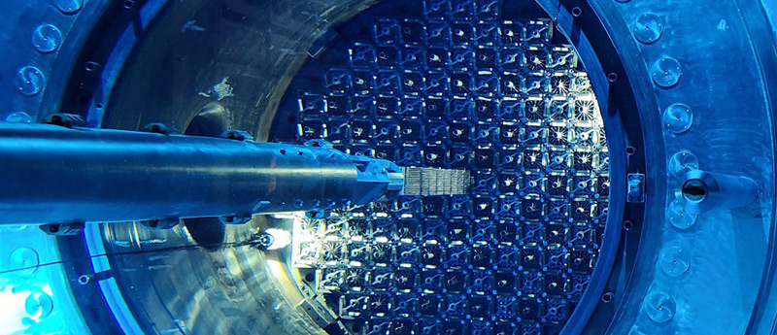
Upcoming Major Milestones
Unit 3
3R01 Refueling Outage in October 2024
Unit 4
4R01 Refueling Outage in September 2025

Slide 9
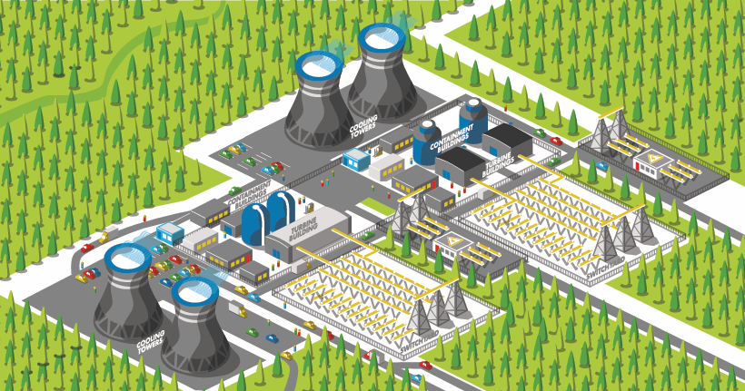
Extended Power Uprate (EPU) project
Anticipated 10 year project for a 300-350 MW increase in output across the fleet

Slide 10
Design Change Process and Configuration Management Challenges During Startup

Slide 11
Design Authority Turnover (DATO) and CM Challenges
Westinghouse Electric Company (WEC) turned over Design Authority for Unit 3 on October 13th, 2022 and Unit 4 on July 11th, 2023 to Southern Nuclear Company (SNC)
This meant using SNC’s process to perform design changes going forward
Many challenges were presented to the configuration management of the plant
  Site organizations were still in construction mindset
  Pending design changes from WEC were still in process
  Temporary modifications from the Initial Testing Program (ITP) were installed and needed converted to SNC’s process
  The volume of incoming needed changes was large
  SNC Design Engineering required a transition period to learn the Standard Design Change Process
  WEC procedures and processes were designed for construction, not operating units
The solution was to proactively create a new transitional design change process to bridge the gap between WEC and SNC design authority

Slide 12
Creating a New Design Change Process
SNC uses the NMP-ES-095 procedure as the interface for IP-ENG-001, the Industry Standard Design Change Process
It was anticipated that use of the Standard Design Change Process would not be feasible for the plant startup transitional period due to sheer number of required changes needed and tight turnaround time
SNC Design Engineering proactively created the B-GEN-ENG-038 design change process to cover the gap between DATO and Commercial Operation Declaration (COD)

Slide 13
B-GEN-ENG-038 Change Process Overview
Hybrid Southern Nuclear/Westinghouse Change Process
WEC developed a system within their WNEXUS software that allows SNC to perform Owner’s Acceptance Reviews (OARs) of design products
Allowed the use of CMISDP (Configuration Management Interface - Standard Design Process) software to process design changes produced by WEC within the requirements of Southern Nuclear
Utilized Westinghouse’s design change process, qualifications, quality assurance and years of expertise to produce needed design changes to supplement SNC in-house design changes
Sunset at Unit 4 COD; Vogtle 3&4 now uses the Standard Design Change Process per NMP-ES-095 & IP-ENG-001

Slide 14
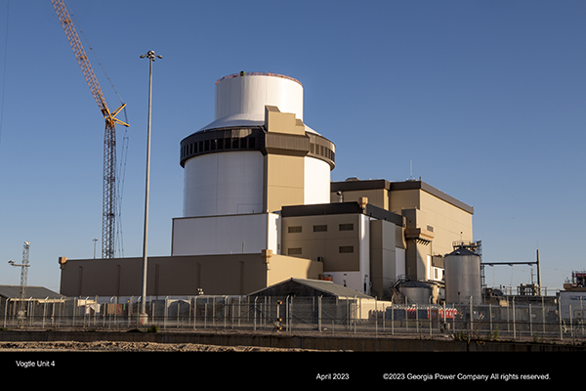
B-GEN-ENG-038 Results
Process worked successfully for Design Engineering to meet the demands of the plant during startup
The new process was used to create approximately 1000 changes since Unit 3 DATO (completed or currently in-process)
New Design Engineers were able to get design qualified and experience for post-COD
Smooth transition back to Standard Design Process

Slide 15
Challenges and Lessons Learned During Startup
All the challenges faced at Unit 3 ensured a smoother transition for Unit 4
Communicating and learning a new design change process site-wide was challenging, but organizational cooperation and knowledge was strengthened
Utilizing a shared software between WEC and SNC to perform design change reviews and signoffs was convenient and efficient; cut down on back-and-forth draft file delivery
Maintaining design document updates between WEC and SNC was a significant challenge in early stages
Utilizing two dedicated design teams during Unit 4 startup, one for each unit, allowed focus to be placed on the unique demands between online and startup
Standing up Plant Health Process post-COD required site-wide culture shift following construction
Growing pains integrating from construction procedures into SNC fleet procedures

Slide 16
Looking Forward for Future Configuration Management

Slide 17
Construction Engineering Debt Closeout Project
Building a new nuclear plant results in a lot of paperwork
Large backlog of design debt from DATO, such as:
  Unimplemented WEC design changes that were turned-over
  Implemented WEC design changes that were turned-over, but not yet incorporated into Design Documentation
  Closeout of the large amount of SNC design change packages created during startup, including incorporation into Design Documentation
  Unrealized Design Change requests in CAP
  Plant Health Process (Long-Term Asset Management (LTAMs))

Slide 18
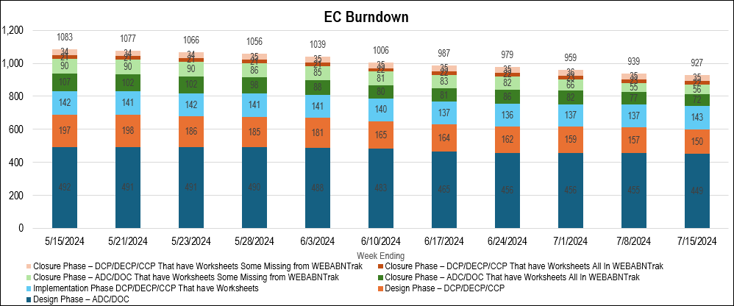
Construction Engineering Debt Closeout Project

Slide 19
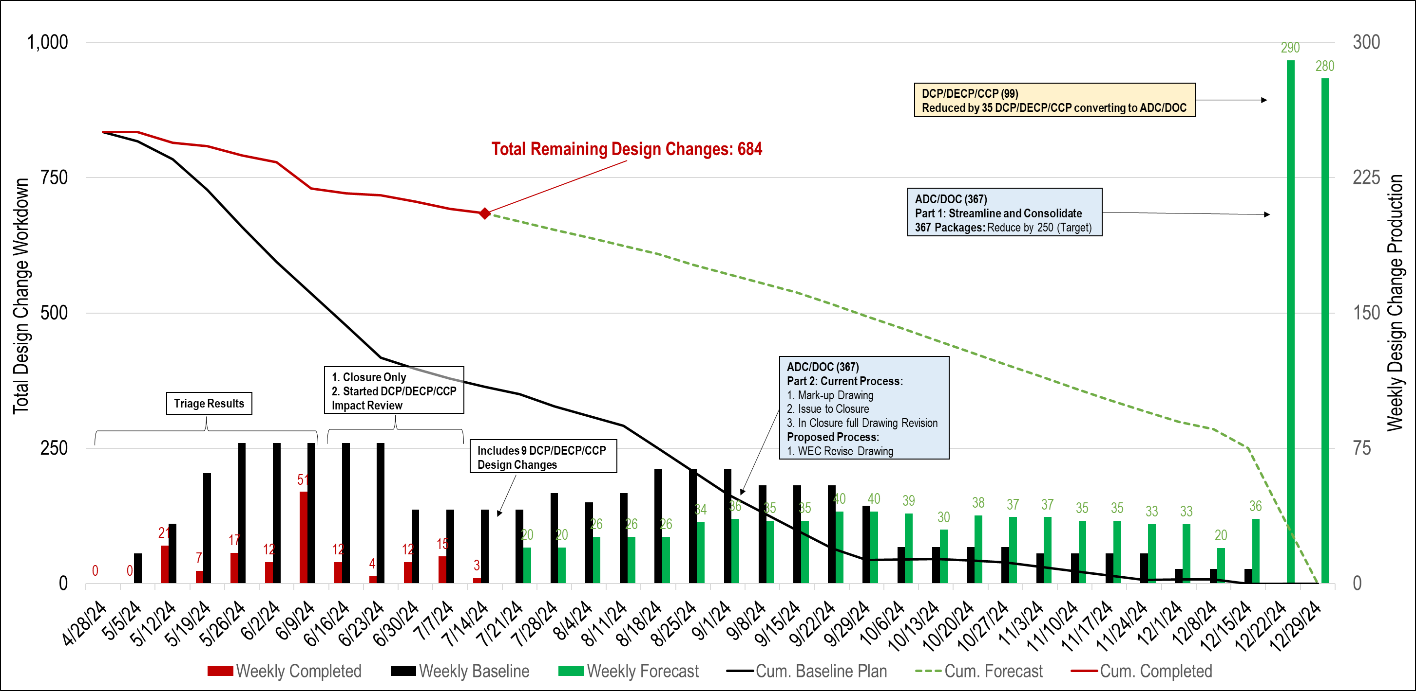
Construction Engineering Debt Closeout Project

Slide 20
Other Ongoing CM Improvements
Improving relay and digital settings database
Cleaning up meta data in document repository (Documentum) post-DATO
Further integrations between the CAP and work management databases (Maximo), document repository, CMISDP and WNEXUS to ensure design data is maintained consistently

Slide 21
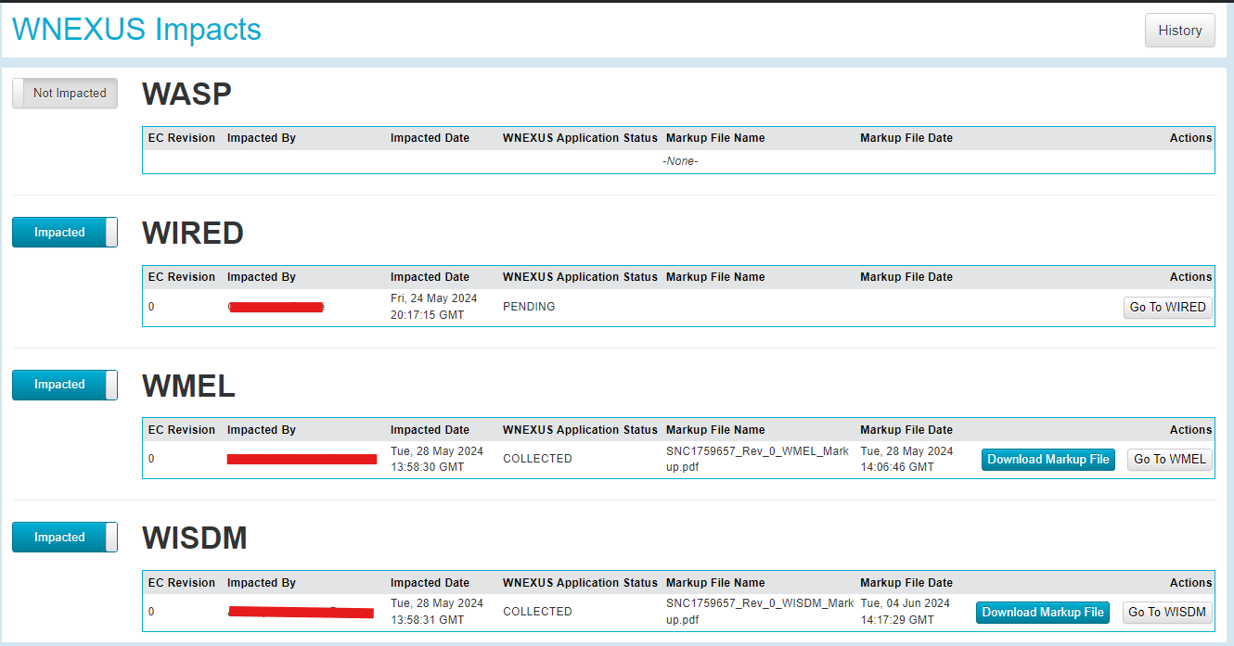
New WNEXUS Module in CMISDP

Slide 22
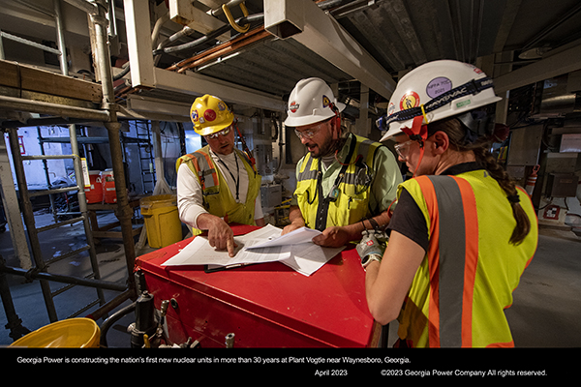
Questions?

