Slide 1
EPRI Plant Reliability and Resilience Program
CMBG Update
Jason Castro
Principal Technical Leader
July 28, 2025

Slide 2



PRR: Instrumentation & Control
MISSION
To provide industry leading tools, technologies, methods, and knowledge transfer, that support the implementation of modern information and operational technologies in both new and existing facilities.
Our goal is to advance system reliability and performance through direct engagement and research developed with a strong technical basis and demonstrated efficacy.
EXECUTION
This mission achieved through…
  Use of modern international, industry standards
  Demonstration of new technologies and risk-informed methods and processes
  Advances in knowledge transfer and training to support rapidly and continuously changing technology
Together…Shaping the Future of Energy®

Slide 3








I&C
Team
Nick Camilli
Deputy Program Manager
PRR Strategy
Michael Thow
PRR Sr Program Manager
mthow@epri.com
Kelli Voelsing
Senior Program Manager
ER Strategy
fferrante@epri.com
Matt Gibson
Sr. Technical Executive
Digital I&C - IT / OT
mgibson@epri.com
Stephen Lopez
Principal Team Leader
Maintenance, M&D, EMC
slopez@epri.com
Christina Novogoratz
Tech Leader
Maintenance, EMC
cnovogoratz@epri.com
Cristina Corrales
Principal Tech Leader
M&D, HFE, Simulation, IT/OT
ccorrales@epri.com
Jason Castro
Principal Tech Leader
Digital I&C, Cybersecurity
jcastro@epri.com

Slide 4
Supplemental Funded:
Digital Systems Engineering User Group - 3002022140
Next Meeting in Charlotte
August 13th and 14th 2025
A forum for information sharing of digital specific material
Current Members to Date (26)
Operational Experience
Lessons Learned
Interactive community
Common Design Packages
Cyber Security Evaluations
Member Feedback
American Electric Power ( DC Cook)
Bruce Power
Callaway (Ameren)
Constellation Energy
Curtiss Wright
Dominion Energy South Carolina, Inc.
Dominion Energy, Inc.
Duke Energy Corp.
Enercon Services
Energy Northwest
Entergy Services, Inc.
Evergy Services (Wolf Creek)
Framatome
GE-Vernova
NPPD (Cooper)
Palo Verde
PG&E (Diablo)
PSEG (Salem/Hope Creek)
Rolls Royce SMR
Sargent & Lundy Engineers
Southern Company
South Texas Project (STP)
Tennessee Valley Authority (TVA)
Vistra Corp. (Comanche Peak)
Westinghouse Electric Company, LLC
Xcel Energy
Current Activities:
Harmonization of the DEG,HAZCADS,DRAM,TAM,EMCAM,HFAM, and Digital Lifecycle Strategy Guide. Improves coordination between products and updates with current OE. Synchronized Update of all products in 2025.
Roll out of the member sharing website.
Nuclear Digital Project Experience Baseline 2024 published. Updated annually, members of this supplemental can download EPRI Technical Report 3002029458. This report provides a baseline of installed digital equipment across members.
Notes:
- DSEUG is growing and has a good representation of the industry (US and Canada)
Next meeting is Aug 13th- 14th
Digital Project Experience report is published. Members can download
Harmonization effort is underway to sync products with planned delivery in April.
DEG, Digital Engineering Guide
HAZCADS, Hazards and Consequence Analysis for Digital Systems
DRAM, Digital Reliability Analysis Methodology
TAM, Cyber Security Technical Assessment Methodology
EMCAM, Electromagnetic Compatibility Assessment Methodology
HFAM, Human Factors Analysis Methodology

Slide 5
EPRI’s Digital Framework Elements
EPRI’s high-quality engineering process uses the same modern methods and international standards used in other safety related industries to improved efficiency and reduce implementation cost
Utilize Industry Standards
Use the same proven design and supply chain structures that non-nuclear safety related industries use (IEC-61508/61511/62443). This leverages the economies-of-scale achieved in other industries.
Use of Systems Engineering
Use of a modern, high performance, single engineering process that leverages systems engineering in the transition to team-based engineering for conception, design, and implementation.
Risk Informed Engineering
Making effective engineering decisions via hazards and risk analysis to integrate all engineering topics (such as cyber security and SCCF) into a single engineering process.
Capable Workforce

Slide 6
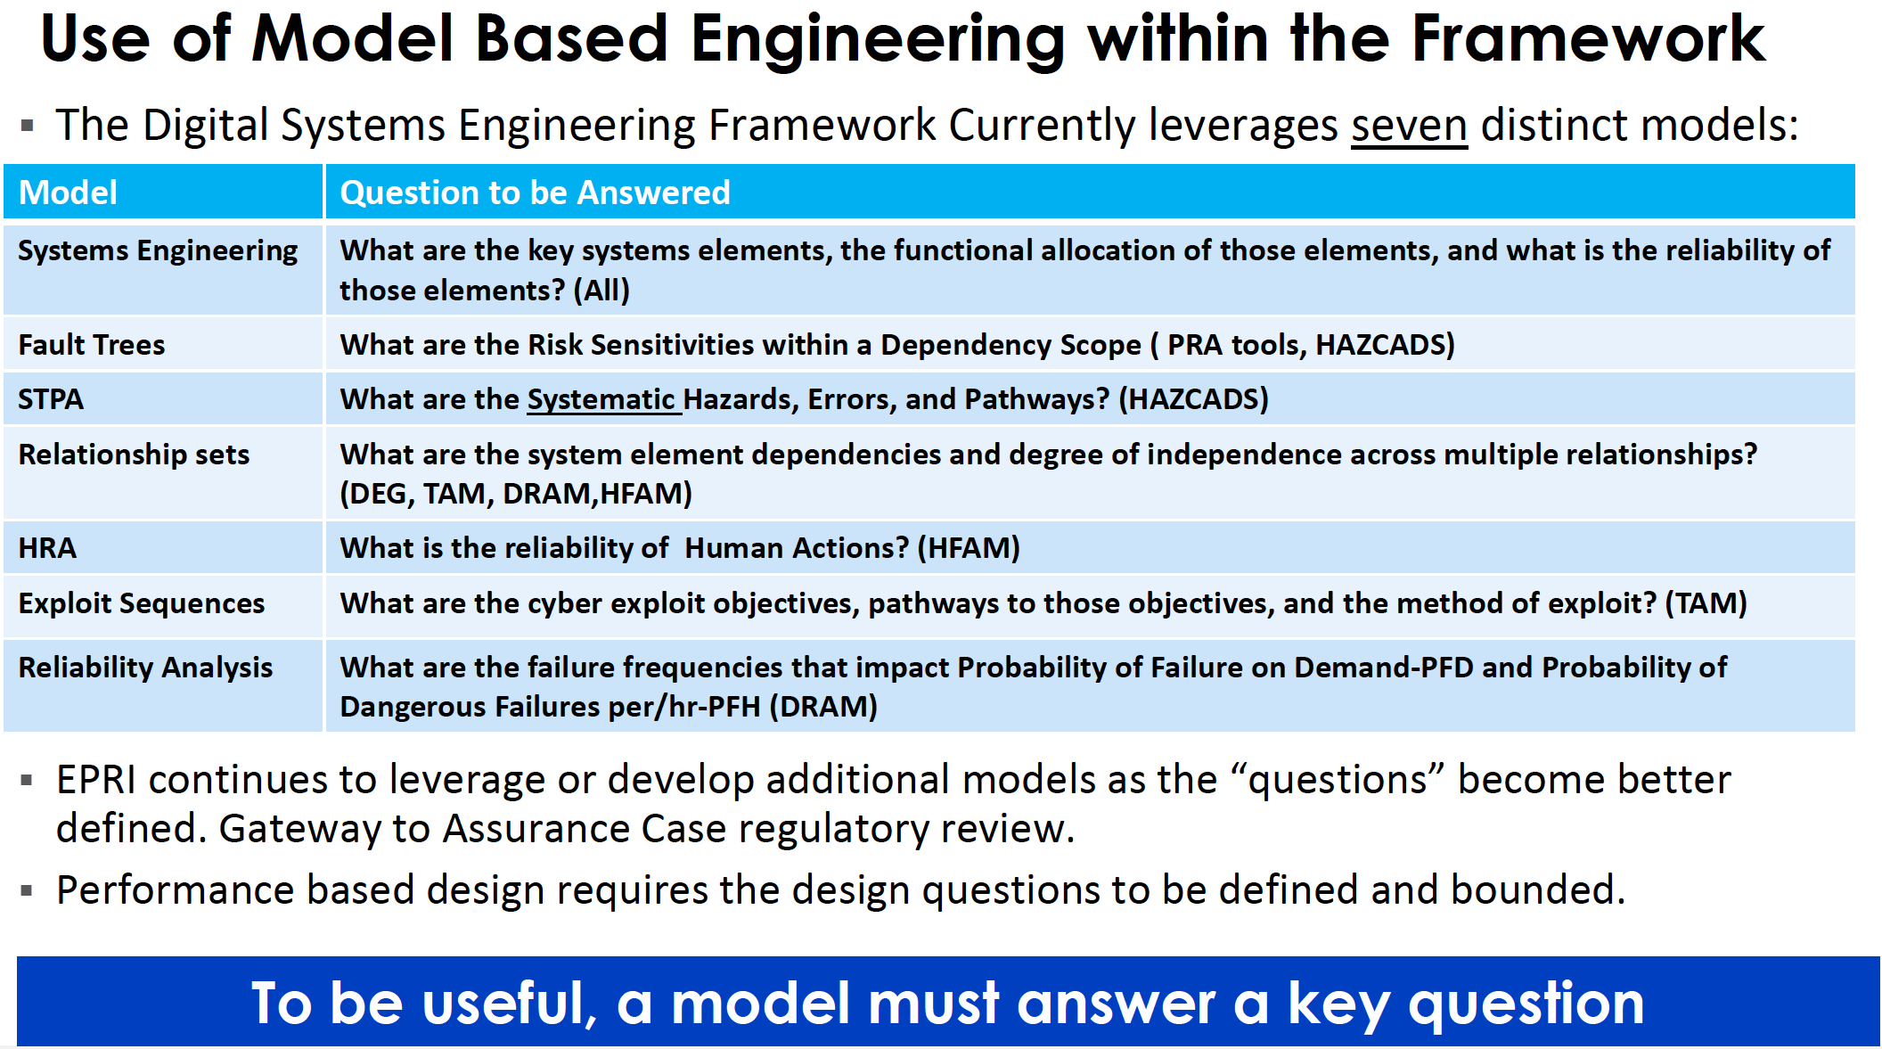

Slide 7
DEG – Synthesizes the Systems Engineering framework from IEC-15288. Includes all relevant Lifecycle topics. Takes strategic input from the Lifecycle guide and formulates design description.
HAZCADS
UCA + RRT
DRAM
IEC-61511
IEC-61508
Control Methods
HAZCADS – Uses STPA/FTA to identify hazards and associated UCA. FTA and Risk Matrices develop a Risk Reduction Target (RRT) which informs the downstream processes. Implements a PHA/LOPA from IEC-61511.
TAM
IEC-62443
Strategies
Lifecycle
Guide
DRAM – Identifies Hardware and Software reliability vulnerabilities and develops Loss Scenarios. Formulates and scores Control Methods to protect, detect , and respond/recover from UCA to meet the RRT.
DEG
HFAM
IEC-61511
IEC-15288
Design Elements
TAM – Identifies cyber security vulnerability classes and develops Exploit Sequences. Develops and scores control methods to protect, detect and respond/ recover from UCA to meet the RRT.
IEC-15289
IEC-12207
EMCAM
IEC-62443
Control Methods
Design Description
HFAM – Identifies important human actions and develops Loss Scenarios. Identifies and scores control methods to “design out” Human Error until meeting the RRT.
Design Elements
Configuration Management Guide
Requirements Engineering Guide
Testing Guide
Network Design Guide
EMCAM – Identifies EMC vulnerability classes. Develops and scores protect, detect , and respond/ recover control methods using the RRT
RRT= Risk Reduction Target STPA=System Theoretic Process Analysis LOPA= Layers of Protection Analysis PHA=Process Hazards Analysis
UCA= Unsafe Control Action FTA= Fault Tree Analysis EMC= Electromagnetic Compatibility
Notes:
The power of Systems Engineering is that it integrates everything. It is one integrated process the pulls together different disciplines and topics to create or modify a complete system or subsystem – it seeks to understand the WHOLE Elephant. Here we introduce each component of the Framework including and the downstream processes that create both a loss scenario, additional reliability insight and control method developments. Systems Engineering can now become the glue that brings order and efficiency to the emerging complexity. It does have the potential to be disruptive as it is a profoundly different process to what is used in the US and other areas of the world. In addition, an integrated process begins converging everyone to a single process framework/model that does everything. This will be important in reducing staff and easing workforce development.
The Digital Engineering Guide (DEG) is the backbone of the Framework and describes the system engineering approach that brings order and efficiency to the emerging complexity. HAZCADS identifies hazards and ranks their associated risk-significance. The “downstream processes” from HAZCADS look in detail at the UCAs from the perspective of a particular technical discipline. It is these downstream processes that develop loss scenarios and identify control methods commensurate with reliability needed to meet the risk reduction target from HAZCADS.
DRAM – looks at digital reliability, including hardware and software
TAM – looks at cyber security
HFAM – looks at human factors
EMCAM looks at electromagnetic compatibility

Slide 8
The Digital Systems Engineering Framework Guides
Product ID | Title | Item Type
3002031207 | Cyber Security Technical Assessment Methodology (TAM)- Risk Informed Exploit Sequence Identification and Mitigation: Revision 2 | Guide
3002031208 | Network Design Guide (NDG)- Use Case Based Approach for Operational Technology (OT) Networks: Revision 1 | Guide
3002031209 | Digital Maintenance and Management Guide (DMG): Revision 0 | Guide
3002031210 | Digital Systems Configuration Management Guide (DCMG): Revision 1 | Guide
3002031211 | Digital Systems Requirements Engineering Guide (DREG): Revision 1 | Guide
3002031212 | Digital Systems Testing Strategies and Methods (DTS): Revision 1 | Guide
3002031213 | Digital IC Lifecycle Strategy Guide (DLSG): Revision 2 | Guide
3002031214 | Electromagnetic Compatibility Assessment Methodology (EMCAM): Revision 1 | Guide
3002031215 | Human Factors Analysis Methodology (HFAM) for Digital Systems- A Risk-Informed Approach to Human Factors Engineering: Revision 1 | Guide
3002031216 | Digital Reliability Analysis Methodology (DRAM): Revision 1 | Guide
3002031217 | Hazards and Consequence Analysis for Digital Systems (HAZCADS): Revision2 | Guide
3002031218 | Digital Engineering Guide (DEG) - Decision Making Using Systems Engineering: Revision 1 | Guide
12 Harmonized and Updated Guides
Notes:
Here we have a complete list of the twelve digital systems engineering framework guides for reference. These guides are available separately and are used in conjunction with the other elements of the framework.

Slide 9
Digital Engineering Guide Revision 1

Slide 10
Digital Engineering Guide (DEG) – Systems Engineering
Scoping
Analysis & Requirements
Functional Allocation
Hazard Analysis
Synthesis & Validation
Synthesized from the ISO/IEC/IEEE-15288/15289/12207 Framework
Life Cycle Phase, Activity, and Level of Interest Based
Iterates through the SE process for each phase in a
non-linear fashion
Includes topical guidance for each phase
Iteratively converges on the final synthesized design
Systems Engineering
The DEG Addresses The Following Areas
  Functional Allocation ( including Human/System Allocation)
  Hazard Analysis , Reliability Analysis (including CCF) and Mitigations ( 2.4.10. 2.4.11. 2.4.12)
  Verification and Validation (V&V)
  Testing & Discovery
  Transition to the O&M Phase
  Division of Responsibility (DOR)
  Interface Analysis
  Topical Elements (Cyber, HFE, Procurement, EMC,CM, Data Comm)
  Requirements Development
  Architecture Development including Relationship Sets

Slide 11
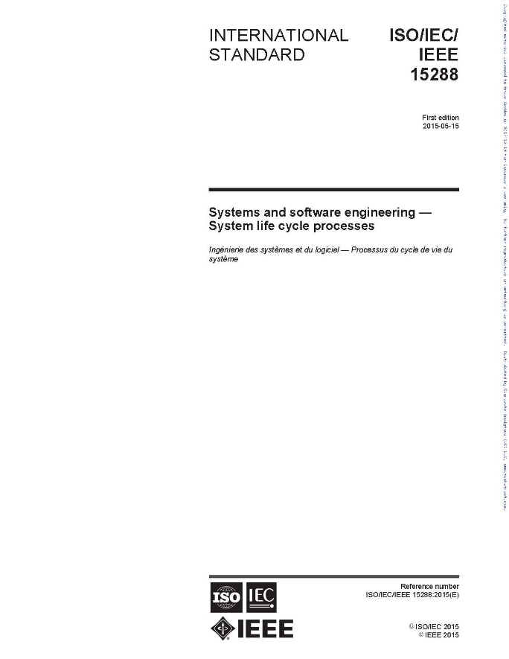
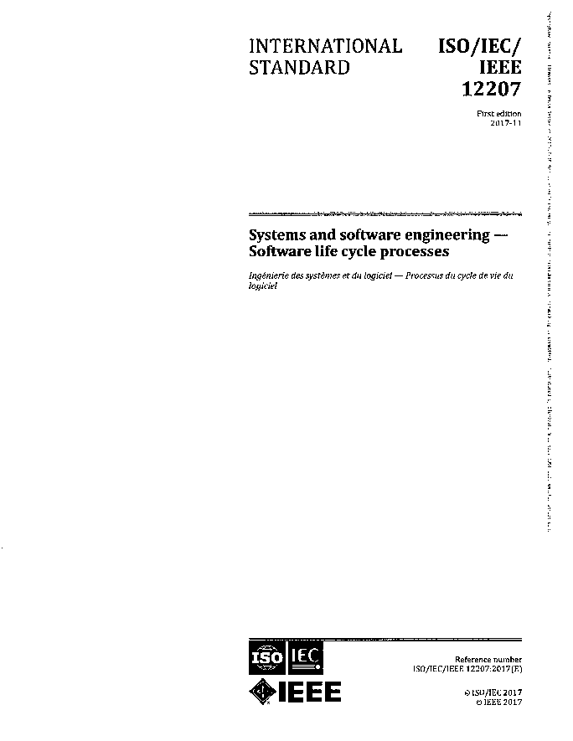
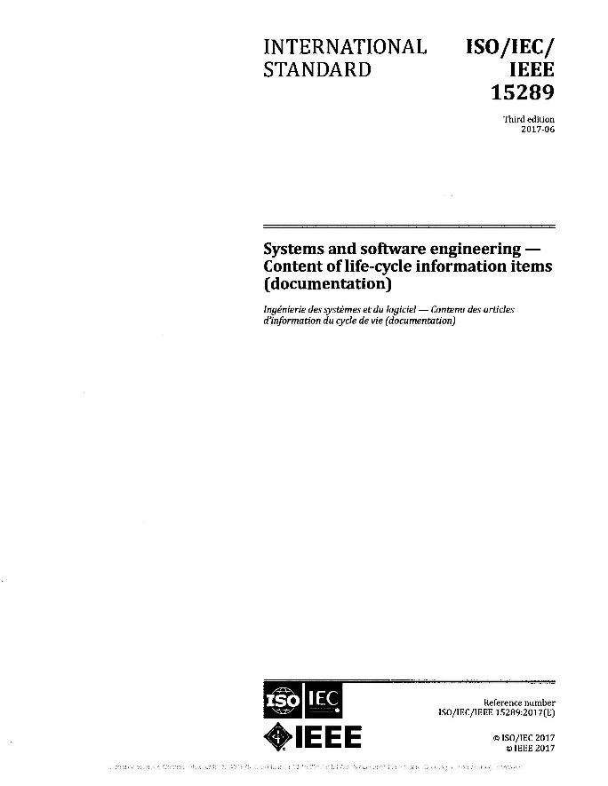
“This document specifies the purpose and content of all identified systems and software life‐cycle information items…”
ISO/IEC/IEEE Std. 15288-2015
ISO/IEC/IEEE Std. 12207-2017
ISO/IEC/IEEE Std. 15289-2017
“This International Standard does not detail information items in terms of name, format, explicit content and recording media. ISO/IEC/IEEE 15289 addresses the content for life cycle process information item (documentation).”
“This document does not detail information items in terms, of name, format, explicit content and recording media. ISO/IEC/IEEE 15289 addresses the content for life cycle process information items (documentation).”
Standards are Synthesized into Actionable Guidance

Slide 12
DEG R1 Activity Phases
The DEG is organized by Phases. This phases match most lifecycle models that implement new or modified designs for systems or facilities. Activity numbers are formatted by [Phase.Topic.Sequence]. The Phases are:
Phase 1- Initial Scoping (1.X.X)
Phase 2- Conceptual Design (2.X.X)
Phase 3- Detailed Design (3.X.X)
Phase 4- Installation Planning Phase (4.X.X)
Phase 5- Installation and Test Phase (5.X.X)
Phase 6- Closeout Phase (6.X.X)
Phase 7- Operations and Maintenance Phase (7.X.X)

Slide 13
DEG R1 Activity Topics
Topic 4 – Systems Engineering (X.4.X)
Topic 5 – Procurement (X.5.X)
Topic 6 – Human Factors Engineering (X.6.X)
Topic 7 – Data Communications Engineering (X.7.X)
Topic 8 – Cyber Security Engineering (X.8.X)
Topic 9 – Plant Integration Engineering (X.9.X)
Topic 10 – Testing (X.10.X)
Topic 11 – Configuration Management (X.11.X)
Topic 12 – Obsolescence Management (X.12.X)
Systems Engineering
Procurement
HFE
Data Comms
Cyber Security
Plant Integration
Testing
Config. Mgmt.
Obsolescence Mgmt.

Slide 14
Topic 11 – Configuration Management Activities X.11.X
Identification of Digital Configuration Items
Configuration (Change) Control
Configuration Status Accounting
Configuration Audits
System Configuration Management Plans
Detail Guidance Can be found in the EPRI 3002031210: Digital Systems Configuration Management Guide (DCMG): R1
Systems Engineering
Procurement
HFE
Data Comms
Cyber Security
Plant Integration
Testing
Config. Mgmt.
Lifecycle Mgmt.

Slide 15
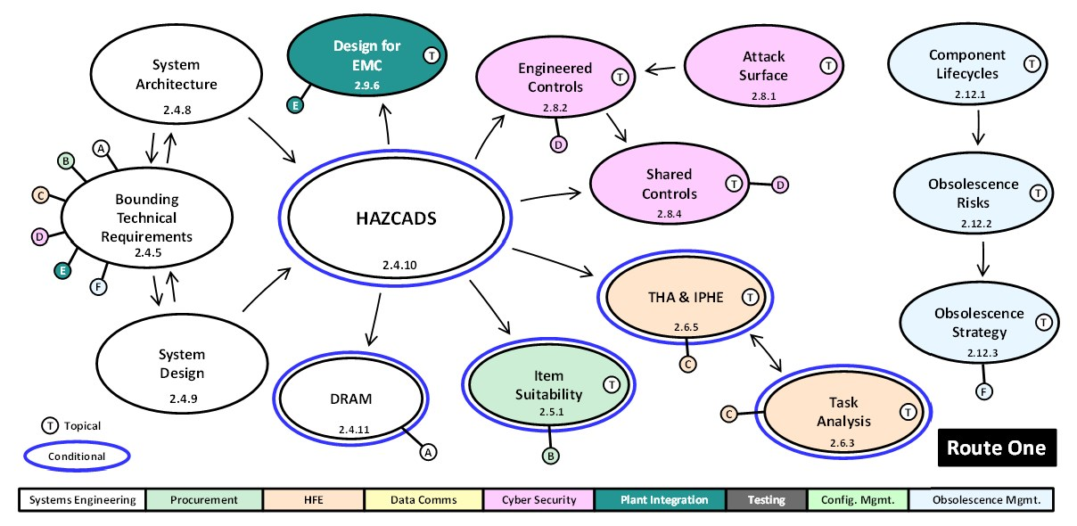
DEG Activity Groups
“Activity groups” are clusters of related activities that promote engineering efficiency in digital projects by:
    Focusing on key technical decisions
    Promoting distillation of technical information into key information items
    Helping you make decisions that are informed by various topics, instead of thinking about each topic in isolation
This is an example “activity”
The “T”s indicate “topical screens”
The letters “A-F” refer to connections to other activities, which in turn are labeled with these letters
The blue outer circles indicate “conditional screens”
These are the nine “topics,” which are color-coded in the activity bubbles
This activity group covers route one (risk informed analysis) of the two routes

Slide 16
Initial Scoping
Config. Mgmt. Interfaces
Affected
Info Items
Lifecycle Mgmt. Impacts
Affected Config. Items
1.11.2
Plan for Discovery
T
1.11.3
1.12.1
1.11.1
1.4.2
Level of Interest
Test
Strategy
Info. Mgmt.
Strategy
1.10.1
1.4.3
Procurement Strategy
1.4.1
T
Project Boundary
1.5.1
T
Project Meas.
Strategy
Data Comms Use Cases
1.9.1
1.4.4
HFE Impacts
& User Needs
T
Defensive Strategy
T
1.7.1
T
1.6.1
HFE Planning
Affected Assets
1.8.2
T
Topical
T
T
Conditional
1.6.2
1.8.1
Systems Engineering
Procurement
HFE
Data Comms
Cyber Security
Plant Integration
Testing
Config. Mgmt.
Lifecycle Mgmt.

Slide 17
System Verification & Validation in the Conceptual Design Phase
Regression Analysis
Bounding Technical Requirements
System Architecture
Overall Test Strategy
2.10.1
2.4.5
Test
Methods
2.4.8
2.10.3
Verification & Validation
System
Design
2.10.2
System Config. Mgmt. Plan
HFE
V&V
T
2.4.9
2.4.14
2.11.4
2.6.7
Implementation
Configuration Identification
Configuration Control
Config. Status
Accounting
T
Topical
2.4.13
2.11.1
2.11.2
2.11.3
Conditional
Systems Engineering
Procurement
HFE
Data Comms
Cyber Security
Plant Integration
Testing
Config. Mgmt.
Lifecycle Mgmt.

Slide 18
Operations & Maintenance Phase (continued)
Maintain Config. Control
Perform Config. Accg.
Assess Lifecycle Management
7.11.2
T
7.11.3
7.12.1
Perform Phys. Config Audits
Support O&M Activities
Monitor Human Perf.
7.11.1
T
7.6.1
7.4.1
Execute O&M Tests
Monitor Data Comms.
T
Assess Adversary Capabilities
7.10.1
T
Topical
7.7.1
T
Conditional
7.8.1
Systems Engineering
Procurement
HFE
Data Comms
Cyber Security
Plant Integration
Testing
Config. Mgmt.
Lifecycle Mgmt.

Slide 19
Configuration Management Guide Revision 1

Slide 20
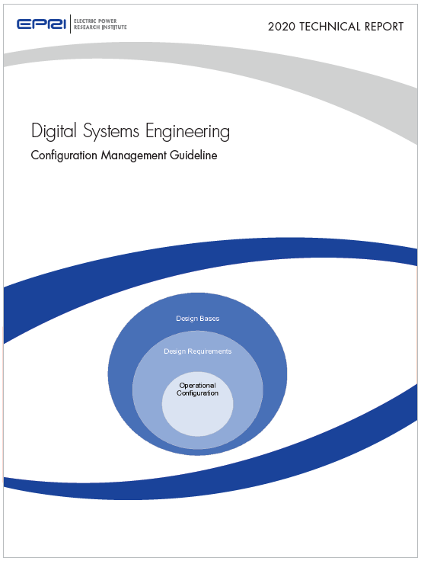
Configuration Management Guideline 300203120
Will supercede Revision 0, 3002015755
  Defines critical CM elements for digital
  Details CM processes for digital systems
  Describes CM documentation approaches
  Explains change control methods for digital
  Uses the Graded Approach from the EPRI Digital Engineering Guide(DEG) Revision 1, 3002031218
Integrates with the DEG – Topic 11
Notes:
Industry experience indicates there is a digital CM gap affecting existing processes, procedures, and skills within a nuclear station’s organization needed to address the unique aspects of configuration management for digital I&C equipment.
This guideline addresses these CM gaps for digital systems by providing focused guidance for implementing configuration management for digital I&C equipment and systems. It addresses both software and hardware configuration items.
Best practices and effective methods are identified and developed into practical guidance for owner/operator engineers and their contractors. The guideline addresses the finer points of digital CM, including methods for identifying hardware and software configuration items, controlling application logic, controlling configuration data, and optimizing and controlling documentation.
The guidance differentiates methods for user-controlled data, tunable parameters, safety system actuation set points, and other data sets. It complements existing methods for design control, document control, parts control, and other quality program criteria.

Slide 21
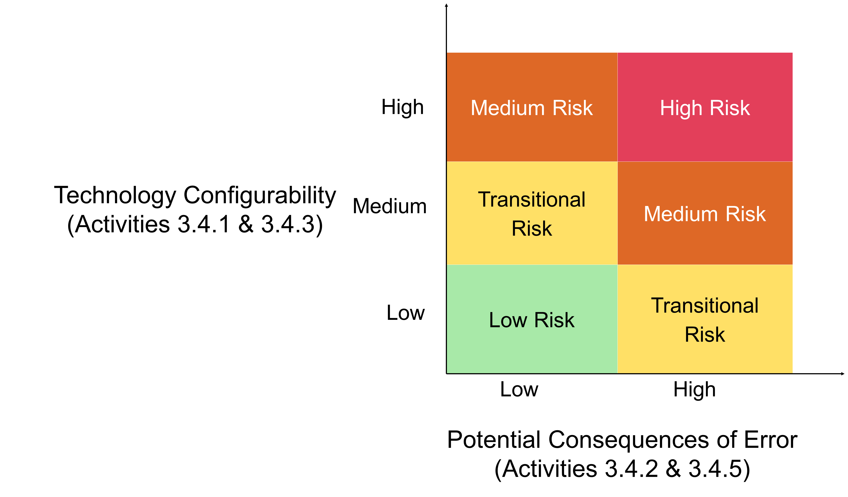
Risk Informed Graded Approach in the DEG
This is Risk at the Project level not the Facility Design level
Facility Design Risk is addressed within the DEG/CM process
Notes:
Likelihood is determined by evaluating digital I&C equipment configurability (from the DEG user’s perspective) because greater configurability (i.e., more decisions) implies greater opportunity for error in requirements, design, implementation, integration, installation, etc., and greater benefit from performing more DEG activities.
Consequences are determined by evaluating potential consequences of engineering errors, including those made performing DEG activities, malfunctions caused by installed/affected I&C equipment, and malfunctions caused by human errors using installed/affected HSIs.
The DEG’s graded approach is based on these concepts to determine which activities are performed and the degree of rigor and intensity in performing and documenting them.
To be clear , "low consequence" ≠ "no consequence" and “less rigor” ≠ "who cares if it's right or wrong".
This approach reduces process risk by limiting likelihood and consequences of both project execution errors and subsequent operational events.

Slide 22
Configuration Equilibrium
Requirements
Configuration Management maintains the balance or equilibrium across the three configuration elements:
Design Requirements
Physical Configuration
Configuration Information.
Information
Physical Configuration
This is the CM “Big Picture”
Identification of Configuration Items
CM interfaces
Configuration Control
Developing a Configuration Management Plan
Configuration Audits
Disaster Recovery Planning
Notes:
This guideline enhances an existing configuration management program such as one described in IAEA guide Configuration management in nuclear power plants. Vienna : IAEA, 2003. IAEA-TECDOC-1335, where the objective is maintaining the balance of the three configuration elements : 1.) Design Requirements, 2.)Physical Configuration, and 3.)Configuration Information.
In an ideal world, the three elements are always in balance, however there are several scenarios when they can become out of balance. Usually a Design Change like those produced by the DEG will suggest a change to the balance. Periodic configuration audits required per Section 8 Configuration Audits may discover an error in a previous design change or human error during maintenance or operation. The purpose of a Cyber Security review of configuration such as described in TAM: Topical Guide on Baselining Configuration is to catch malicious attempts to subvert the digital configuration of the site. When such a condition exists, CM processes will guide facility staff to restore the elements back to balance. In that sense the CM process is much like a closed control loop with feedback.

Slide 23
Digital Maintenance Guide

Slide 24
Digital Maintenance Guide
Configuration Management & Patching
Sustaining Modern Technology
Key Objectives
Troubleshooting
The DMG seeks to establish actionable maintenance and management activities that follow a graded approach using risk informed insights.
It is activity based and seeks to integrate with PMBD. It is based on a lifecycle approach and reflects O&M activities from
IEC-15288 that reflect the practical realities of maintaining and managing digital technology in a nuclear power plant environment.
System Recovery
Repair and Replacement
All Industry Workshops Completed
Publishing planned for late-2025
Lifecycle Management
For More Information: Matt Gibson (mgibson@epri.com)
Notes:
Novogoratz
Refinements continue on the guide
Did a fall workshop in 2024 with utilities
Couple workshops tentatively planned for 2025 – Vogtle 3/4, and Hinkley Point (EDF UK)
Trying to get input from those utilities with Digital I&C experience
Will be translated into Chinese given the data shared from CNNP
Draft posted in the DSEUG forum and comments can be provided
Draft was sent to US DSEUG members and also shared with NextEra (Steve Hedrick)
With the installed base of digital systems and components in the nuclear industry increasing, demand for effective digital maintenance, management, and troubleshooting guidance is on the rise.
Currently, there is no one-stop guidance document available to the nuclear industry on digital maintenance, management, and troubleshooting.
Each licensee currently maintains their own specific methods and processes to manage and troubleshoot installed digital equipment.
The DMG will provide case-based maintenance, management, and troubleshooting guidance for nuclear plant digital systems and equipment.
One-stop guidance document for digital equipment maintenance and management
Targeted for Publication in Spring 2025

Slide 25
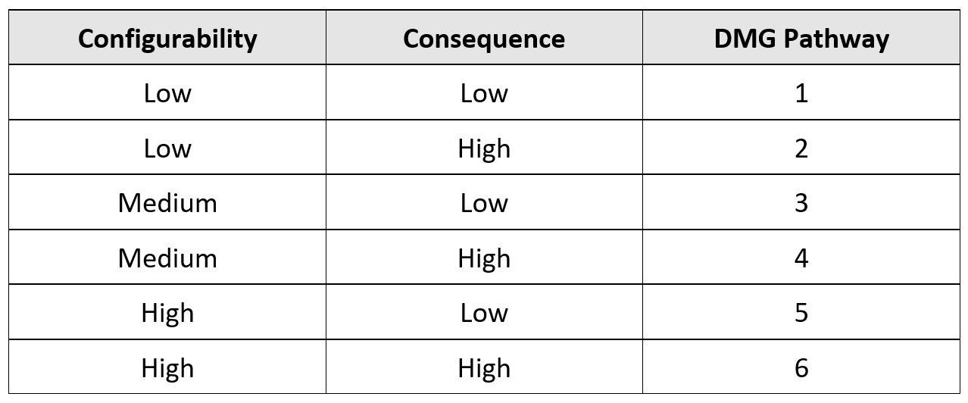
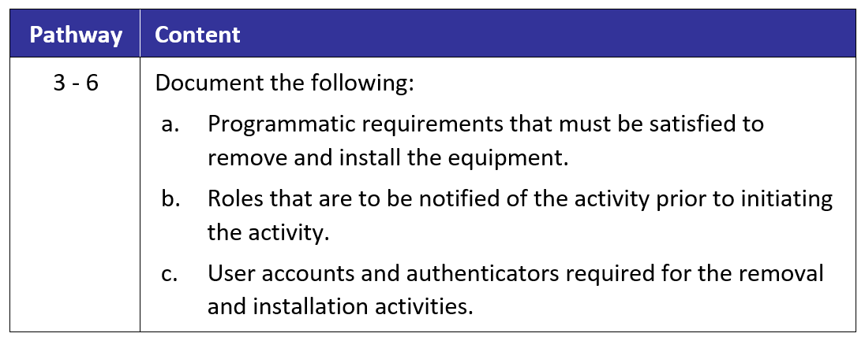
Graded Approach Philosophy
Like DEG Rev. 1, the DMG will adopt a graded approach:
Configurability of applied technology and consequences of error will be used to determine applicability of the task.
Should the same configurability metrics from the DEG apply?
Configurability of applied technology and consequences of error will also be used to determine how much of the activity is applicable and how it should be documented.

Slide 26
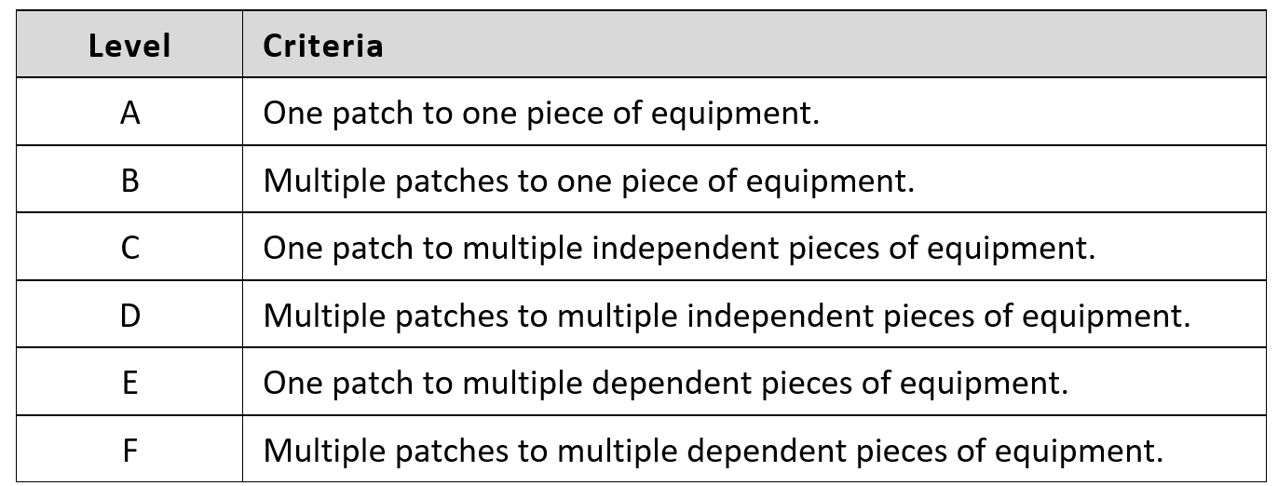
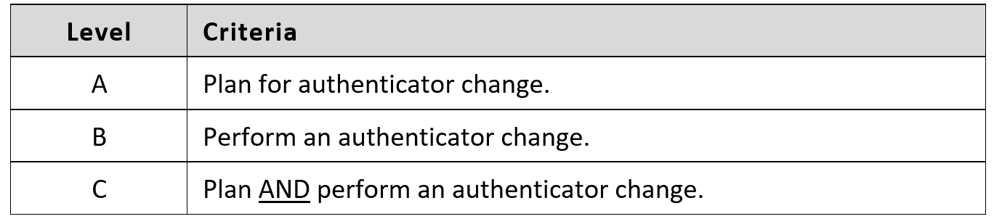
Graded Approach Philosophy (cont.)
Like DEG Rev. 1, the DMG will adopt a “Level of Interest” approach:
Level of Interest determination is specific to the maintenance activity.
The tables to the left illustrate the different Levels of Interest for patching and authenticators.
The level of interest specifically impacts activities performed.

Slide 27
Overview of DMG Content
1. Introduction and Screening
2. Digital Equipment Configuration Management
3. Maintenance Planning and Management Strategy
4. Planned Maintenance
5. Digital Equipment Patching
6. Authenticator Lifecycle
7. Digital Recovery
8. Time-Based Digital Equipment Management
9. Digital Equipment Troubleshooting
10. Digital Equipment Acquisition
11. Digital Equipment Replacement
12. Digital Equipment Tools
13. Training of Personnel
14. Definitions and Acronyms
15. References

