Slide 1
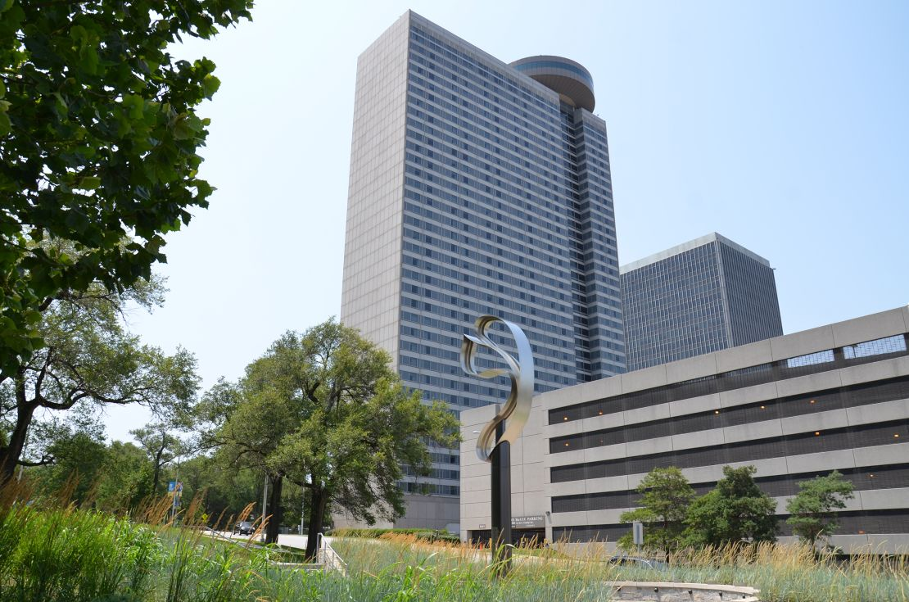
Hyatt Regency
Walkway Collapse
Kansas City, Missouri
July 17th, 1981

Slide 2
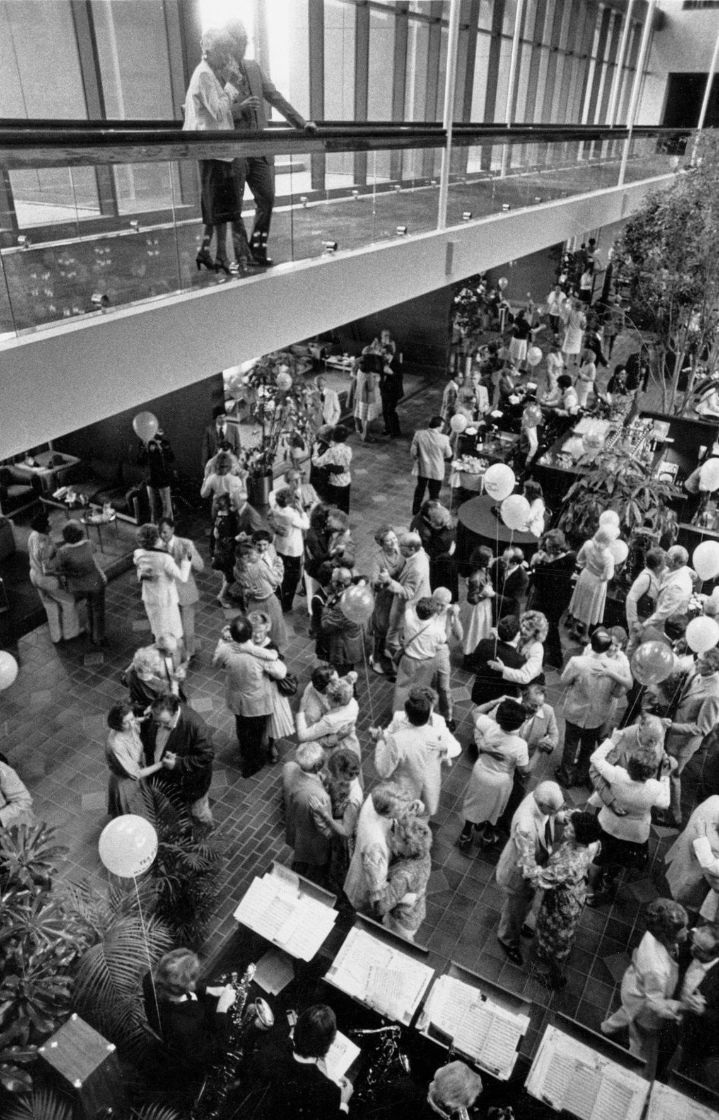
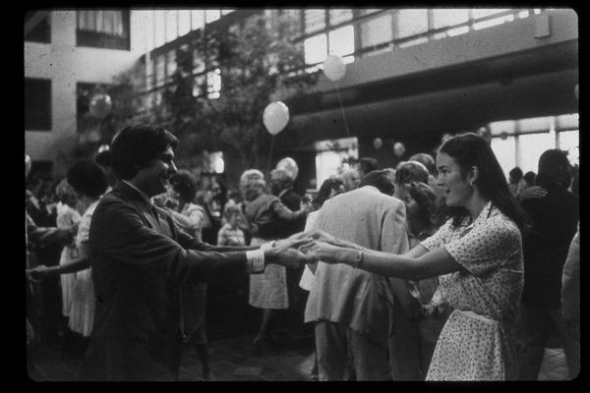
Hyatt Regency Walkway Collapse
Notes:
Brief Description of the Accident

Slide 3
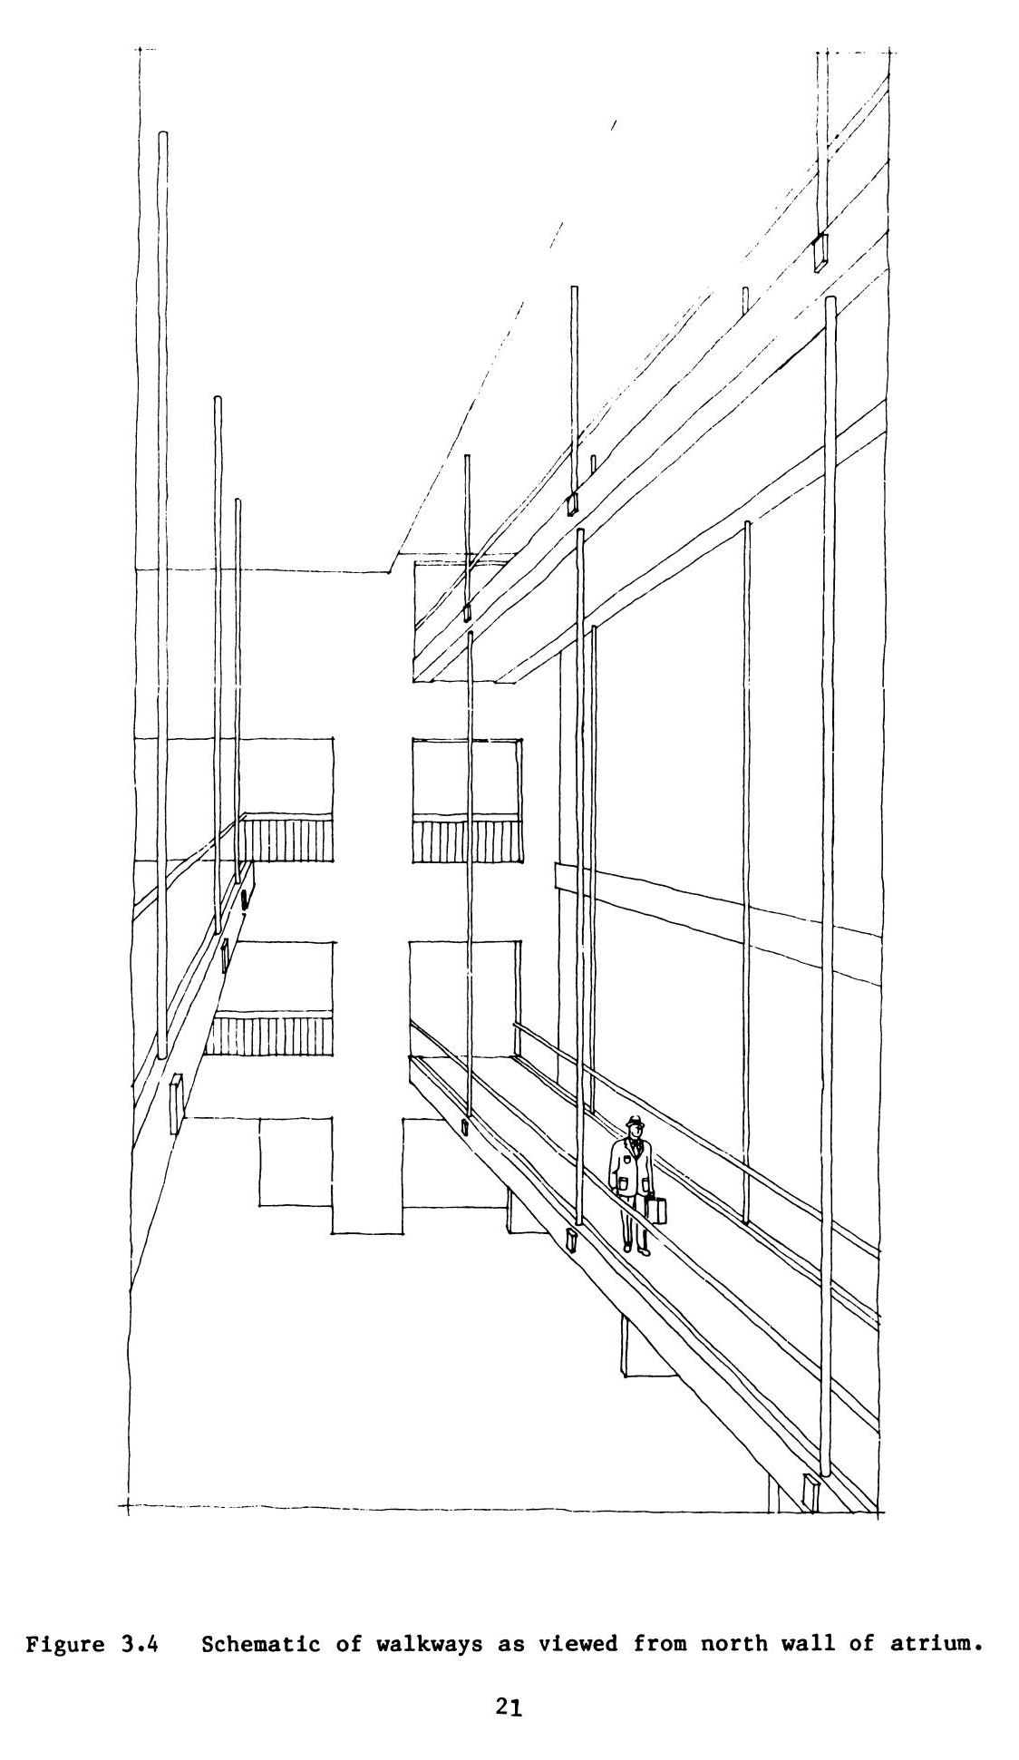
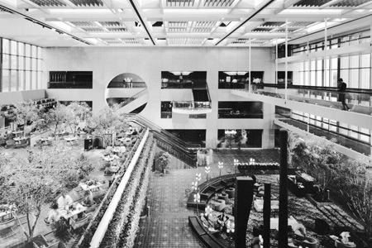
Hyatt Regency Walkway Collapse
Notes:
Brief Description of the Accident

Slide 4
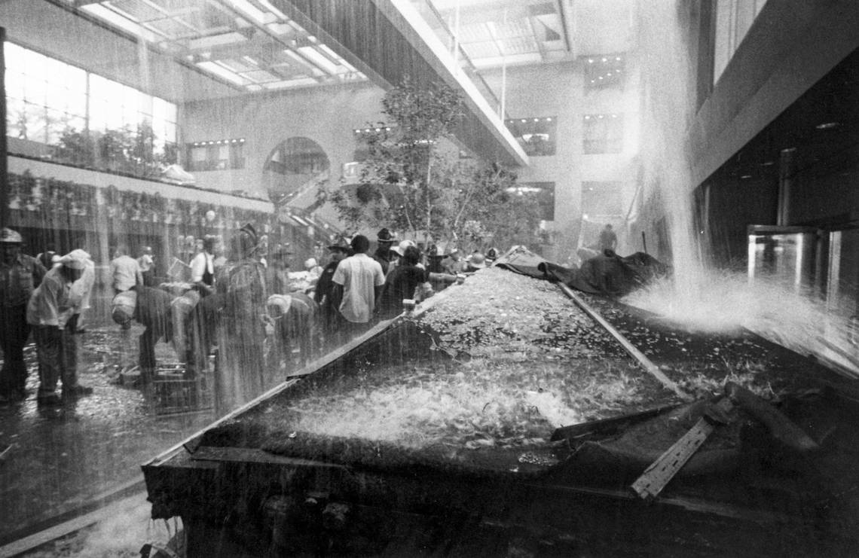
Hyatt Regency Walkway Collapse
Notes:
Brief Description of the Accident

Slide 5
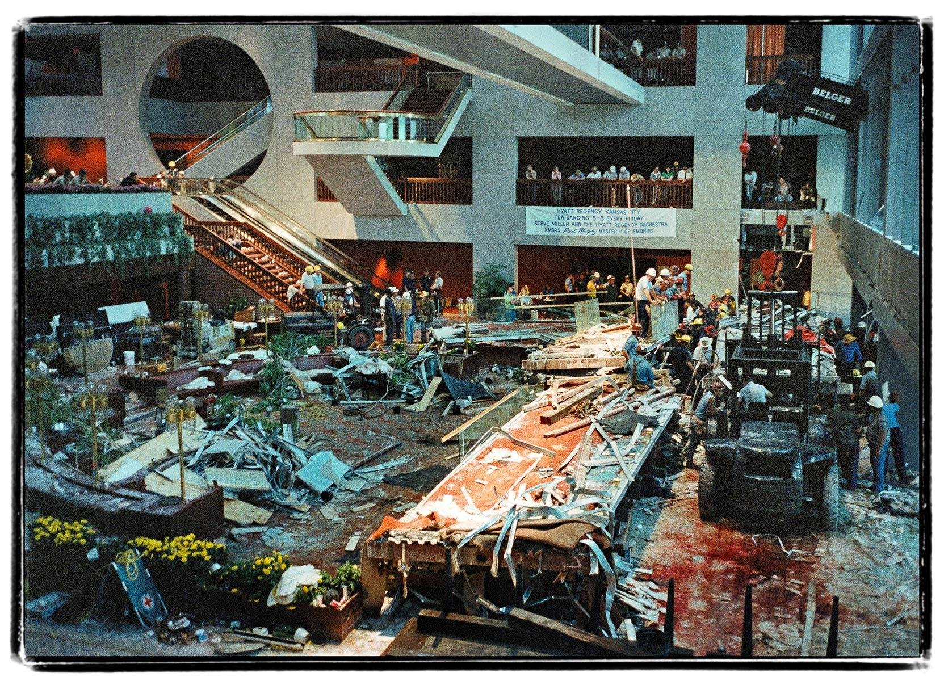
Hyatt Regency Walkway Collapse
Notes:
Brief Description of the Accident

Slide 6
Hyatt Regency Walkway Collapse
What happened?
  "[Any] first-year engineering student could figure it out."
  - Jack D. Gillum, Engineer of Record
How did it happen?

Slide 7
Hyatt Regency Walkway Collapse
Contributing Factors
Aspects of the Project
Long Term Effects

Slide 8
Contributing Factors
National Climate
  High Unemployment
  Inflation
  Double-Digit Interest Rates
  Alarming Rate of Structural Failures
Notes:
National Climate: The Kansas City Star July 15, 2001
“The Hyatt collapse occurred in an era of high unemployment, inflation and double-digit interest rates. All those factors added pressure on builders to win contracts and complete projects swiftly. Notable structures around the country were failing at an alarming rate. The roof of the Hartford Civic Center arena collapsed in 1978. The following year, Kemper Arena’s roof fell during an overnight rainstorm.”
During construction of the Hyatt Regency, the roof of the atrium partially collapsed, but, while the engineering of the roof was given further (limited) scrutiny before proceeding, the walkway designs were not also given extra scrutiny.
2. Corporate Aspirations
When building these hotels, a “huge emphasis” was placed on the impressiveness of the building’s interior, the most important area being the lobby, since that’s the first thing guests will see. The Hyatt Regency was the tallest building in Kansas City at the time and they wanted the building to have the “Jesus Christ Factor.”
“The Hyatt Corporation wanted you to walk into the hotel, look around the lobby, and say, ‘Jesus Christ, this is beautiful,’” he says. “So they were pushing the architects for big designs and to think outside the box, and they came up with these skywalks.” (Popular Mechanics)
3. Corporate “Scroogery”
In addition to the normal cutting of corners you would expect from a project like this, there a few notable examples of scroogery worth mentioning.
When the atrium roof collapsed in October 1979, Crown Center Redevelopment Corporation hired an independent firm to examine the engineering of the roof connection that failed, but did not broaden the scope to include the walkways that were attached to the atrium roof.
Gillum-Colaco, the principal engineer overseeing the design of the hotel, offered, on three separate occasions, to provide on-site project representation to check all fabrication during construction, citing the added expense.
The third bit of scroogery is broad enough to be its own category:
4. Rushed Schedule
I probably don’t need to dwell on the downsides and potential pitfalls of designing the building and constructing the building at the same time. One source claimed that the Crown Center Redevelopment Corporation had calculated a cost of $500,000 of lost income for every month that the hotel was closed.
5. Poor Communication

Slide 9
Contributing Factors
National Climate
Corporate Aspirations
Notes:
National Climate: The Kansas City Star July 15, 2001
“The Hyatt collapse occurred in an era of high unemployment, inflation and double-digit interest rates. All those factors added pressure on builders to win contracts and complete projects swiftly. Notable structures around the country were failing at an alarming rate. The roof of the Hartford Civic Center arena collapsed in 1978. The following year, Kemper Arena’s roof fell during an overnight rainstorm.”
During construction of the Hyatt Regency, the roof of the atrium partially collapsed, but, while the engineering of the roof was given further (limited) scrutiny before proceeding, the walkway designs were not also given extra scrutiny.
2. Corporate Aspirations
When building these hotels, a “huge emphasis” was placed on the impressiveness of the building’s interior, the most important area being the lobby, since that’s the first thing guests will see. The Hyatt Regency was the tallest building in Kansas City at the time and they wanted the building to have the “Jesus Christ Factor.”
“The Hyatt Corporation wanted you to walk into the hotel, look around the lobby, and say, ‘Jesus Christ, this is beautiful,’” he says. “So they were pushing the architects for big designs and to think outside the box, and they came up with these skywalks.” (Popular Mechanics)
3. Corporate “Scroogery”
In addition to the normal cutting of corners you would expect from a project like this, there a few notable examples of scroogery worth mentioning.
When the atrium roof collapsed in October 1979, Crown Center Redevelopment Corporation hired an independent firm to examine the engineering of the roof connection that failed, but did not broaden the scope to include the walkways that were attached to the atrium roof.
Gillum-Colaco, the principal engineer overseeing the design of the hotel, offered, on three separate occasions, to provide on-site project representation to check all fabrication during construction, citing the added expense.
The third bit of scroogery is broad enough to be its own category:
4. Rushed Schedule
I probably don’t need to dwell on the downsides and potential pitfalls of designing the building and constructing the building at the same time. One source claimed that the Crown Center Redevelopment Corporation had calculated a cost of $500,000 of lost income for every month that the hotel was closed.
5. Poor Communication

Slide 10
Contributing Factors
National Climate
Corporate Aspirations
Corporate “Scroogery”
Notes:
National Climate: The Kansas City Star July 15, 2001
“The Hyatt collapse occurred in an era of high unemployment, inflation and double-digit interest rates. All those factors added pressure on builders to win contracts and complete projects swiftly. Notable structures around the country were failing at an alarming rate. The roof of the Hartford Civic Center arena collapsed in 1978. The following year, Kemper Arena’s roof fell during an overnight rainstorm.”
During construction of the Hyatt Regency, the roof of the atrium partially collapsed, but, while the engineering of the roof was given further (limited) scrutiny before proceeding, the walkway designs were not also given extra scrutiny.
2. Corporate Aspirations
When building these hotels, a “huge emphasis” was placed on the impressiveness of the building’s interior, the most important area being the lobby, since that’s the first thing guests will see. The Hyatt Regency was the tallest building in Kansas City at the time and they wanted the building to have the “Jesus Christ Factor.”
“The Hyatt Corporation wanted you to walk into the hotel, look around the lobby, and say, ‘Jesus Christ, this is beautiful,’” he says. “So they were pushing the architects for big designs and to think outside the box, and they came up with these skywalks.” (Popular Mechanics)
3. Corporate “Scroogery”
In addition to the normal cutting of corners you would expect from a project like this, there a few notable examples of scroogery worth mentioning.
When the atrium roof collapsed in October 1979, Crown Center Redevelopment Corporation hired an independent firm to examine the engineering of the roof connection that failed, but did not broaden the scope to include the walkways that were attached to the atrium roof.
Gillum-Colaco, the principal engineer overseeing the design of the hotel, offered, on three separate occasions, to provide on-site project representation to check all fabrication during construction, citing the added expense.
The third bit of scroogery is broad enough to be its own category:
4. Rushed Schedule
I probably don’t need to dwell on the downsides and potential pitfalls of designing the building and constructing the building at the same time. One source claimed that the Crown Center Redevelopment Corporation had calculated a cost of $500,000 of lost income for every month that the hotel was closed.
5. Poor Communication

Slide 11
Contributing Factors
National Climate
Corporate Aspirations
Corporate “Scroogery”
Rushed Schedule
Notes:
National Climate: The Kansas City Star July 15, 2001
“The Hyatt collapse occurred in an era of high unemployment, inflation and double-digit interest rates. All those factors added pressure on builders to win contracts and complete projects swiftly. Notable structures around the country were failing at an alarming rate. The roof of the Hartford Civic Center arena collapsed in 1978. The following year, Kemper Arena’s roof fell during an overnight rainstorm.”
During construction of the Hyatt Regency, the roof of the atrium partially collapsed, but, while the engineering of the roof was given further (limited) scrutiny before proceeding, the walkway designs were not also given extra scrutiny.
2. Corporate Aspirations
When building these hotels, a “huge emphasis” was placed on the impressiveness of the building’s interior, the most important area being the lobby, since that’s the first thing guests will see. The Hyatt Regency was the tallest building in Kansas City at the time and they wanted the building to have the “Jesus Christ Factor.”
“The Hyatt Corporation wanted you to walk into the hotel, look around the lobby, and say, ‘Jesus Christ, this is beautiful,’” he says. “So they were pushing the architects for big designs and to think outside the box, and they came up with these skywalks.” (Popular Mechanics)
3. Corporate “Scroogery”
In addition to the normal cutting of corners you would expect from a project like this, there a few notable examples of scroogery worth mentioning.
When the atrium roof collapsed in October 1979, Crown Center Redevelopment Corporation hired an independent firm to examine the engineering of the roof connection that failed, but did not broaden the scope to include the walkways that were attached to the atrium roof.
Gillum-Colaco, the principal engineer overseeing the design of the hotel, offered, on three separate occasions, to provide on-site project representation to check all fabrication during construction, citing the added expense.
The third bit of scroogery is broad enough to be its own category:
4. Rushed Schedule
I probably don’t need to dwell on the downsides and potential pitfalls of designing the building and constructing the building at the same time. One source claimed that the Crown Center Redevelopment Corporation had calculated a cost of $500,000 of lost income for every month that the hotel was closed.
5. Poor Communication

Slide 12
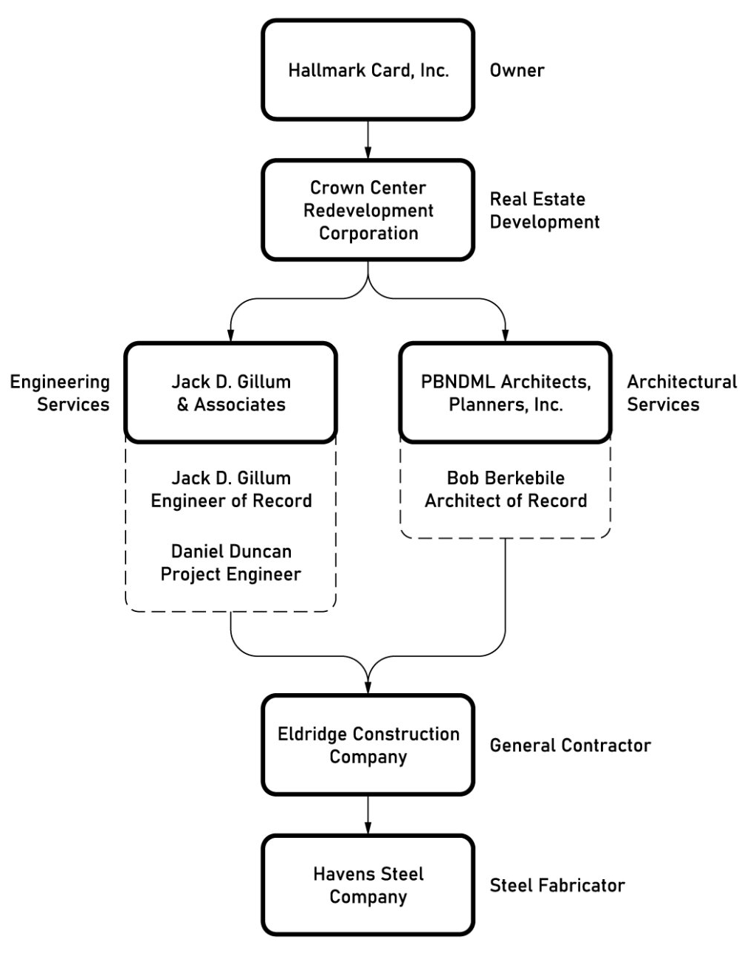
Contributing Factors
National Climate
Corporate Aspirations
Corporate “Scroogery”
Rushed Schedule
Critical Failures in Communication
Notes:
National Climate: The Kansas City Star July 15, 2001
“The Hyatt collapse occurred in an era of high unemployment, inflation and double-digit interest rates. All those factors added pressure on builders to win contracts and complete projects swiftly. Notable structures around the country were failing at an alarming rate. The roof of the Hartford Civic Center arena collapsed in 1978. The following year, Kemper Arena’s roof fell during an overnight rainstorm.”
During construction of the Hyatt Regency, the roof of the atrium partially collapsed, but, while the engineering of the roof was given further (limited) scrutiny before proceeding, the walkway designs were not also given extra scrutiny.
2. Corporate Aspirations
When building these hotels, a “huge emphasis” was placed on the impressiveness of the building’s interior, the most important area being the lobby, since that’s the first thing guests will see. The Hyatt Regency was the tallest building in Kansas City at the time and they wanted the building to have the “Jesus Christ Factor.”
“The Hyatt Corporation wanted you to walk into the hotel, look around the lobby, and say, ‘Jesus Christ, this is beautiful,’” he says. “So they were pushing the architects for big designs and to think outside the box, and they came up with these skywalks.” (Popular Mechanics)
3. Corporate “Scroogery”
In addition to the normal cutting of corners you would expect from a project like this, there a few notable examples of scroogery worth mentioning.
When the atrium roof collapsed in October 1979, Crown Center Redevelopment Corporation hired an independent firm to examine the engineering of the roof connection that failed, but did not broaden the scope to include the walkways that were attached to the atrium roof.
Gillum-Colaco, the principal engineer overseeing the design of the hotel, offered, on three separate occasions, to provide on-site project representation to check all fabrication during construction, citing the added expense.
The third bit of scroogery is broad enough to be its own category:
4. Rushed Schedule
I probably don’t need to dwell on the downsides and potential pitfalls of designing the building and constructing the building at the same time. One source claimed that the Crown Center Redevelopment Corporation had calculated a cost of $500,000 of lost income for every month that the hotel was closed.
5. Poor Communication

Slide 13
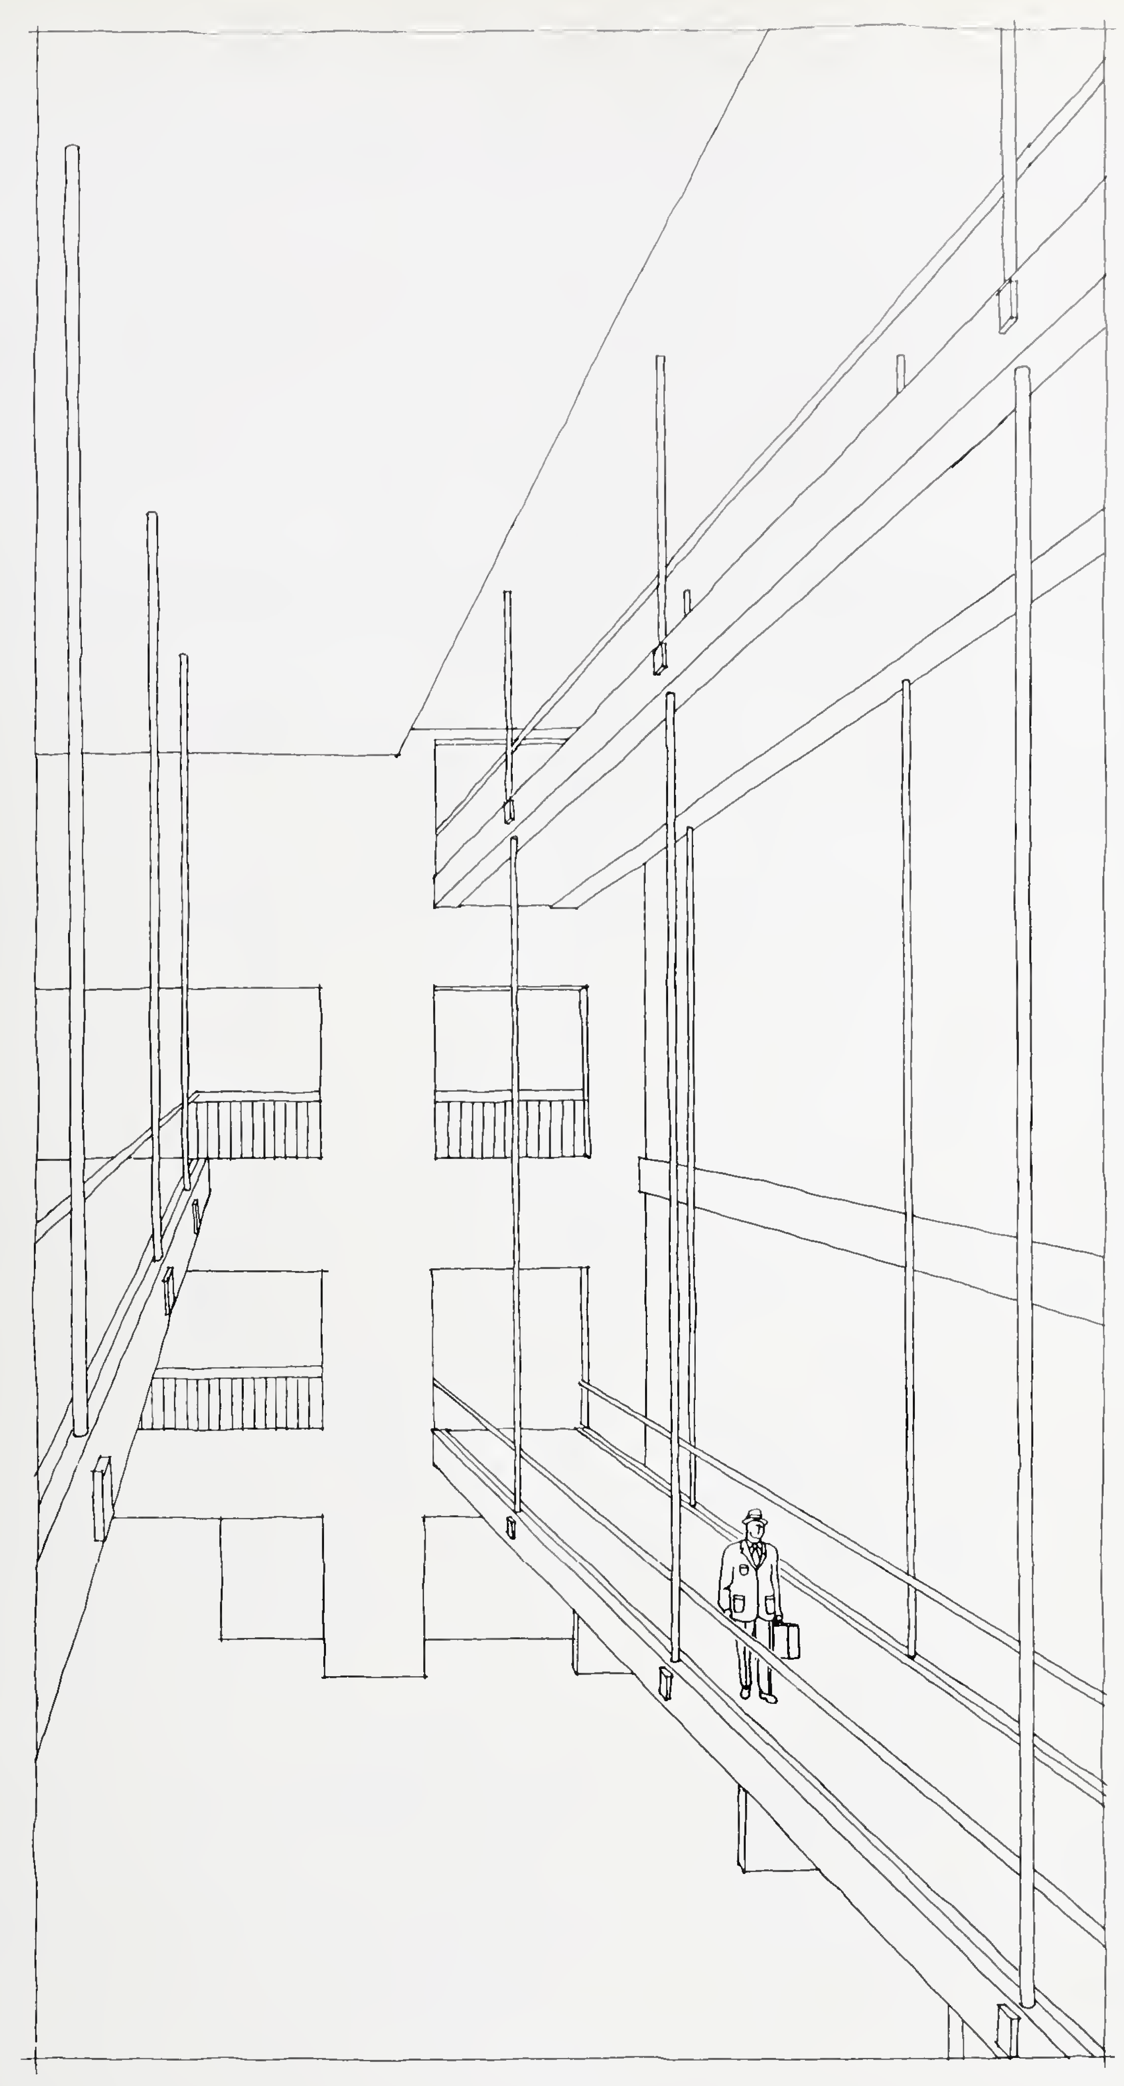
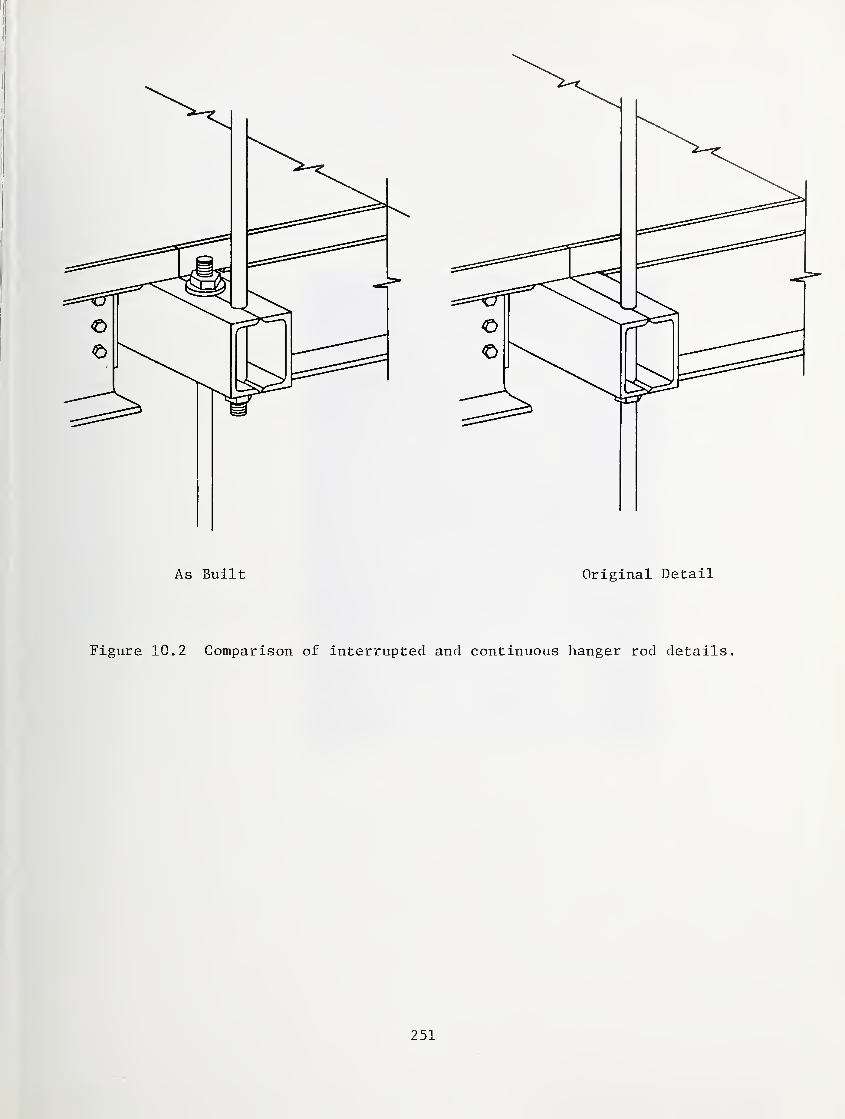
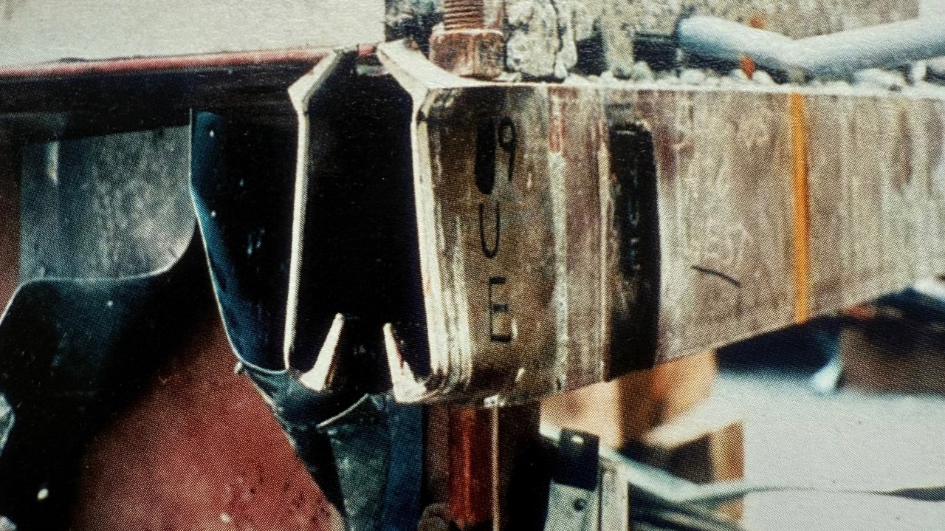
Critical Failures in Communication

Slide 14
Loss of Configuration Control

Slide 15
What Changed?

Slide 16
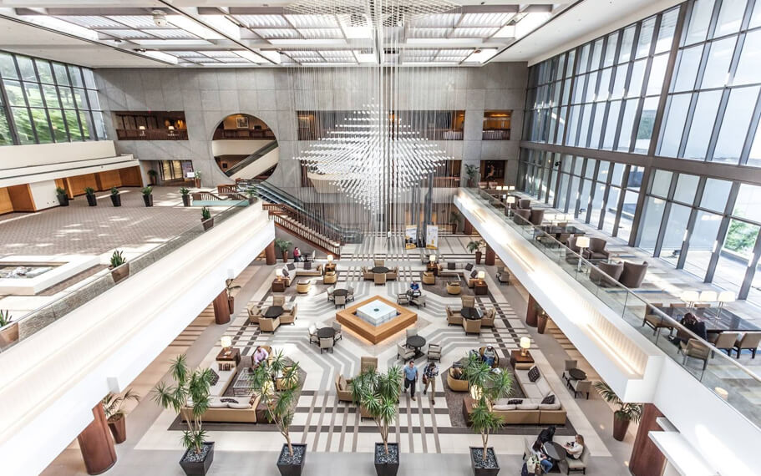
Questions?

