Slide 1
INPO Update
Zack Wei
Senior Evaluator, Engineering & Equipment Reliability
Institute of Nuclear Power Operations

Slide 2
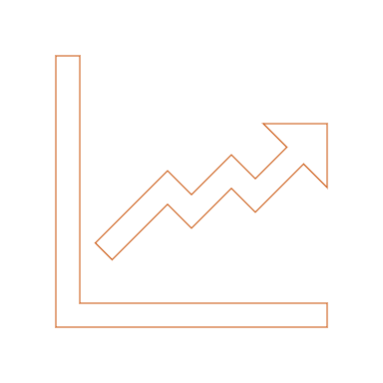
Advance Performance and Sustainability

Slide 3
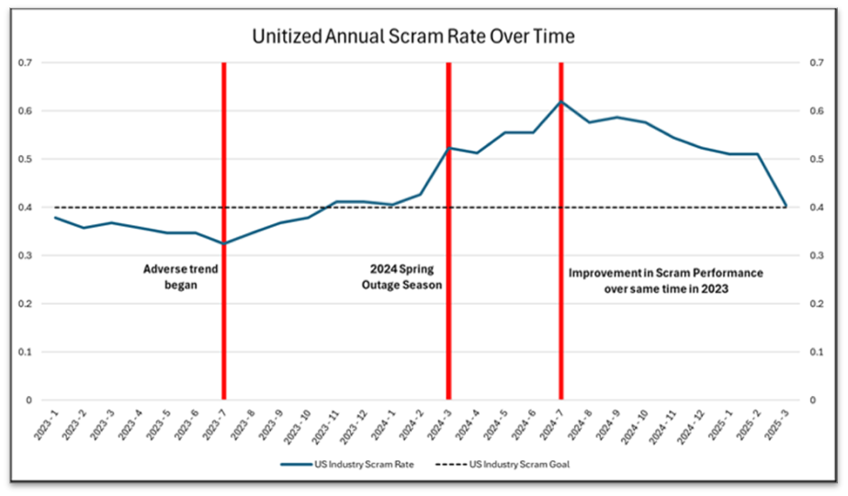
Monitoring Plant Performance

Slide 4
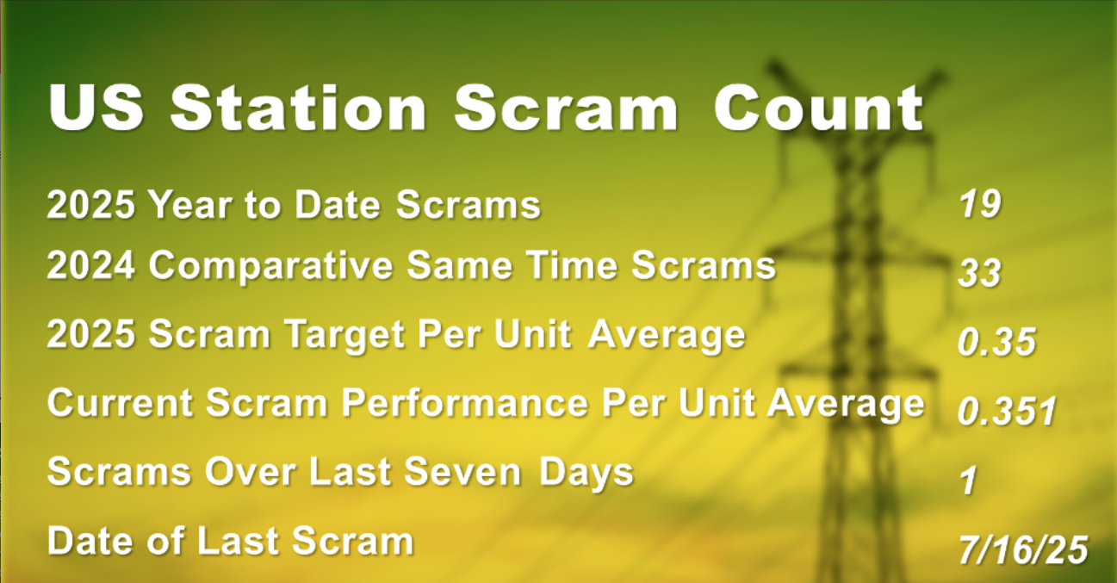

Slide 5
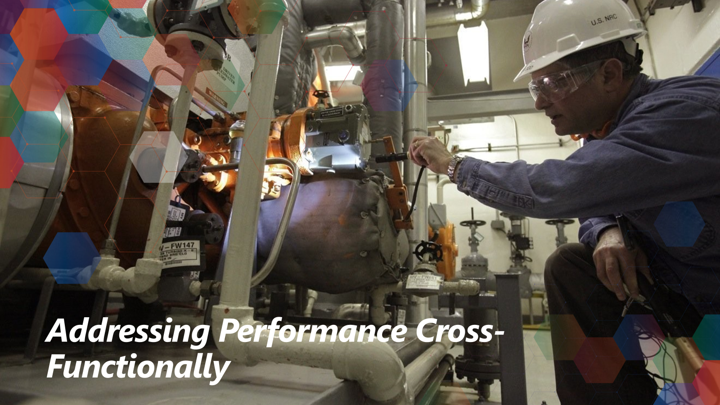

Slide 6
2024 Domestic Performance – Cross-Functional
24 of 49 scrams were associated with an outage related activity. Many occurred during unit shutdown or start-up from an outage (Conditional Single Point Vulnerabilities)
Proficiency – A cause contributor in approximately 25% of all consequential events – both Team and Individual
Risk – IER L2 21-4 Improving Plant Reliability Recommendations 4 and 5 were the most frequently identified gaps identified – all aspects
Use of operating experience – Causal contributors identified in 45% of the EN Consequential Events

Slide 7
Engineering Causes & Contributors
Engineers did not validate all assumptions associated with the design.
Engineers and other stakeholders did not fully understand the operational impacts of the modification.
The engineering organization did not adequately mitigate risks associated with reliance on vendor technical expertise.
Engineers did not ensure post-modification testing was adequate to detect deficiencies within the design.
0
1
2
3
4
5

Slide 8
Equipment Reliability Causes and Contributors
Scram risk is not recognized and mitigated when moving online work pre-outage or when deferring work to after the outage.
During off-normal conditions, reduced redundancy in shutdown, or return to full power, conditional single point vulnerabilities (C-SPVs) were created without adequate mitigation.
In some cases, work to correct a degraded condition or eliminate an SPV was descoped from an outage, or there were missed opportunities to include the work in forced outages and downpowers that occurred for other conditions.

Slide 9
Plant Reliability Events -Results of Analysis
Revised Gap Statement:
Weaknesses exist in the ability of nuclear professionals to identify and resolve issues that impact or have the potential to impact plant reliability. This has resulted in cyclic performance of scrams, equipment reliability, and engineering consequential events.
(IER 21-4, Improving Plant Reliability, INPO 21-003, Achieving and Sustaining High Plant Reliability)

Slide 10



INPO Interactions
PEER REVIEWS
CONTINUUM
INDUSTRY TOUCHPOINTS

Slide 11
What is the OE telling us?

Slide 12
Inadequate Design Change Implementation
Failures in implementing or validating design changes led to misalignment between intended and actual configurations. Examples:
EDG room temperature controller failure due to inadequate UFSAR alignment (IRIS 584663).
Turbine trip caused by a configuration setting error from a 2007 vendor design (IRIS 587002).
Turbine supervisory system tripped due to unreviewed vendor trip parameters (IRIS 607384).

Slide 13
Legacy Configuration Vulnerabilities
Long-standing undocumented or misunderstood configurations caused latent failures Examples:
Legacy gas valve pressed on Schrader valve, causing a leak (IRIS 582190).
Diesel generator failure due to foreign material from a 2008 design change (IRIS 591687).
Wiring error from 2023 modification left a safety pump inoperable (IRIS 592054).

Slide 14
Human Performance and Procedural Weaknesses
Errors in execution or verification of configuration changes due to unclear procedures or training gaps. Examples:
HPCI pressure switch miscalibrated due to over-torquing (IRIS 586592).
Valve mispositioned due to incorrect assumptions (IRIS 589897).
Missing wire in relay circuit undetected due to poor documentation (IRIS 609892).

Slide 15
Inadequate Testing and Validation Post-Modification
Modifications were not adequately tested under real-world conditions, leading to failures. Examples:
Check valve failed due to thermal expansion not tested at operating temperature (IRIS 603025).
Feedwater control logic failed due to transmitter response time issues (IRIS 587468).
CM Equilibrium Upset: Design Requirements not validated against Physical Configuration during testing.

Slide 16
Equipment Aging and Configuration Drift
Over time, equipment degraded or drifted from its documented configuration, reducing reliability. Examples:
Damper misalignment from a 2022 motor replacement traced to legacy documentation gaps (IRIS 580807).
Oil filter clogged due to detergent oil releasing aged deposits (IRIS 593667).
Fan failure due to aged blades not replaced as planned (IRIS 610524).
Notes:
equilibrium as equipment ages and conditions change.

Slide 17
Takeaways from 12-Month OE Review
CM Equilibrium Upsets
Design
Requirements
Discrepancy between Design Requirements and Physical Configuration due to poor change control.
Facility Configuration Information did not reflect actual Physical Configuration.
Breakdown in Work Management and Document Control processes.
Design Requirements not validated against Physical Configuration during testing.
Physical Configuration diverged from Facility Configuration Information due to aging and lack of updates.
Physical
Config
Facility
Config
Info

Slide 18
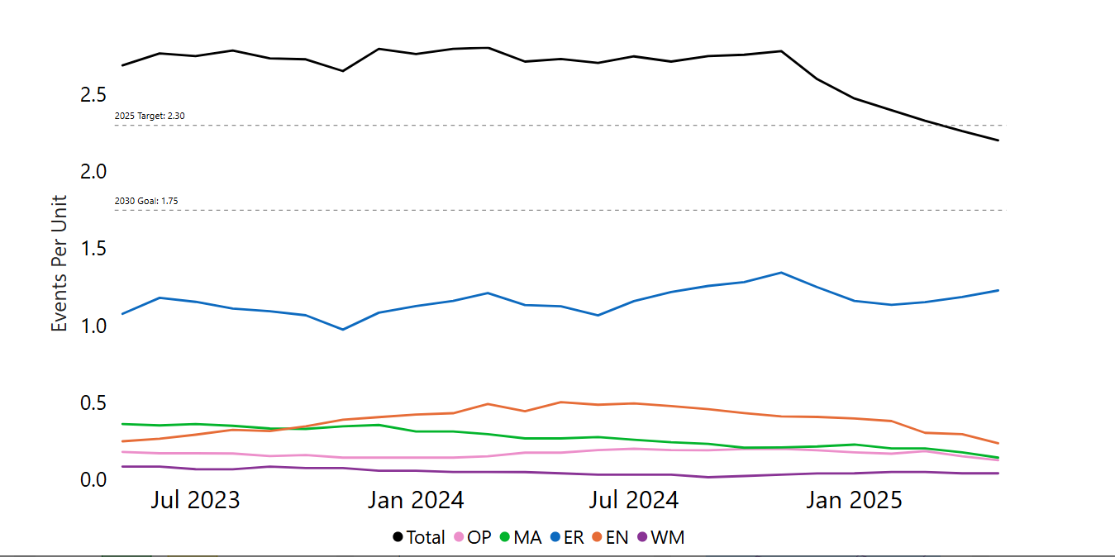
Consequential Events Over Time

Slide 19
Engineering and Equipment Consequential Event Themes
Top Engineering Behavioral Contributors
Associated Engineering Process/Programs:
Design change
Engineering Fundamentals – Evaluate
Technical conscience – Challenge Plant Conditions
Risk Management – Decision Making
PM Strategy Development
Evaluation/Calculation/Analysis
Top Equipment Reliability Contributors
Feedwater Component and Interconnecting System failures
Generator Zone – Support and Protection Component degradation
Managing Equipment Vulnerabilities – unknown and unmitigated SPVs

Slide 20
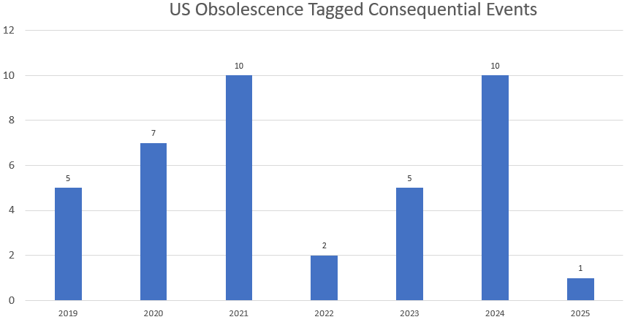
Parts Obsolescence

Slide 21
2025 Parts Initiative
Best practices identified, such as improved catalogue health, use of 50.69 and identifying parts early
Benchmarking several stations to collect best practices
Presenting to IER 21-4 Industry Call
Adding best practices to AP-928

Slide 22
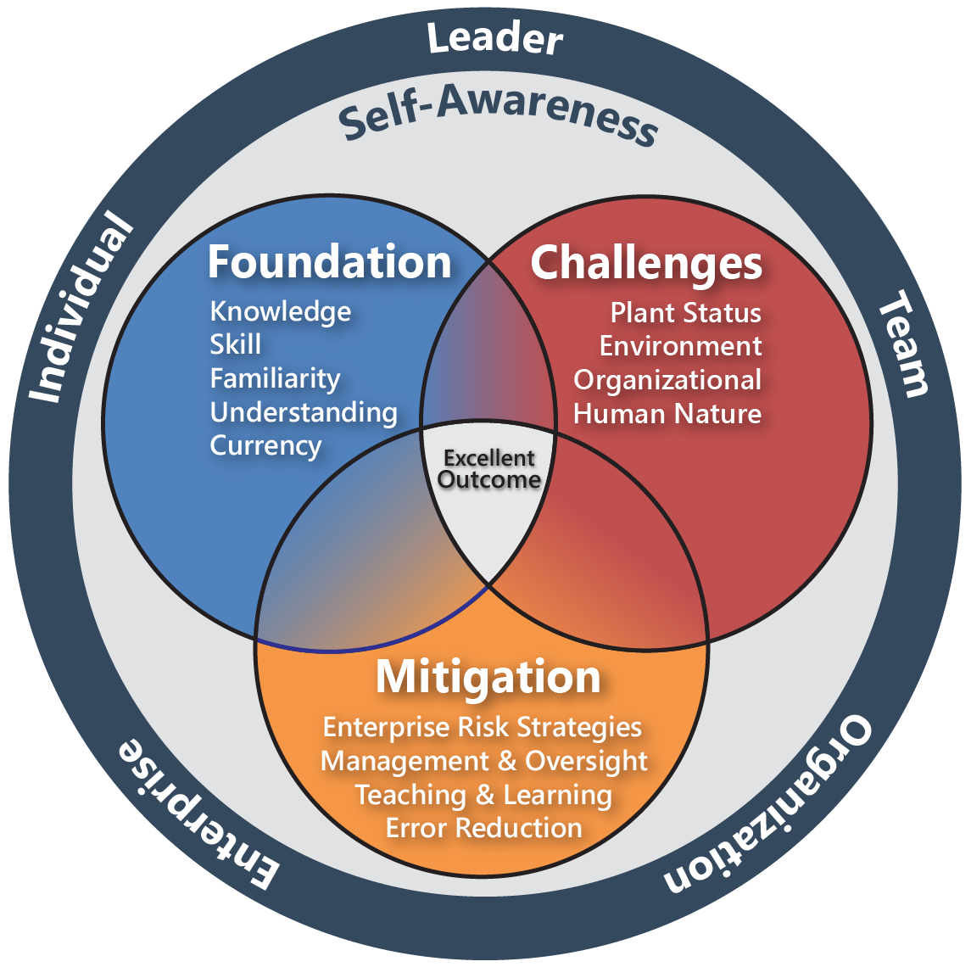
Proficiency
Advancing Human and Organizational Performance

Slide 23

Why Proficiency?
Contributes to one-third of consequential events
Workforce is turning over and likely to expand
Not well understood or used

Slide 24

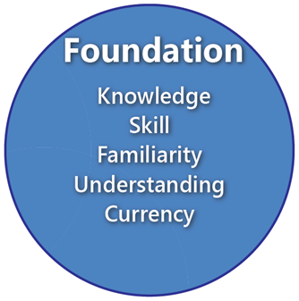
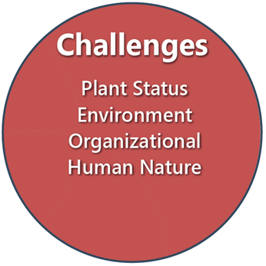
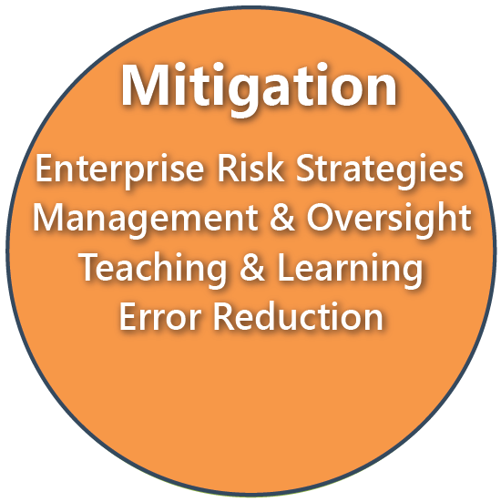
Explore the Elements
  Each element of the model describes behaviors of:
  Senior Leaders
  Managers & Supervisors
  Nuclear Professionals
Human Risk Elimination!

Slide 25
Upcoming Activities
Publications
Meetings
INPO Tier 2 Guidance - Conduct of Engineering
Rapid OE – Feedwater System Reliability
IER L3 – Automatic Scram Caused by Excavation Activities
IER L3-Grid Transient Events
IER L4- Initial Licensed Operator Class Throughput lessons Learned
INPO 22-001 Parts Quality and Availability to Support Plant Reliability
Materials Programs Managers Workshop
August 13-14th
Fall Engineering VP Meeting
October 15-16th

Slide 26

Questions

