Slide 1
License Renewal Information on Drawings
CMBG 2025

Slide 2
Requirements
10 CFR 54.21 requires for each license renewal application an integrated plant assessment listing structures and components subject to an aging management review.
  Known an “Scoping and Screening”
Sites are required to maintain information sources for the scoping and screening process. These are identified in the LRA.
  For example, Wolf Creek’s sources are:
    Current licensing basis documents
    Maintenance rule data base
    Engineering drawings
    Technical position papers
    Master equipment list and Q-List
Each LRA is different, but most are similar
2
7/28/2025

Slide 3
Which Drawings?
Wolf Creek currently has 123 License Renewal Application drawings
  120 are P&ID drawings
  2 are electrical
  1 is structural
Originally developed in 2006, during the LRA process
  Have not been updated since
These are currently maintained separately from other drawings under a different name
  e.g. M-12KC03 vs. LR-WCGS-KC-M-12KC03
As drawings were updated, the LR version was not
3
7/28/2025

Slide 4
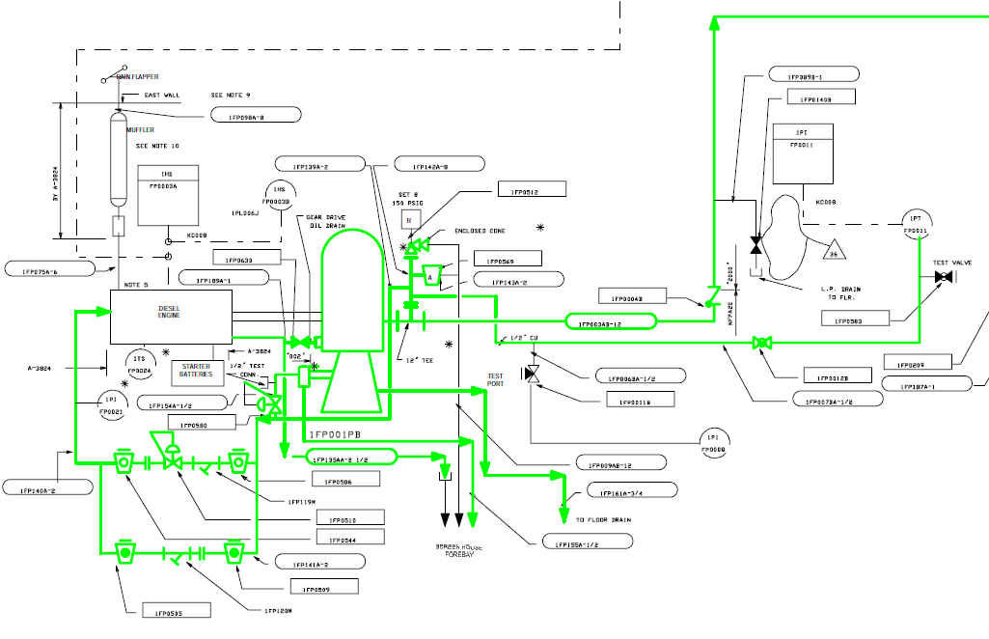

Slide 5
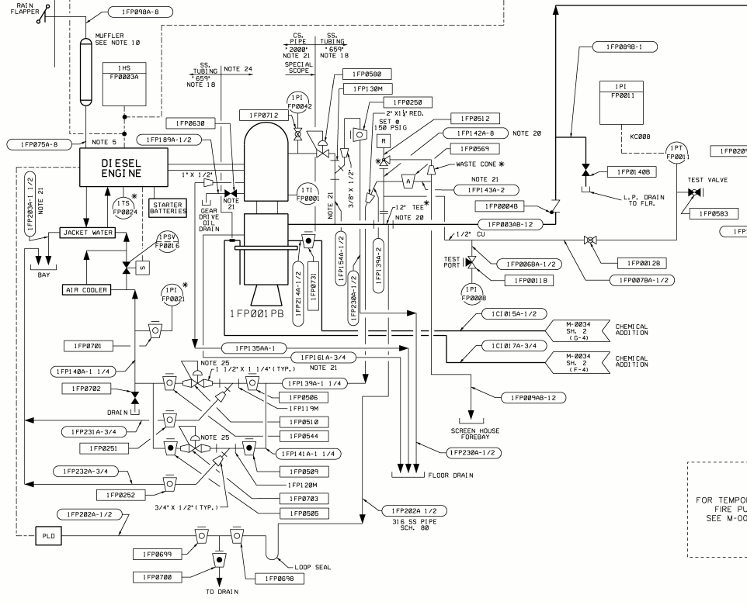

Slide 6
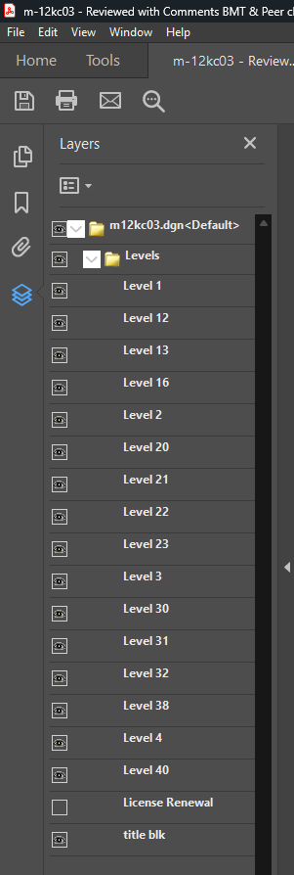
Drawing Development
Most sites treat LR boundary drawings similarly to Wolf Creek
  Owned by the LR team and not updated
During benchmarking, an industry peer identified that the St. Lucie plant embedded license renewal information directly into their essential drawings
Drafting team determined that a new layer could be added to existing drawings for use in outlining the LR boundary
  Allows LR information to be turned on and off as needed
This allows LR information to be more accessible
6
7/28/2025

Slide 7
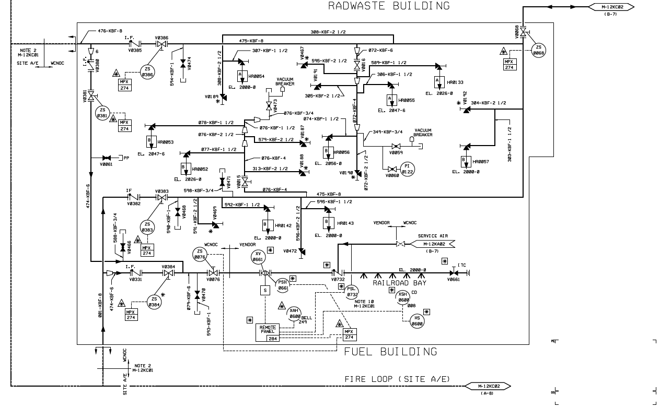
M-12KC03

Slide 8
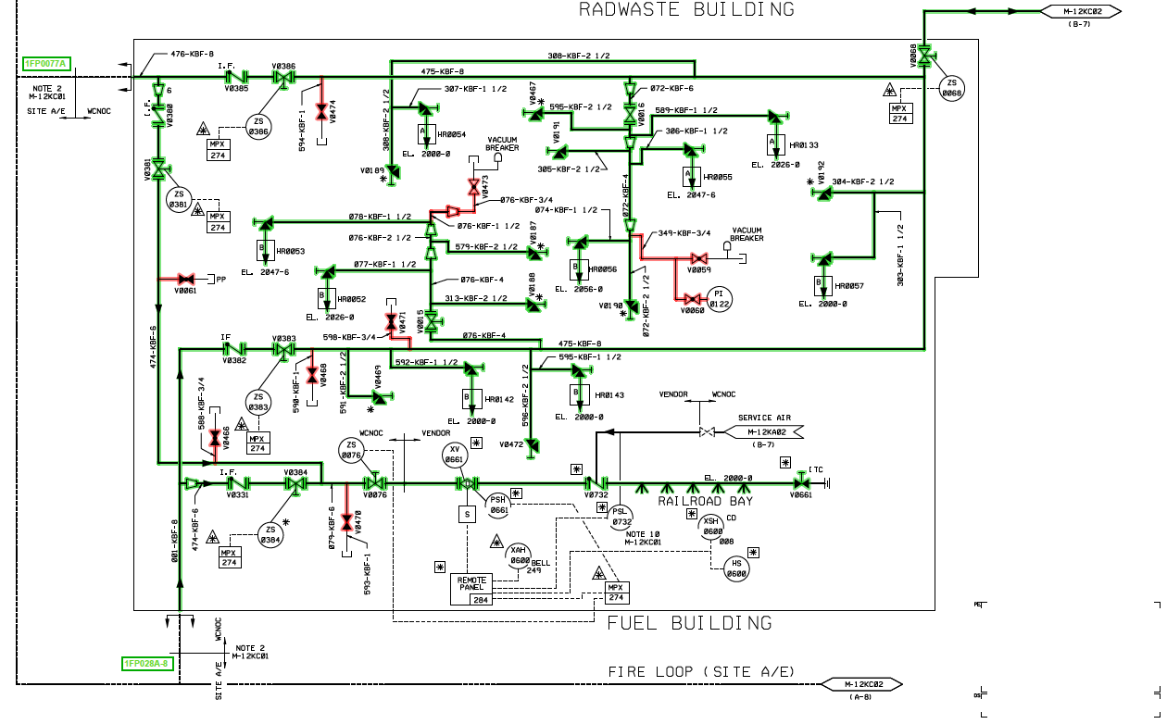
M-12KC03

Slide 9
Drawing Colors
LR boundary drawings are required by the NRC to be in color
  Identifies different classes of SSCs within LR:
    10 CFR 54.4(a)(1) and (3): Safety Related components and components regulated under FP, EQ, ATWS, PTS, and SBO
    10 CFR 54.4(a)(2): Non-safety Potentially Affecting Safety
Previous essential drawings were only in black and white when exported to PDF
This required the development of a new pen table to ensure NRC compliance
Colors are necessary, but not standardized

Slide 10
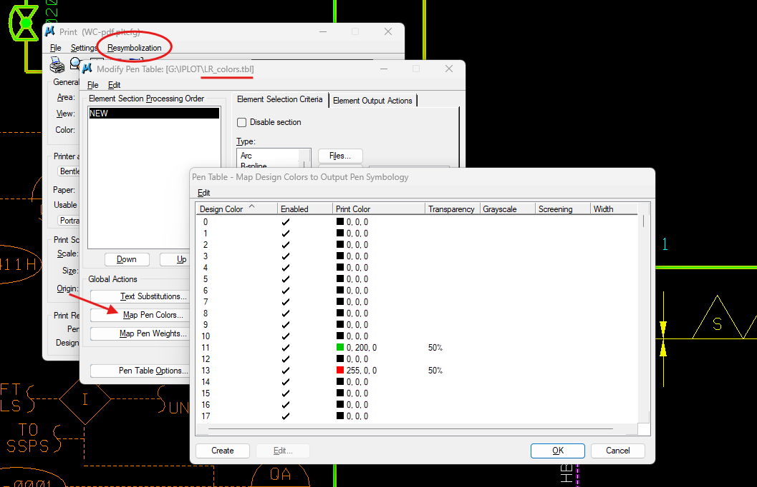

Slide 11
Major Benefits
Ensures important information is kept up-to-date and readily accessible.
Allows for more information to be included without cluttering the drawing
  Makes the drawing easier to understand for those unfamiliar
Allows for hiding other important, but often extraneous information
  Seismic flagging, quality flagging, etc.
Relatively simple and inexpensive to implement
  Compatible with MicroStation, AutoCAD, and other CAD software
  Did require LR team to update all LR boundary drawings prior to implementation
11
7/28/2025

Slide 12
Thank You
Questions?
12
7/28/2025

