Slide 1
Modernizing TVA’s Software Quality Assurance Program
Josh Perrel
Sequoyah Equipment Reliability Program Manager
(Former Fleet SQA Program Manager)
July 2025
Notes:
Disclaimers

Slide 2
Software Quality Assurance
What is it?
Quality controls and processes for the development, procurement, modification, and configuration management of computer software/firmware used to support the design, operation, modification, and maintenance of the nuclear power plant.
Why do we need it?
To ensure that software/firmware perform its intended function(s) correctly and that the output of the software/firmware is correct/can be used without further verification.
Software/firmware is more prevalent now than ever before – permeating virtually every aspect of business and plant operations.
Notes:
Ensuring that software will do what we say it will do. And documenting that so that we can prove it, if needed.

Slide 3
Software Quality Assurance Controls
Software Requirements Specification (SRS)
Requirements Traceability Matrix (RTM)
Software Design Description (SDD)
Software Verification and Validation Plan (SVVP)
Software Verification and Validation Report (SVVR)
Software Dedication Documentation
User Documentation
Human Factors Engineering Review
Notes:
A Requirements Traceability Matrix (RTM) is a document that maps and tracks the relationships between project requirements and other development artifacts like test cases, design elements, and even defects. It ensures that all requirements are addressed and verified throughout the software development lifecycle.

Slide 4
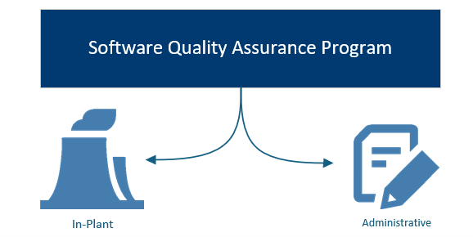
TVA’s Software Quality Assurance Program
Notes:
Required by Quality Assurance Plan [ANSI N45.2 (1971)]

Slide 5
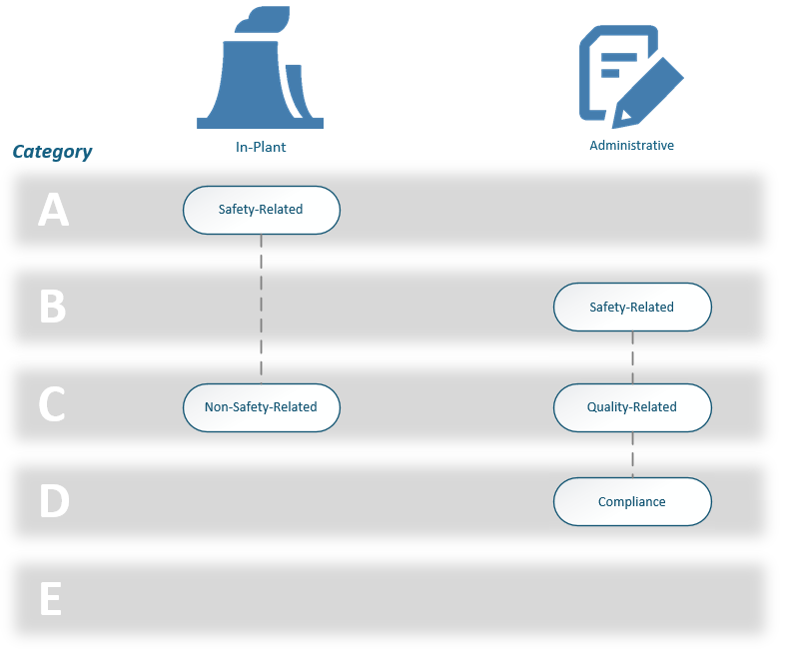
TVA’s Software Quality Assurance Program
Graded Approach
Risk / Consequence
Applied Controls
Notes:
I’m responsible for the program itself and the administrative portions. Alex Bowman is more knowledgeable regarding in-plant software.
Graded Approach - The selective assignment of the quality assurance elements that the software must
comply with based on its assigned quality classification. This is determined by the
evaluation of the functional process(es) the software supports.
NITSL – Nuclear Information Technology Strategic Leadership

Slide 6

TVA’s Software Quality Assurance Program
Engineering
Change Process
How do we control changes to software/firmware?
Software Service Request Process
Notes:
Software Service Request process – primarily used for plant process computer.
Safety-Related Admin: Design and analysis software – Gothic; VOTES; AFT Fathom; Proto-Flo
Some software designated as handled by SSR process. But also –
Examples of non-safety changes that would use SSR process:
generic DCS patch, if:
a) non-safety related
b) from the OEM
c) fully tested by OEM to be compatible with the plant’s version of system/device,
d) All software and changes are documented by OEM and understood by Engineering prior to implementing.
configuration changes within the limitations or bounds of design output documentation (within a range previously approved by engineering output). So changing controller PID settings or setpoints for a single loop controller maybe if the software configuration drawing or controlling procedure says (setpoint = 20-80%, setting X = 20-30, etc.)

Slide 7
TVA’s Software Quality Assurance Program
Master Equipment List
ServiceNow
/
Information Technology
How do we address configuration management?
Notes:
The fact that Non-Safety In-Plant software can use the SSR process has presented challenges. SSR process has to force use of MEL updates.

Slide 8
SQA Self-Assessment 2023
Problems Identified:
Accurate list of software/firmware no longer maintained in MEL or ServiceNow
  Loss of Configuration Control
  Non-Plant Operational Technology not scoped into either system
Notes:
MEL was official repository for in-plant, but updates had not been entered correctly or always pursued (requirement not enforced – separate forms)
Previous database abandoned for Excel spreadsheet which was not always updated, and which eliminated the record of items previously evaluated/screened

Slide 9
TVA’s Software Quality Assurance Program
Master Equipment List
Non-Plant Operational Technology
ServiceNow
/
Information Technology
How do we address configuration management?
Notes:
Ice Condenser – Frosty
Fuels and reactor engineering software for core design and core evaluations

Slide 10
SQA Self-Assessment 2023
Problems Identified:
Accurate list of software/firmware no longer maintained in MEL or ServiceNow
  Loss of Configuration Control
  Operational Technology not scoped into either system
Individuals unaware of controls and could easily circumvent process
Difficult to find previous documentation associated with software and software changes
Notes:
MEL was official repository for in-plant, but updates had not been entered correctly or always pursued (requirement not enforced – separate forms)
Previous database abandoned for Excel spreadsheet which was not always updated, and which eliminated the record of items previously evaluated/screened

Slide 11
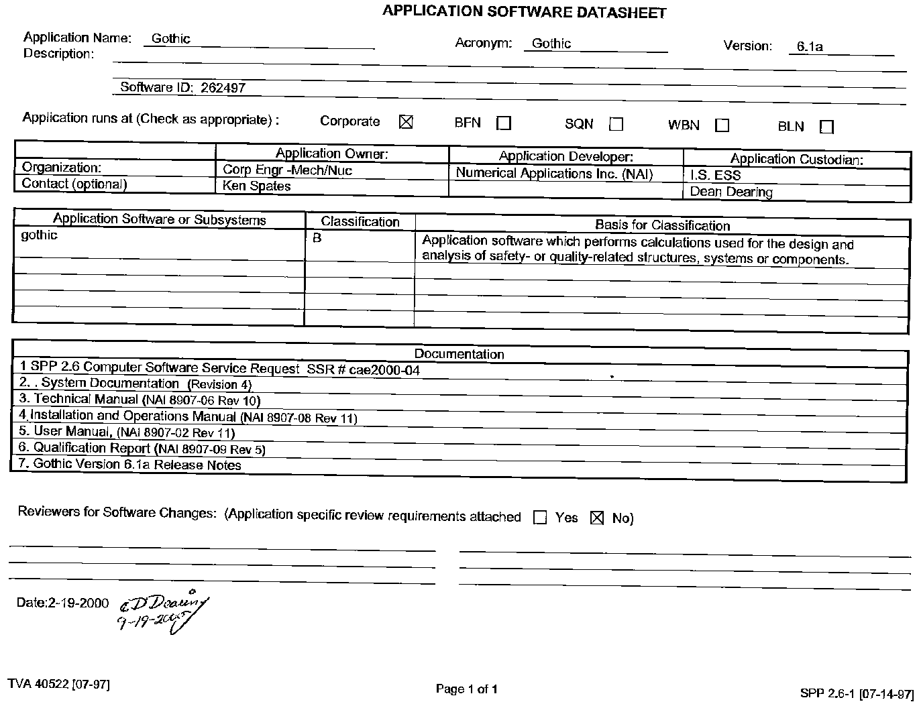
SQA Documentation
Elimination of previous database
Failure to maintain a unique identifier
Reliance on paper documentation which was not consistently filed (standard nomenclature)
Inability to differentiate between active and retired software
Inability to determine what applications an individual was responsible for
Notes:
Software Quality Assurance program… was not using available software tools to manage the software

Slide 12
SQA Self-Assessment 2023
Problems Identified:
Accurate list of software/firmware no longer maintained in MEL or ServiceNow
  Loss of Configuration Control
  Operational Technology not scoped into either system
Individuals unaware of controls and could easily circumvent process
Difficult to find previous documentation associated with software and software changes
Implementation of DEG and NISP-EN-04 changed approach for in-plant software/firmware
  Engineering change process failure to integrate with software control process
  Shift from software categories to configurability/consequence
Difficult to identify software/firmware installation locations in-plant
Notes:
MEL was official repository for in-plant, but updates had not been entered correctly or always pursued (requirement not enforced – separate forms)
Previous database abandoned for Excel spreadsheet which was not always updated, and which eliminated the record of items previously evaluated/screened
Software Error Reports? Part 21 Reports? How do you go about finding all the affected equipment – whether that’s in-plant, operational technology, or on the business network?
Separation in Maximo of UNIDs and digital asset information

Slide 13
SQA Program
Solutions Implemented:
Creation of Nuclear Application Database
Notes:
Problems Identified:
Accurate list of software/firmware no longer maintained in MEL or ServiceNow
Loss of Configuration Control
Operational Technology not scoped into either system
Individuals unaware of controls and could easily circumvent process
Difficult to find previous documentation associated with software and software changes
Implementation of DEG and NISP-EN-04 changed approach for in-plant software/firmware
Engineering change process failure to integrate with software control process
Shift from software categories to configurability/consequence
Difficult to identify software/firmware installation locations in-plant

Slide 14
TVA’s Software Quality Assurance Program
Master Equipment List
Non-Plant Operational Technology
ServiceNow
/
Information Technology
Nuclear
Application Database
How do we address configuration management?
Notes:
Ice Condenser – Frosty
Fuels and reactor engineering software for core design and core evaluations

Slide 15
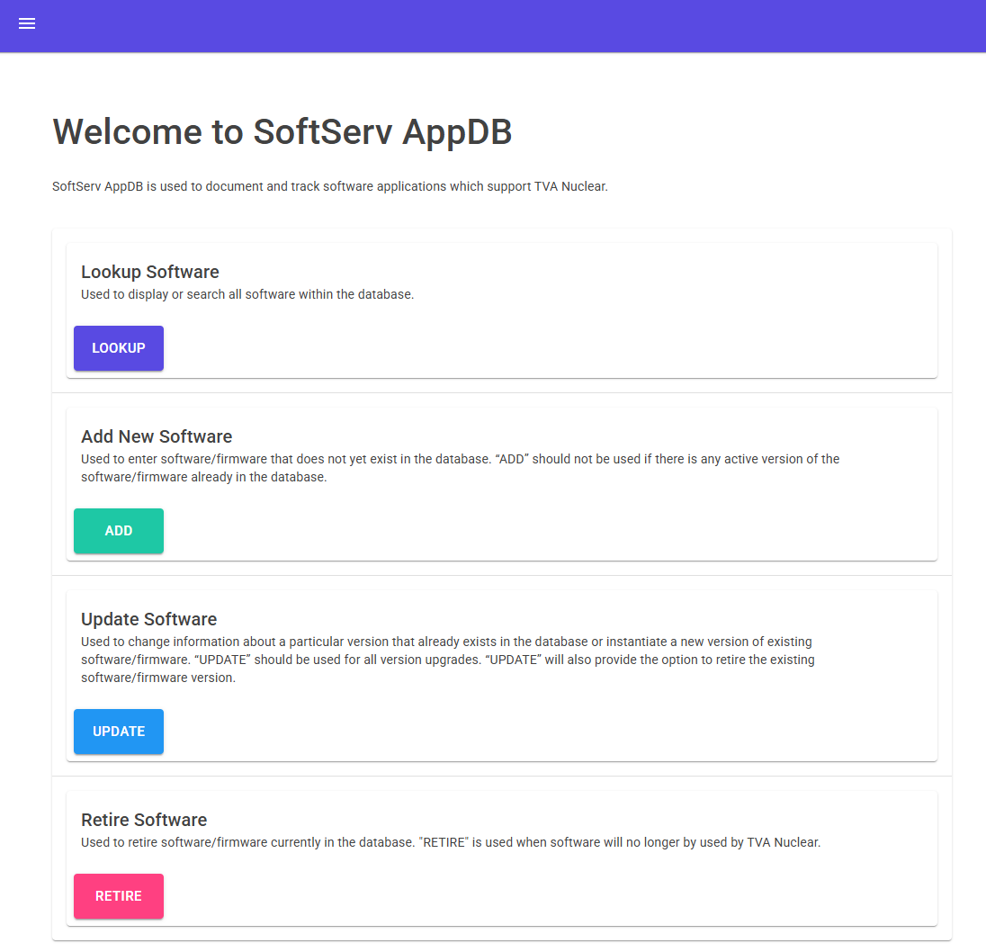
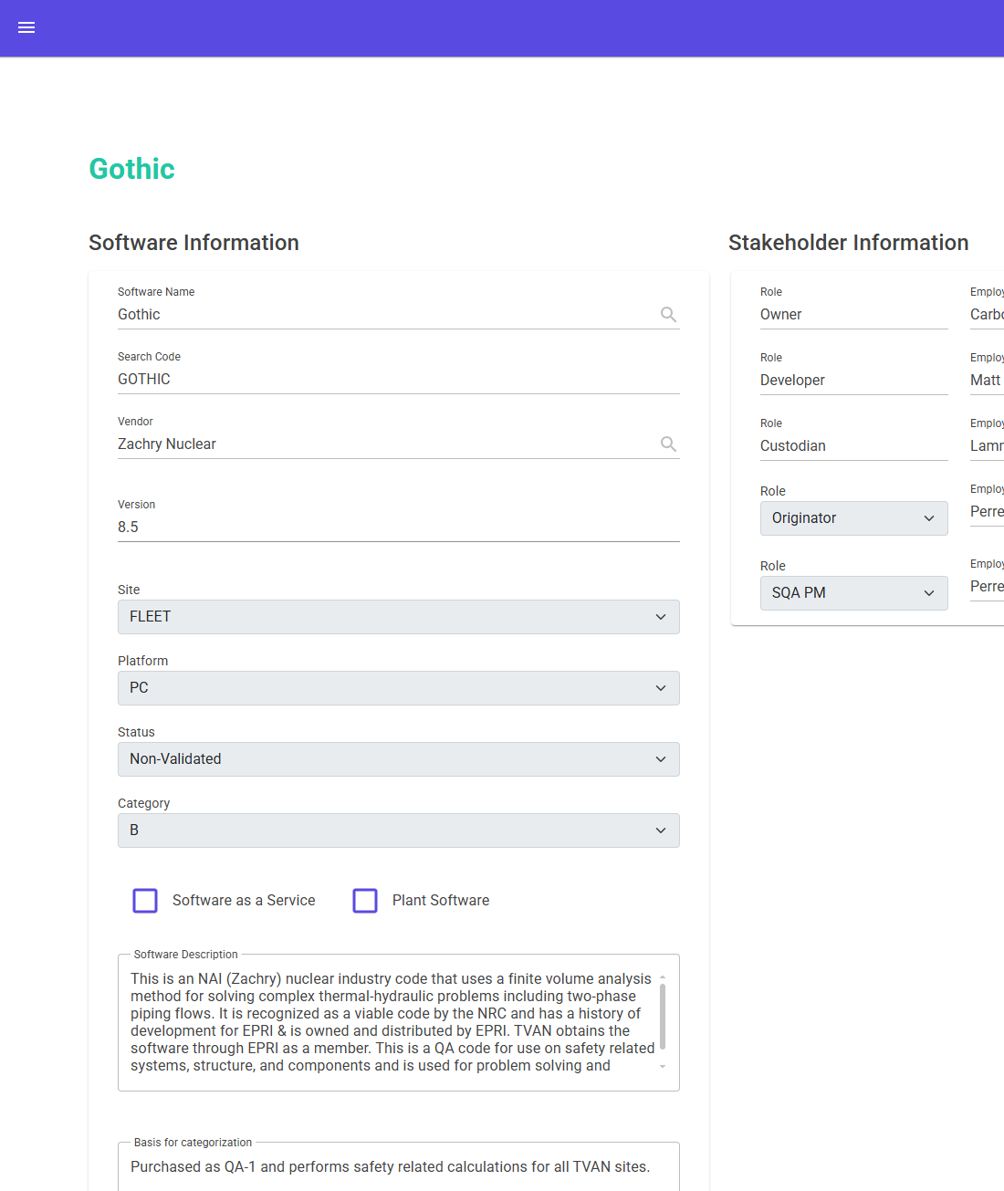
Nuclear Application Database
Unique identifier for each application
Tracks all information in a searchable format
Contains various stakeholder roles
Facilitates approvals and workflows for software changes
Notes:
Problem is that this has still not been integrated with Maximo for MEL data so it cannot be used for clearly showing where software is installed in the plant.

Slide 16
SQA Program
Solutions Implemented:
Created Nuclear Application Database
Improved participation of Computer Engineering in Design Change Meetings
Inserted workflow step for SQA Program Manager approval of Nuclear software requests (non-plant IT process)
Revised governing documents for Engineering Change Process to align program requirements
  Clear line of sight through Software Quality Assurance Process to Quality Assurance Plan
  Clarification of process and responsibilities for Operational Technology
Created Power BI dashboard for in-plant software/firmware
Notes:
Problems Identified:
Accurate list of software/firmware no longer maintained in MEL or ServiceNow
Loss of Configuration Control
Operational Technology not scoped into either system
Individuals unaware of controls and could easily circumvent process
Difficult to find previous documentation associated with software and software changes
Implementation of DEG and NISP-EN-04 changed approach for in-plant software/firmware
Engineering change process failure to integrate with software control process
Shift from software categories to configurability/consequence
Difficult to identify software/firmware installation locations in-plant

Slide 17
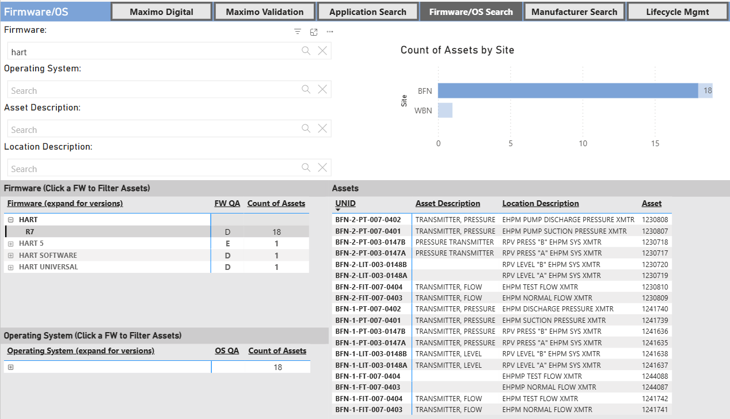
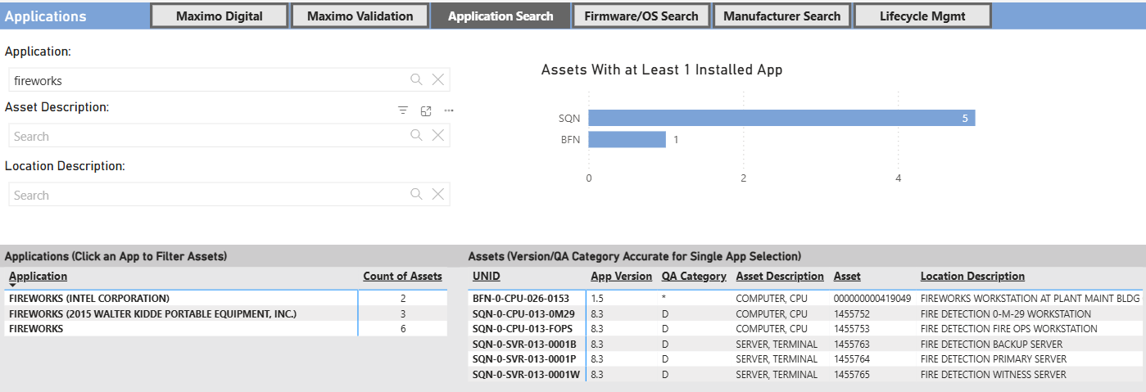
PowerBI for
In-Plant Software
Searchable by software instance
Addresses/provides historical variations in software naming
Ability to drill down by:
  Site
  UNID
  Version
Notes:
But once you can see the software and firmware details, it's easy to see the inconsistencies

Slide 18
Recent Operating Experience
SQN Unit 1 Manually Tripped | June 24, 2025
Reactor manually tripped due to lowering steam generator levels. Loss of steam generator water level was caused due to isolations of significant portions of the condensate system due to a transient introduced when one of the distributed control system processors initiated a reboot cycle. This was a known condition, and contingency plans were in place for a down power to correct the firmware error that caused the reboot, but those had not yet been able to be implemented at the time of the failure.
The firmware update, if implemented, would have prevented the trip.

Slide 19
Current Challenges
In-Plant
Configuration Control of firmware
  Have we made a change and didn’t even know about it?
Lifecycle management for digital components
Failure to specify firmware in procurement documents
  Firmware changes prior to receipt
Business Use
Addressing/tracking operational technology that is neither on the business network or plant network
Implementing controls for emerging technologies: cloud software, artificial intelligence, etc.

Slide 20
TVA’s Next Steps
Transition to NQA-1-2015
  Driven by SMRs
  Increased controls for safety-related design and analysis software
  Increased controls for ‘software tools’ associated with safety-related software
Solving configuration control for firmware
  CMIS configuration file module
  Ensuring procurement documentation addresses firmware versions
  Lifecycle management particularly for non-safety

