Slide 1
Recommissioning Plants
Matt Yarlett
Westinghouse Electric Company
Manager, Projects – Digital Technology
Michel Arcand
TVA - Clinch River Project
Sr. Manager Engineering Support

Slide 2
Recommissioning Plants
Palisades
Christopher M. Crane Clean Energy Center (TMI U1)
Duane Arnold Energy Center (Duane Arnold)

Slide 3
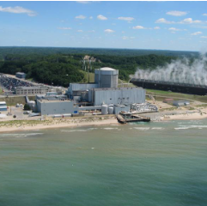
Palisades Update
Location: Covert, MI (5 miles S of South Haven, MI) in Region III
Operator: Holtec Decommissioning International
Operating License: Issued - 02/21/1991¹
Renewed License: Issued - 01/17/2007
License Expires: 03/24/2031
Docket Number: 05000255
Reactor Type: Pressurized Water Reactor
Licensed MWt: 2,565.4
Reactor Vendor/Type: Combustion Engineering
Containment Type: Dry, Ambient Pressure
Notes:
Palisades Nuclear Plant | NRC.gov

Slide 4
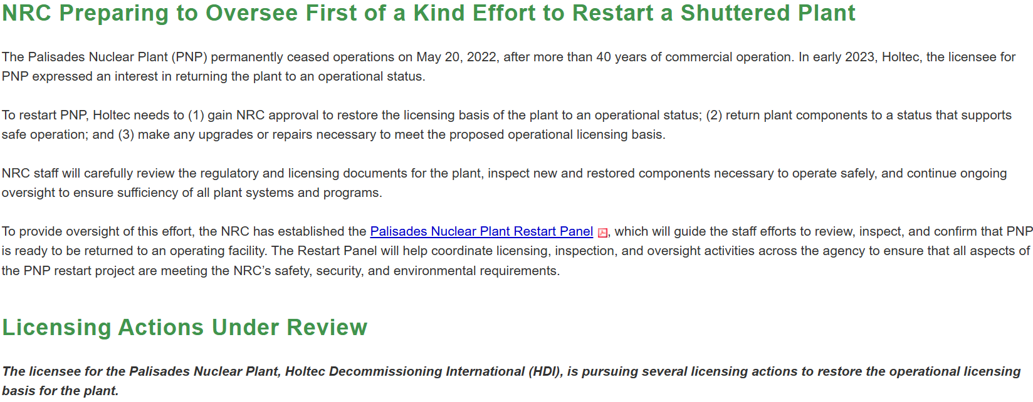
Palisades Update
Notes:
Palisades Nuclear Plant | NRC.gov

Slide 5
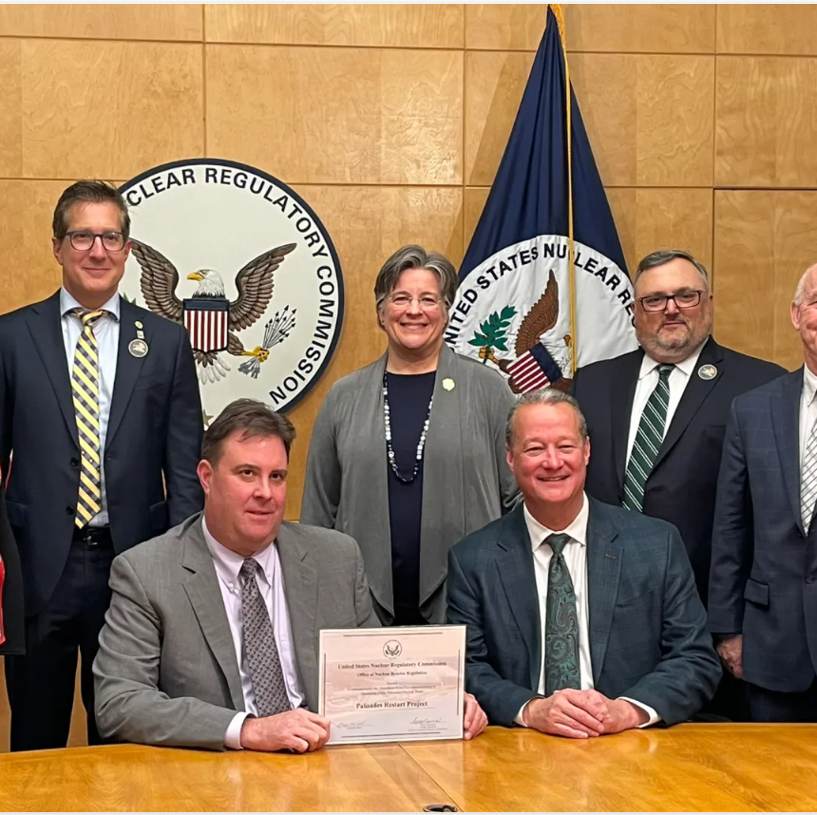
Palisades Update
In a major milestone for the U.S. nuclear industry, the U.S. Nuclear Regulatory Commission (NRC) has formally approved Holtec’s request to transition the Palisades Nuclear Plant from decommissioning status back to an operating license.
The NRC’s action reflects its thorough review of Palisades’ licensing basis under the agency’s existing regulatory framework, marking the first time a previously shut-down U.S. nuclear plant has received approval to return to operations.
With this approval, Palisades is authorized to receive new fuel and formally transition licensed reactor operators to on-shift status. The plant continues to progress towards a timely restart, with extensive readiness work underway – including rigorous testing, inspections, and maintenance – to ensure a safe and reliable return to service under ongoing independent federal oversight.
Once returned to service, Palisades will generate more than 800 megawatts of safe, reliable, and carbon-free baseload power – enough to power more than 800,000 households. The restart of Palisades will enhance grid reliability and help meet growing energy demand in Michigan and beyond.
Notes:
NRC Reauthorizes Palisades Operating License in Historic First for U.S. Nuclear Industry - Holtec International

Slide 6
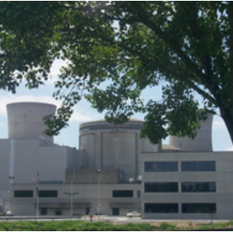
Christopher M. Crane Clean Energy Center Update
Location: Middletown, PA (10 miles SE of Harrisburg, PA) in Region I
Operator: Constellation Energy Generation, LLC
Operating License: Issued - 04/19/1974
Renewed License Issued - 10/22/2009
License Expires - 04/19/2034
Docket Number: 05000289
Reactor Type: Pressurized Water Reactor
Licensed MWt: 2,568
Reactor Vendor/Type: Babcock & Wilcox Lowered Loop
Containment Type: Dry, Ambient Pressure
Notes:
Christopher M. Crane Clean Energy Center | NRC.gov

Slide 7
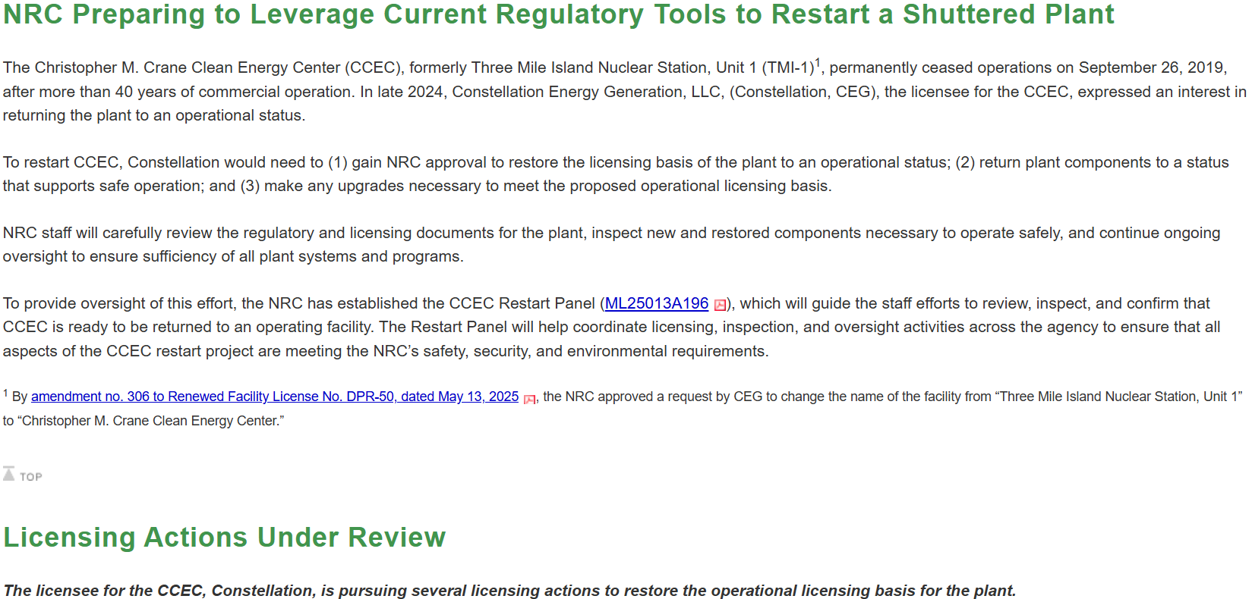
Christopher M. Crane Clean Energy Center Update
Notes:
Christopher M. Crane Clean Energy Center | NRC.gov

Slide 8
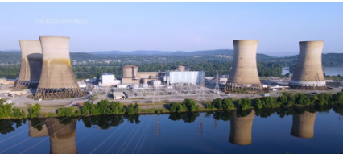
Three Mile Island Update
Constellation signs its largest-ever power purchase agreement with Microsoft, a deal that will restore TMI Unit 1 to service and keep it online for decades; add approximately 835 megawatts of carbon-free energy to the grid; create 3,400 direct and indirect jobs and deliver more than $3 billion in state and federal taxes
Notes:
Palisades Nuclear Plant | NRC.gov

Slide 9
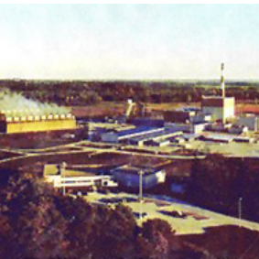
Duane Arnold Energy Center Update
Location: Palo, IA (8 miles NW of Cedar Rapids, IA) in Region III
Operator: NextEra Energy Duane Arnold, LLC
Operating License: Issued - 02/22/1974
Renewed License: Issued - 12/16/2010
License Expires: 02/21/2034
Docket Number: 05000331
Reactor Type: Boiling Water Reactor
Licensed MWt: 1,912
Reactor Vendor/Type: General Electric Type 4
Containment Type: Wet, Mark I
Notes:
Duane Arnold Energy Center | NRC.gov

Slide 10
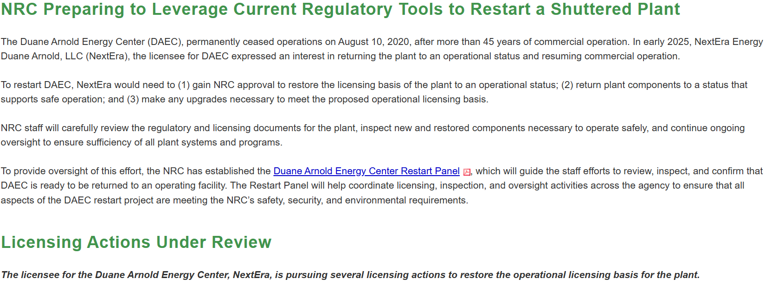
Duane Arnold Energy Center Update
Notes:
Duane Arnold Energy Center | NRC.gov

Slide 11

Duane Arnold Energy Center Update
The Duane Arnold Energy Center is Iowa’s only nuclear power plant and is located near Palo, Iowa, approximately nine miles northwest of Cedar Rapids. Currently, NextEra Energy Resources, the majority owner of the idled Duane Arnold Energy Center, is conducting a comprehensive engineering evaluation of the entire site, which is necessary before any restart decision can be made.
NextEra Energy Duane Arnold, LLC is an indirect subsidiary of NextEra Energy.
Resuming operations at an idled nuclear plant requires a comprehensive evaluation and many factors must be considered, including, but not limited to:
Conducting a comprehensive engineering evaluation
Finding an appropriate customer for the electric output
Restoration of plant systems to ensure the facility’s safety, security and reliability
Hiring and training licensed nuclear operators
Nuclear Regulatory Commission licensing
Procurement of updated equipment
Build new cooling towers and training and maintenance buildings
Notes:
NextEra Energy Resources | Duane Arnold Energy Center

Slide 12

Lessons Learned / Benchmarking
As sites being recommissioned are coming back to operations, there are several issues that are being addressed including the following:
Equipment Condition (Restoring equipment to meet design requirements)
Corrective and/or Restorative Maintenance
Training for Operators and/or new staff
Engineering / Stakeholder Training
Applying any deferred Licensing Requirements that were excepted due to Decommissioning
Notes:
NextEra Energy Resources | Duane Arnold Energy Center

