Slide 1
SMR Update
Eric Lessmann
TerraPower - Natrium
Configuration Management Specialist
Michel Arcand
TVA - Clinch River Project
Sr. Manager Engineering Support
Copyright © 2025 TerraPower, LLC. All Rights Reserved
Notes:
Locations Of Nonpower Production And Utilization Facilities | NRC.gov
List Of Power Reactor Units | NRC.gov
Pre-Application Activities | NRC.gov
Hearing Opportunities | NRC.gov
Locations Of New Nuclear Power Reactor Applications | NRC.gov

Slide 2
Technologies
TerraPower Natrium®¹
Sodium Fast Reactor w/ Salt Energy Storage
NEI 18-04 Licensing Modernization Project
TVA BWRX-300*
Gen 3+ Light Water BWR
PSAR and ER under NRC Review
IAEA Safety Standards
CPA submitted to NRC
Early Site Preparation in progress (TN)
Non-Nuclear Construction in progress (WY)
*TVA has not yet decided to deploy a SMR. Any decision will be subject to support, risk sharing, required internal and external approvals, and completion of all necessary environmental and permitting reviews.
1: a TerraPower and GE-Hitachi technology
Copyright © 2025 TerraPower, LLC. All Rights Reserved
Notes:
Eric L / Mike A

Slide 3
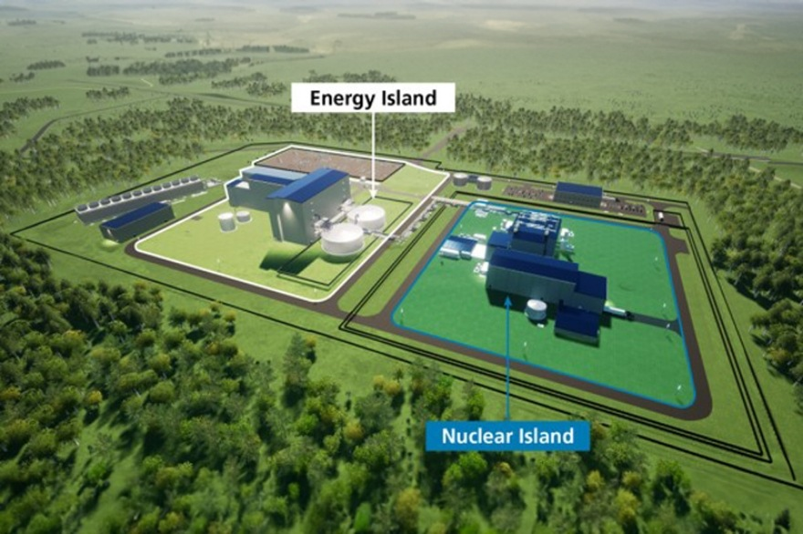
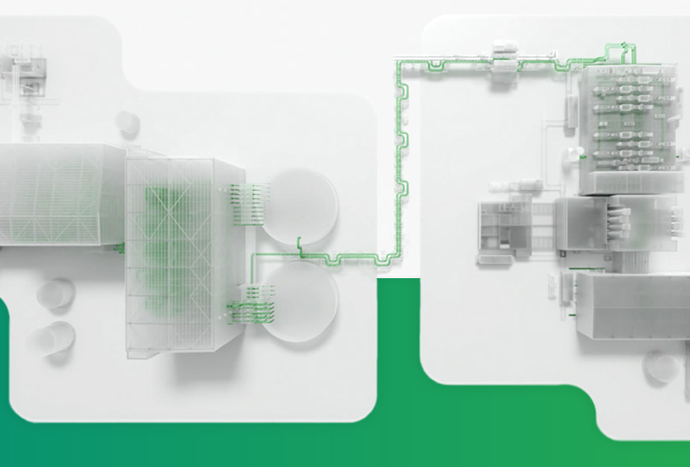

TerraPower Natrium Update
https://www.terrapower.com/natrium/
Notes:
Eric L

Slide 4
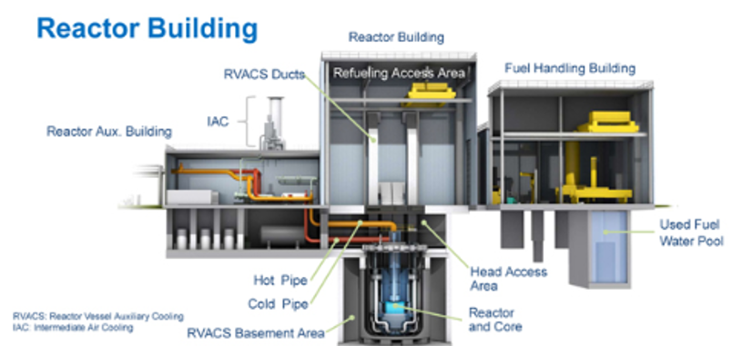
TerraPower Natrium Update
Sodium Fast Reactor
840 MWt
345 MWe (steady state)
100 – 500 MWe for 5.5+ hours
N.O.P. ~Atmospheric / N.O.T. ~930F
PSAR and ER under NRC Review – on going Audit
  PRA Configuration Control
US DOE completed Final Environmental Assessment
Construction of Energy Island Facilities in progress
  Training Center
  Test and Fill Facility (sodium)
Major Procurement Awards, Contracts
  Curtiss-Wright: Distributed Control System
  Mirion Technologies, Inc.: Radiation Monitoring
  Global Nuclear Fuels: Assemblies
https://www.nrc.gov/reactors/new-reactors/advanced/who-were-working-with/pre-application-activities/natrium.html
https://www.nrc.gov/reactors/new-reactors/advanced/who-were-working-with/applicant-projects/terrapower/dashboard.html
https://www.terrapower.com/terrapower-awards-another-round-of-vendor-contracts-for-natrium-reactor
https://www.terrapower.com/suppliers/
https://www.terrapower.com/downloads/Natrium_Technology.pdf
Notes:
Eric L
Natrium is a Sodium Fast Reactor.
Sodium coolant
No moderator
HALEU (5% < x < 20% enrichment fuel)
Nuclear Island de-coupled from Energy Island (no reactor power follows steam demand)
Energy Island salt storage allows for load following

Slide 5
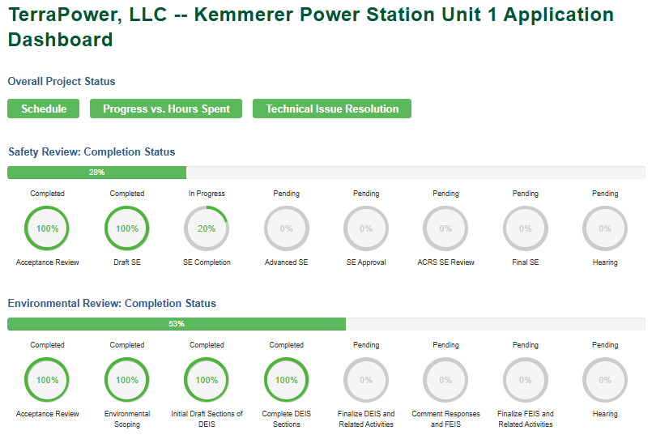
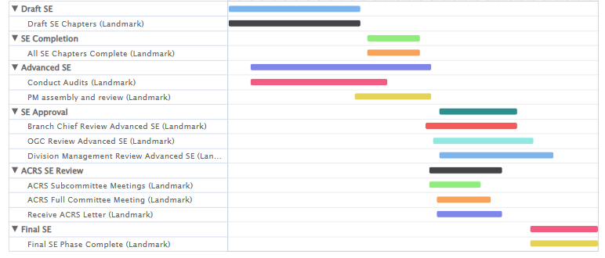
TerraPower Natrium Update
Notes:
Eric L
Natrium is a Sodium Fast Reactor.
Sodium coolant
No moderator
HALEU (5% < x < 20% enrichment fuel)
Nuclear Island de-coupled from Energy Island (no reactor power follows steam demand)
Energy Island salt storage allows for load following

Slide 6
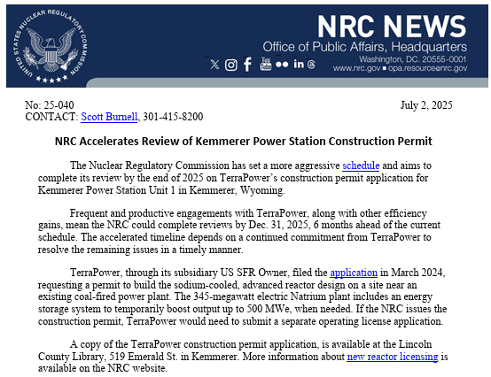
TerraPower Natrium Update
https://www.nrc.gov/cdn/doc-collection-news/2025/25-040.pdf
Notes:
Eric L
Natrium is a Sodium Fast Reactor.
Sodium coolant
No moderator
HALEU (5% < x < 20% enrichment fuel)
Nuclear Island de-coupled from Energy Island (no reactor power follows steam demand)
Energy Island salt storage allows for load following

Slide 7
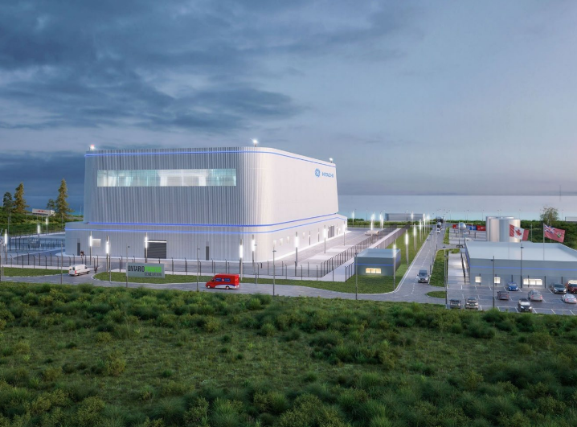
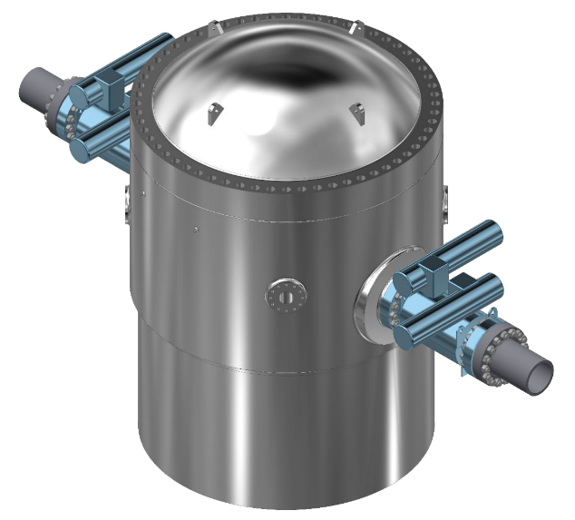
TVA BWRX-300 Update*
*TVA has not yet decided to deploy a SMR. Any decision will be subject to support, risk sharing, required internal and external approvals, and completion of all necessary environmental and permitting reviews.
Notes:
Mike A

Slide 8
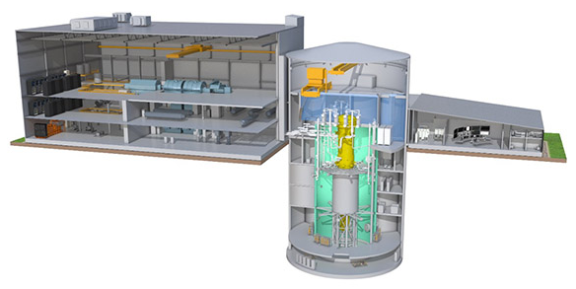
TVA BWRX-300 Update*
Light Water Gen 3+ BWR
  300 MWe
  Natural circulation
  12-24 month refuel cycle
  Passive design
CPA submitted to NRC
LTRs submitted to NRC
Technology-Neutral Site Preparation in Progress
  Site Access (Bridges / Barge Facility)
Integrated Project Delivery Approach
  TVA
  General Electric
  Bechtel
  Sargent and Lundy
*TVA has not yet decided to deploy a SMR. Any decision will be subject to support, risk sharing, required internal and external approvals, and completion of all necessary environmental and permitting reviews.
Notes:
Mike A

Slide 9

“Baseline” Process
What’s the Need?
Partnership with out entities (e.g., Bechtel, S&L, and GE-Hitachi)
Consolidation & Integration of multiple Companies working to their own quality process
Definition
All deliverables that in aggregate provide a complete description of the design and the complete technical basis supporting that design.
Process
Not explicitly defined or required by Design Control regulations or NQA-1
(Non-Quality Process)
Very well defined by System Engineering standards (SAE EIA-649C, INCOSE, NASA, etc.)
Copyright © 2025 TerraPower, LLC. All Rights Reserved
Notes:
Eric L – make these more general for TVA/TP. The Use-Case for TP is like TVA; but TPs was developed in-house for the specific partnership agreement for the Natrium project. Something similar may well be developed later for any future projects.

Slide 10
“Baseline” Process
Procedure
TerraPower: Electronic workflow feature of in-house developed CMIS (Atom)
Interdisciplinary reviews (~SDP DAR)
Licensing Review (PSAR and ER under NRC Review)
Approval by the Design Authority
Documents selected based on Design Milestone and requisite maturity
Graded Approach to Quality
Lesson Learned: Over-utilization of tracking and controlling unverified design inputs (“Open Items”)
May lead to changes to the engineering design
Planned Changes:
Design Change and Control Process
Unplanned Changes:
Engineering Change Requests
Pre-Job Brief
Assignment & Engagement
Prioritization
Sequencing
Copyright © 2025 TerraPower, LLC. All Rights Reserved
Notes:
Eric L – LL: when process enables engineers to track and control unverified design input, this can be abused in deferring verification based on awaiting inputs from other interfacing systems. Specific controls need to be in place to ensure the design progression and maturation can occur while adequately controlling and tracking these artifacts.

Slide 11
“Baseline” Process
Process
Upon electronic Workflow Approval
  Some documents auto populated and retained as records
    Impact Analysis
    Licensing Analysis
    Interdisciplinary Review (SDP DAR)
  Those documents being Baselined receive a metadata flag demonstrating they are Baselined
  A controlled copy is created to retain the Baselined version
Documents are intended to be “Baselined” multiple times during their lifecycle
  Design Maturity
  Open Items are Resolved and Closed
Copyright © 2025 TerraPower, LLC. All Rights Reserved
Notes:
Eric L

Slide 12
TerraPower “Baseline” Process
Future Needs
Impact Analyses
Based in part on 2017 CMBG Presentation by NSE Technology for Korean NPP (KETEP & KHNP)
Leveraging Associated Data Linkages for automating or aiding Impact Analyses
Baselining Data
Requirements
Parameters
SSCs
LMP Data
Automate change management
3D Model Configuration & Change Management
Based in part on 2023 CMBG Presentation by R&L Partners, Inc.
Digital Twin
Process
Improvements
Implementation or Incorporation based on staged pending changes conditionally triggering
Notes:
Eric L – these future process improvements are being considered. Impact analyses automated by

Slide 13
Design Control
Design development will be through selection of engineering design partners with approved quality control programs.
Selected partners will be in contract agreements where the owner operator will be engaged in and provide oversight of design development.
An owners acceptance review process will be used for turnover of design authority.
This will be done in a staged system by system process where the designer is allowed to make changes through turnover, start up, and operational testing. Allowing designer to continue in the development / owners acceptance review process was a lessoned learned from Vogtle.
Designers without an approved quality control program should be avoided / minimized. In the cases where this cannot be avoided, those designers will need to use the owner operators design development process with engagement, review, and sign off by the owner operator design group.
Copyright © 2025 TerraPower, LLC. All Rights Reserved
Notes:
Mike A

Slide 14
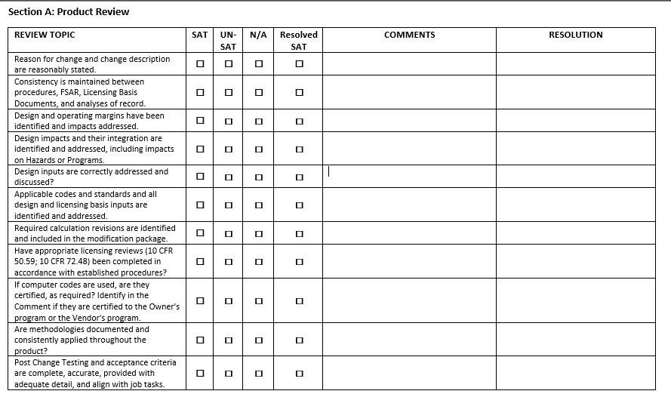
Owners Acceptance Reviews
TerraPower
Prime in partnership and Licensee
Owner Acceptance Review
  DOWG/Callaway WELL Sheet Checklist
    Feedback #1 – Lack of Training / Awareness
    Feedback #2 – Forces Procedural Compliance
TVA
Integrated Project Delivery (IPD) approach with shared development responsibility and risk
Similar Owner Acceptance Review process as TerraPower
Notes:
Eric L – TerraPower introduced a new checklist/form electronically managed based on the Callaway WELL Sheet presented/shared/made available in Phoenix 2023. It’s been well received with two major themes found in feedback; first – the checklist is required when electronically performing partner deliverable acceptance and originators were unaware of this change (so, maintain and implement good change management practices when changing procedures and electronic software); and second – the originators were receptive positively to be required to have the procedural guidance in front of them while performing the task (so, enable engineers to know what jurisdiction their under and what requirements they need to meet when they’re performing work as much as reasonably achievable).
Mike A – TVA has a similar process in place. As a next step we intend to broaden our procedure to govern an new nuclear design development process. This will be similar to a “conduct of” procedure.

Slide 15

Owners Acceptance Reviews
When the Supplier does not have a QA Program; take control and manage
Copyright © 2025 TerraPower, LLC. All Rights Reserved
Notes:
Mike A

Slide 16
Design Authority
Delegation
Approval Authorities
Change Control Board
Copyright © 2025 TerraPower, LLC. All Rights Reserved
Notes:
Eric L / Mike A – brainstorming for going forward considerations for establishing these processes. Add link / arrow to next slide for transition / turnover?
Eric L – we need the right people reviewing and signing approvals for the right products at the right time. With a graded approach being taken to design maturation and required quality implementation with Natrium, this is very important. Records are important to document these delegations, and electronic identification of delegated authorities is important to find the responsible party – both when assigning and assessing.

Slide 17
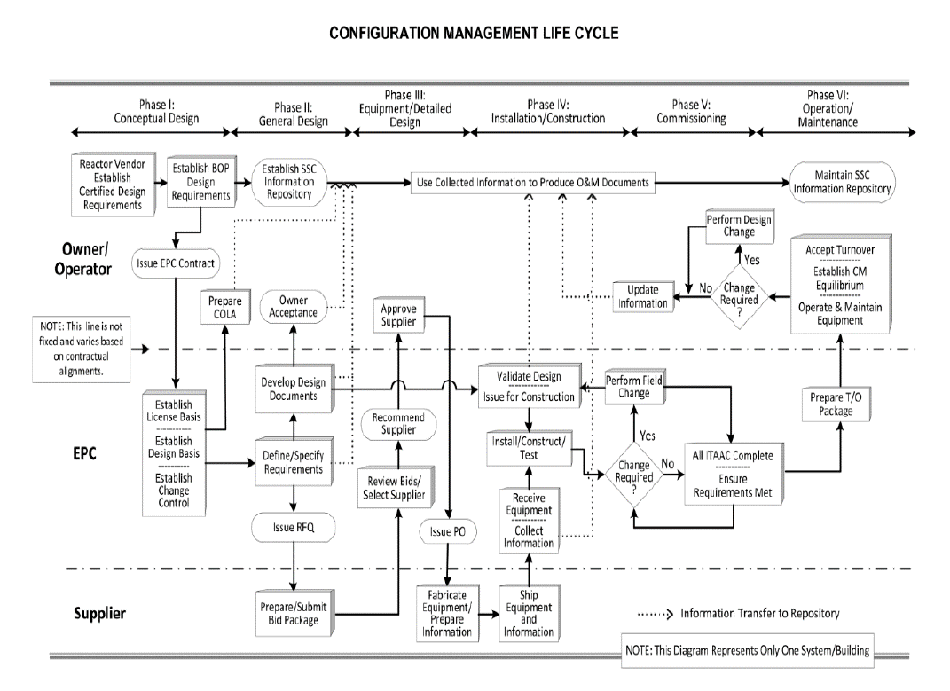
Turnover, Handover, and Transition
TerraPower & TVA – in progress developing Plan based on guidance including:
EPRI Advanced Nuclear Technology
  3002007425 New Nuclear Power Plant Information Turnover Guide
  3002003126 Data Centric Configuration Management
  1022684 Elements of Pre-Operational and Operational Configuration Management
Notes:
Eric L / Mike A – brainstorming for considerations going forward when establishing these processes including the regulations/codes/standards that’ll inform it. Is the background from the CMBG Handbook? If yes, then perfect.
Eric L – the guidance will need to be catered to the specific contractual EPC arrangements and the specific owner/operator for the project. Lessons Learned from the US AP1000 (e.g., CMBG 2023 Vogtle 3&4 presentation) will be incorporated.

Slide 18
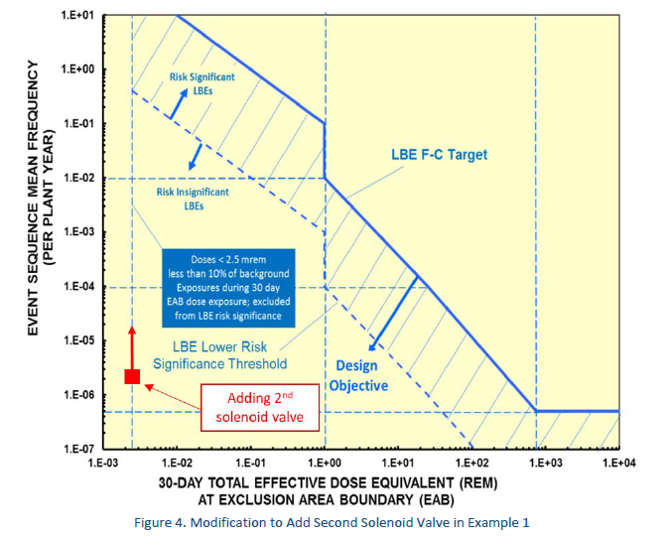
10CFR50.59
TerraPower may need to plan for development of a TIRICE process
NEI 22-05, Technology Inclusive Risk Informed Change Evaluation (TIRICE)
  Based on NEI 18-04: “Risk-Informed Performance Based Technology Inclusive Guidance on Non-LWR Licensing Basis Development”
  Based on NEI 21-07: “Safety Analysis Report Content for Applicants using NEI 18-04”
Copyright © 2025 TerraPower, LLC. All Rights Reserved
Notes:
Eric L – traditional deterministic approaches to SSC safety classification are not being used for Natrium; instead, probabilistic risk informs the required layers of defense in depth based on the probability and consequence (dose) of a given initiating event. This intrinsic risk informed nature for the design and licensing bases development of Natrium leads to an analogously sophisticated change evaluation process. Thus, changes to these SSCs similarly may be graded for their direct and indirect effects to reliability, capability, defense-in-depth, and other features to determine whether prior NRC Approval (LAR, etc.) is required.
In the example on the right, a 2nd solenoid valve is proposed to be added to preclude plant transients when the sole solenoid valve spuriously opens. The frequency (probability) and consequence (dose) chart allows us to determine whether a proposed change is sufficiently adverse to require prior NRC approval. The event consequence (Dose) doesn’t change but the probability is increased. This increase did not change the risk significance of the licensing basis event from non-significant to risk significant. Therefore, no prior NRC approval is required for this change.

