Slide 1
10 CFR 50.69 IN DESIGN
CONFIGURATION MANAGEMENT BENCHMARKING GROUP (CMBG)
JULY 21 - 23, 2026, ORLANDO, FL

Slide 2
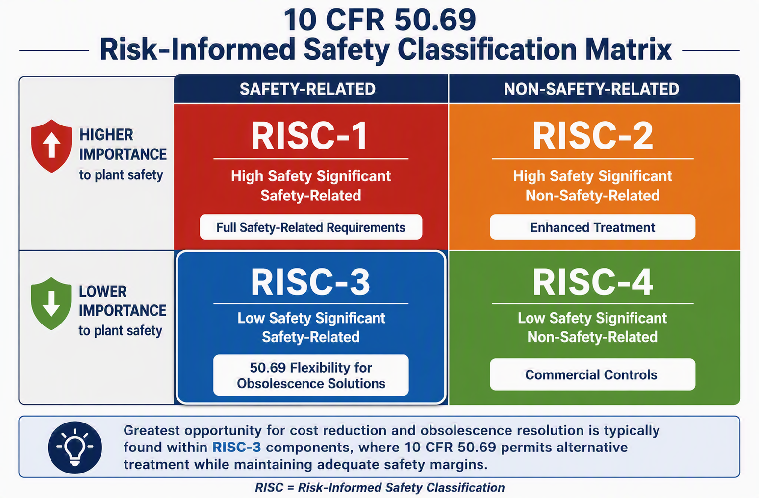
CATEGORIZATION

Slide 3
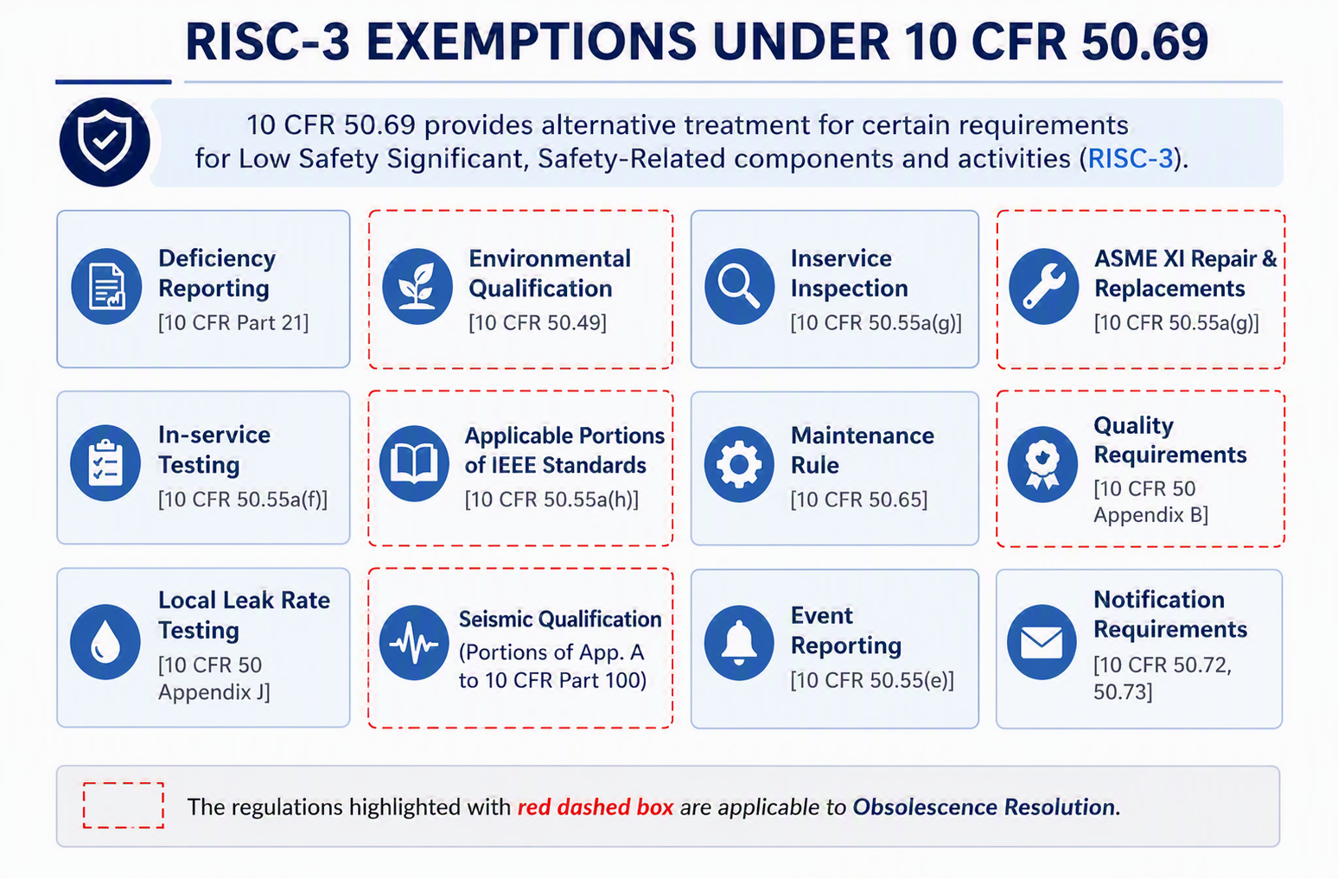
ALTERNATIVE TREATMENT

Slide 4
50.69 SAVINGS TYPES
Projects
Reduce capital costs
Programs
Remove components from special treatment programs and extend or eliminate PMs
Procurement - Daily and Outage
Reduce parts cost by 80%
Examples: Vogtle MSIV Actuators, Hatch Plant Service Water Piping
Example: Equipment Qualification Program, In-Service Testing
Solve obsolescence issues
Cut lead time in half or more
Right Work at the Right Time!
Allows flexibility on purchasing

Slide 5
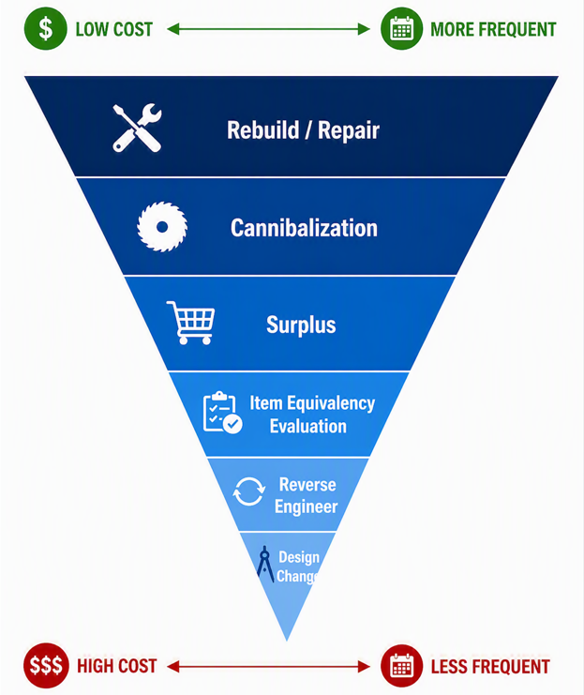
OBSOLESCENCE RESOLUTION PYRAMID
Question:
Where can 50.69 help?
Answer:
All of the above!

Slide 6
50.69 WITHIN DESIGN CHANGE
For RISC-3 SSCs that involve new equipment or a design change, seismic adequacy can be demonstrated using alternative methods that provide reasonable confidence of performing required safety functions under design-basis seismic conditions [EPRI Report 1009669].
Approved evaluation approaches:
  Seismic Experience (both earthquake and test experience)
  Consensus Building Code methodology (ASCE 7)
  Existing plant seismic qualification methods
  Replacement-part criteria for minor modifications to existing RISC-3 components

Slide 7
INDUSTRY LESSONS LEARNED
Contact 50.69 categorization team early
  Is the system categorized?
  Can it be categorized?
  Are we adding new SR components?
    OE – station design team wanted to make the RISC determination on new components without revisiting the categorization or using guidance in NEI 00-04
  Can we revise a design to reduce a component’s risk significance?
    OE – Vogtle 1&2 PSMS system categorization was not favorable, redundancy added into the DCP will bring the RISC values down and reduce the project’s cost

Slide 8
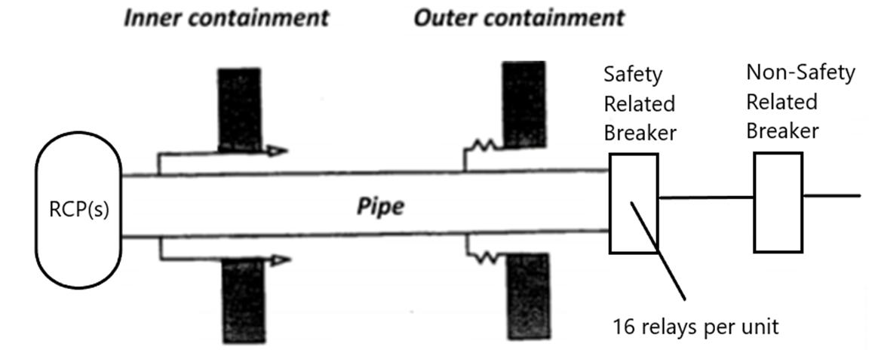
50.69 DESIGN EXAMPLE
Vogtle Reactor Coolant Pump Motor Protection Relays

Slide 9
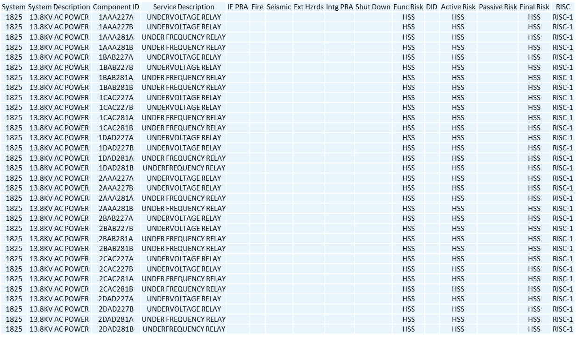
50.69 ORIGINAL CATEGORIZATION
Notes:
Supported functions are HSS. While each individual relay supporting either of these functions could be downgraded because there are 2 relays, DID would prevent us from taking credit for identical, redundant relays. However, by introducing different relay MFRs, the DID barrier would not be an impediment.

Slide 10
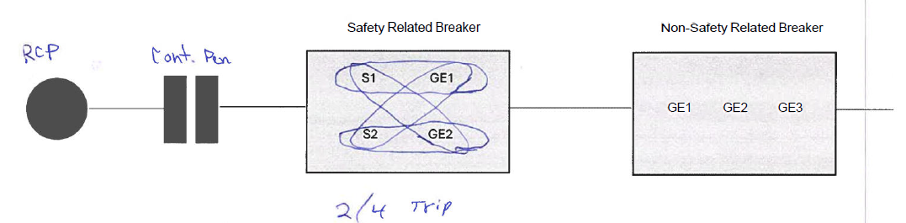
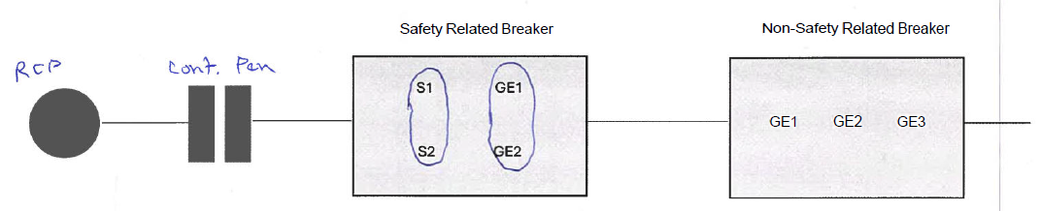
DIGITAL RELAY DESIGN OPTIONS
Configuration 1
Configuration 2

Slide 11
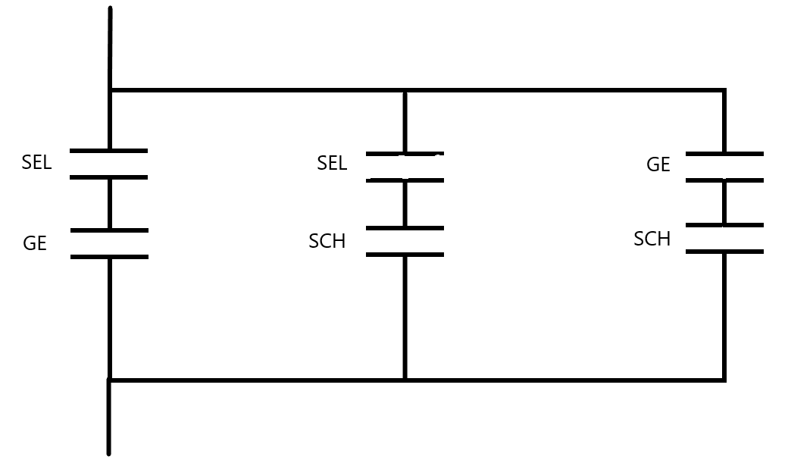
DIGITAL RELAY DESIGN OPTIONS
Configuration 3 (Winner!)
Configuration 3 allows relay categorization to change from RISC-1 to RISC-3
Replacing the RCP motor protection relays in current configuration would cost more than $1M
  Current Plan is for the Design Team to incorporate Configuration 3 into their process
      Pursuing this will cost $144k
        6k per digital relay (need 3 per unit for each RCP [4 total])

Slide 12
SUMMARY
10 CFR 50.69 allows for flexibility within design
  If replacing or adding Safety Related parts, system categorization is highly suggested!
Reasonable Confidence Evaluation may be performed by design engineers and documented within design change package
  Reasonable confidence is station defined
Partnership between categorization team and design team is critical to overall success

Slide 13
Annual 50.69 Workshop Opportunity
BWROG 50.69 Committee Meeting and Workshop
    Topics: Introduction to 50.69, 50.69 Procurement in Design, Categorization, AOV/MOV Alternative Treatment Development
    Target Audience: Design, Projects, Procurement, 50.69 Implementers, AOV/MOV program owners
    In person and virtual in Boston, MA, August 17-20, 2026
    Contact Carrie Gilbreath (caself@southernco.com) for details

Slide 14
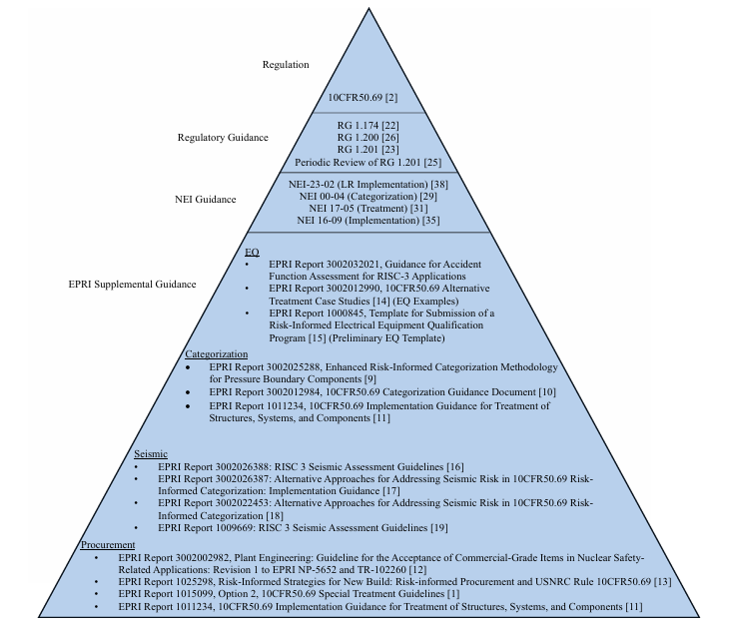
REFERENCES
Figure 5 from EPRI Report 3002032021

Slide 15


