Slide 1
10 CFR 50.69
IN SUPPORT OF OBSOLESCENCE
CONFIGURATION MANAGEMENT BENCHMARKING GROUP (CMBG)
JULY 21 - 23, 2026, ORLANDO, FL

Slide 2
INTRODUCTION
The intent of 10 CFR 50.69 is to provide a means for appropriately focusing attention on those SSCs that are most important to safety, while maintaining reasonable confidence that other SSCs will be capable of performing their design basis functions.
Application of 10 CFR 50.69 provides a risk-informed framework to manage obsolescence for low-safety significant components
  Allows relaxation of special treatment requirements
  Facilitates broader supplier options
  Reduces cost
  Improves availability of replacement solutions
  Allows stations to focus resource on components critical to nuclear safety

Slide 3
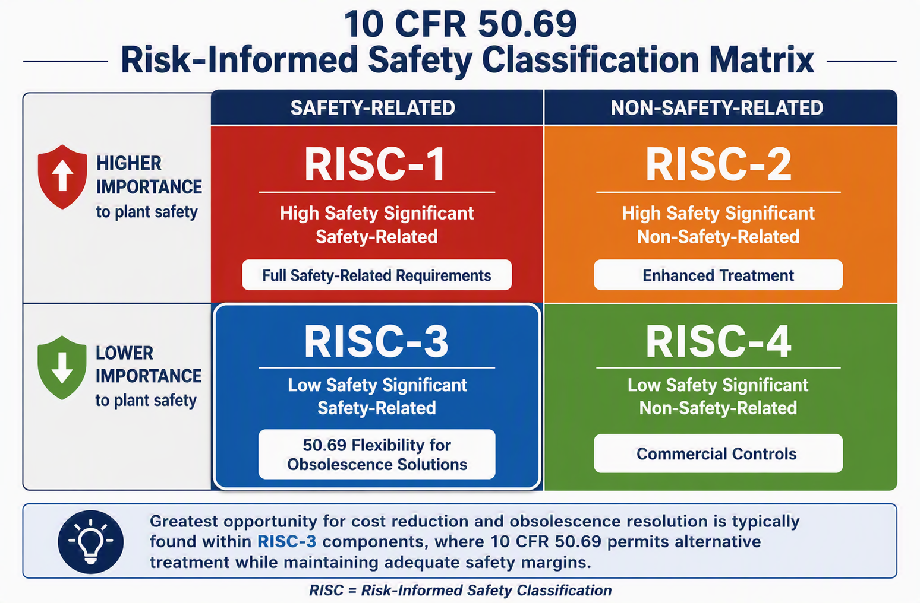
CATEGORIZATION

Slide 4
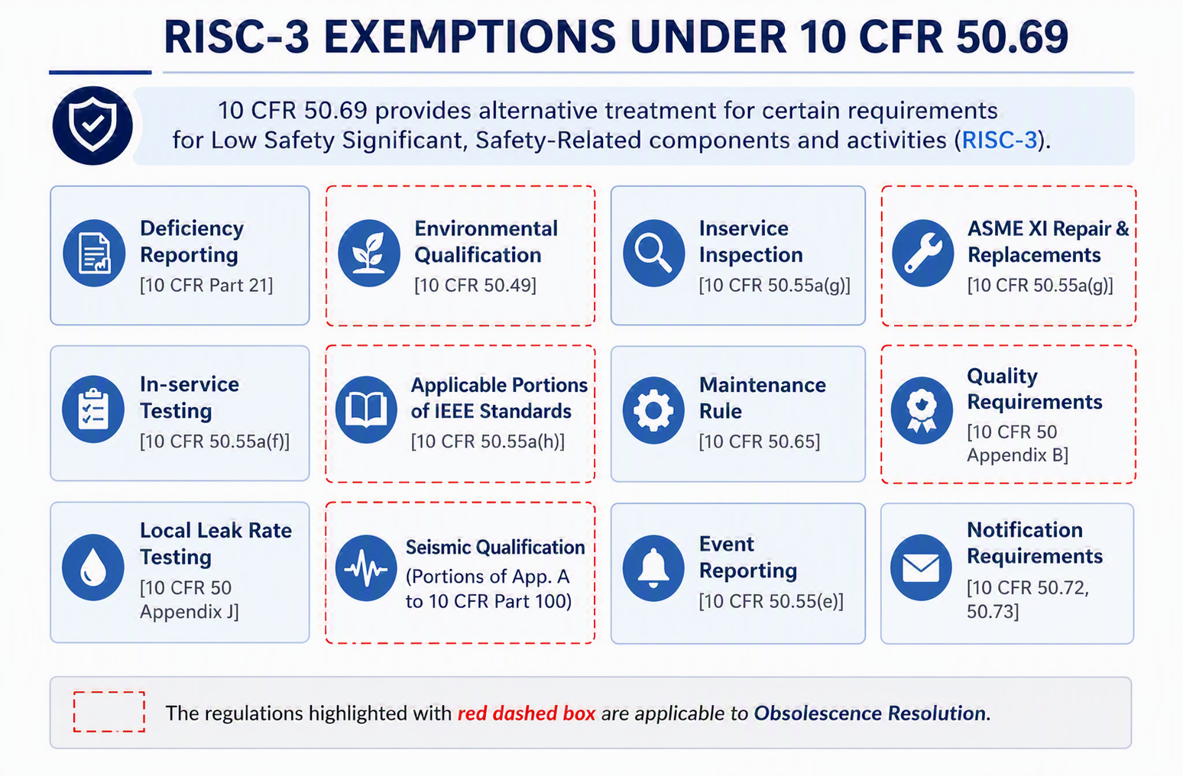
ALTERNATIVE TREATMENT

Slide 5
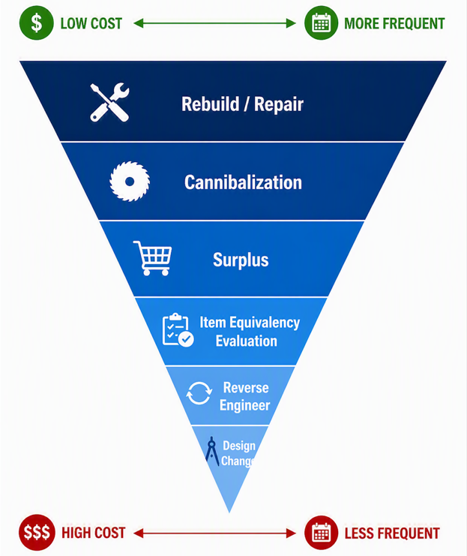
OBSOLESCENCE RESOLUTION PYRAMID
Question:
Where can 50.69 help?
Answer:
All of the above!

Slide 6
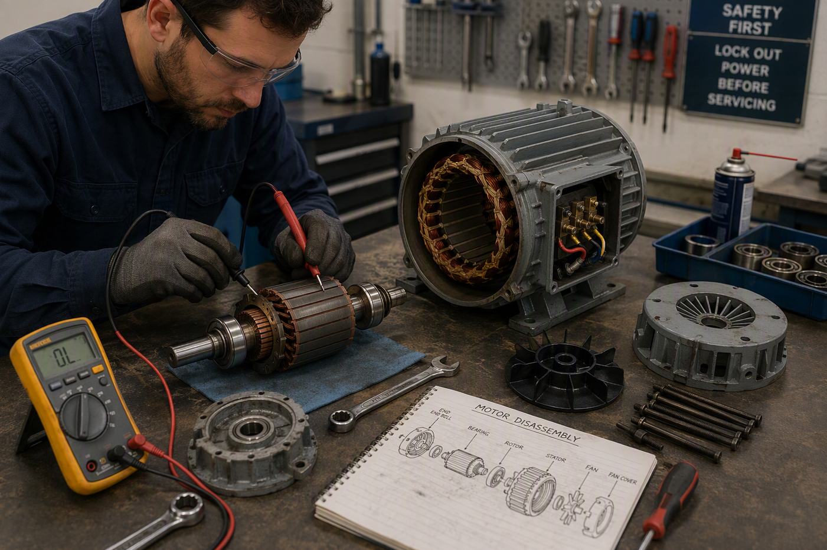
REBUILD / REPAIR
Non-Appendix B vendors can be used for repair/refurbishment of RISC-3 components.
Ensure adequate testing and inspection is performed and documented to provide reasonable confidence the component will perform its safety-related design basis function(s).
Components that are sent offsite for repair can be received under a Non-Safety Related / RISC-3 item master.

Slide 7
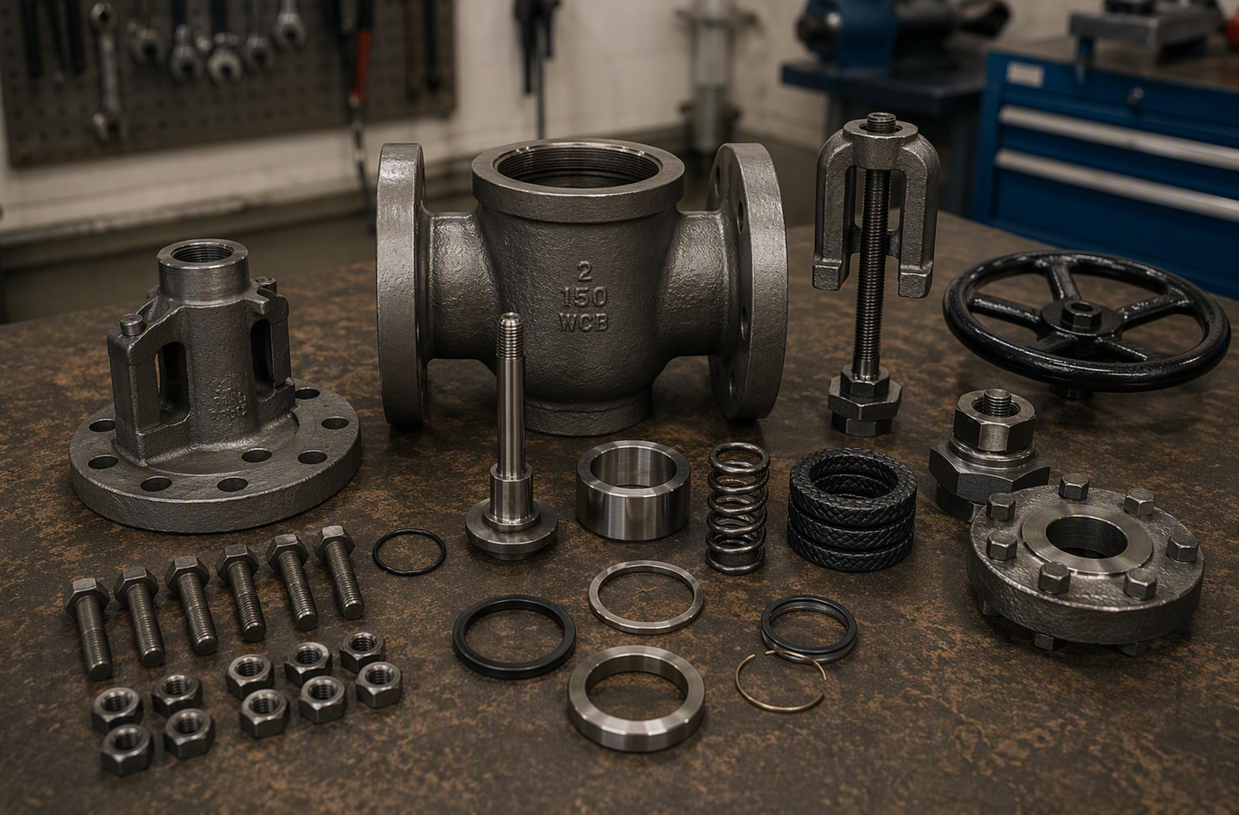
CANNIBALIZATION
The practice of removing serviceable components from one piece of equipment (the “donor”) and installing them into another piece of equipment (the “recipient”) to restore functionality, typically when spare parts are unavailable or delayed.
Piece parts from new, industrial grade components can be evaluated for use as spare parts in RISC-3 components.
Using existing spare parts currently on hand also fall under this category.
Components are verified for like-for-like.

Slide 8
LIKE-FOR-LIKE ITEM
RISC-3 Like-for-Like Item
  An industrial grade item for RISC-3 applications that is physically (configuration, dimensions, materials, etc.) and functionally (manner and design parameters) the same as the corresponding item previously supplied or dedicated for safety related use under a 10 CFR 50, Appendix B Quality Assurance program.
  RISC-3 Like-for-Like Items are procured without the quality assurance requirements associated with safety related items supplied under a 10 CFR 50, Appendix B Quality Assurance program.
  Like-for-like items are reviewed and confirmed that the items are physically identical but require very little engineering evaluation.

Slide 9
LIKE-FOR-LIKE ITEM
EPRI Report 1009669 – RISC-3 Seismic Assessment Guidelines
  An identical item is defined as “the same part, make and model number, which exhibits the same technical and physical characteristics.” In this case, there is no change to the host and no technical evaluation is necessary. Such items may be directly procured and installed without affecting the existing seismic qualification basis.
EPRI Report 3002032021 – Alternative Treatment to Environmental Qualification for RISC-3 Applications
  For RISC-3 replacement items that are identical to the component from the original EQ qualification, no additional 10CFR50.69 analysis is required.

Slide 10
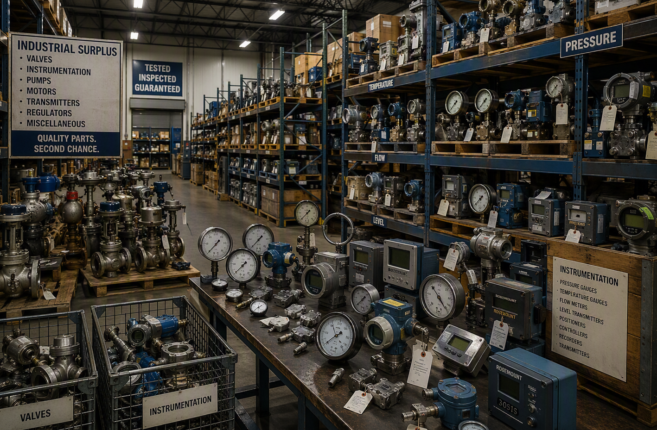
SURPLUS
Industrial grade, like-for-like components are often available.
Commonly found for components like pressure transmitters, power supplies and electrical subcomponents.
May request additional testing and inspection.
Refurbished components can be an option in some cases.

Slide 11
ITEM EQUIVALENCY EVALUATION
RISC-3 Equivalent Item
  An industrial grade item for RISC-3 applications that is physically (dimensions, materials, etc.) different from the corresponding item supplied or dedicated under a 10 CFR 50, Appendix B Quality Assurance program, but is functionally the same as the original item.
  Utilize the Standard Item Equivalency Evaluation process (SIEE), NISP-EN-02, to evaluate.
  All critical characteristics must be considered, drawing and calculation impacts must be addressed.
  SIEE will establish Reasonable Confidence the replacement will reliably perform its safety-related design basis function(s).

Slide 12
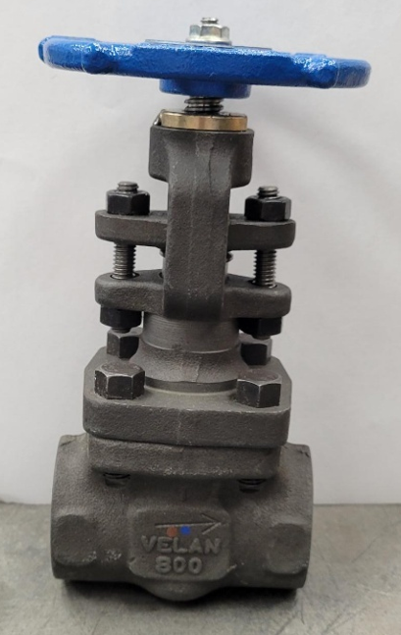
ITEM EQUIVALENCY EVALUATION EXAMPLE
Obsolete Plant Service Water drain valves (1 IN globe valve)
  Equivalent replacement
  Off the shelf commercial valve
    Lead time savings of 50+ weeks
  Savings ≈ $7K per valve
  Projected life of plant savings over $1M

Slide 13
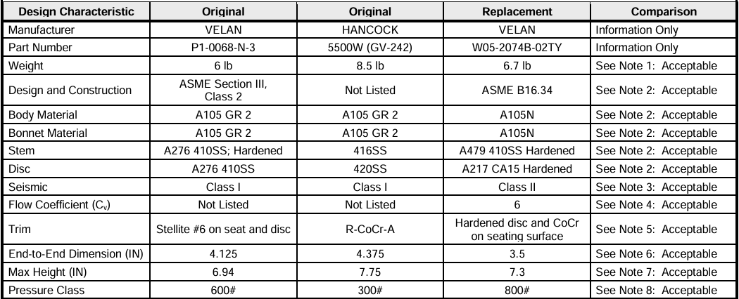
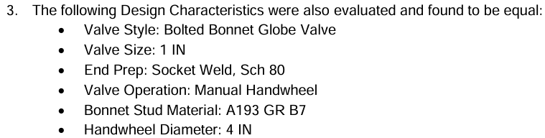
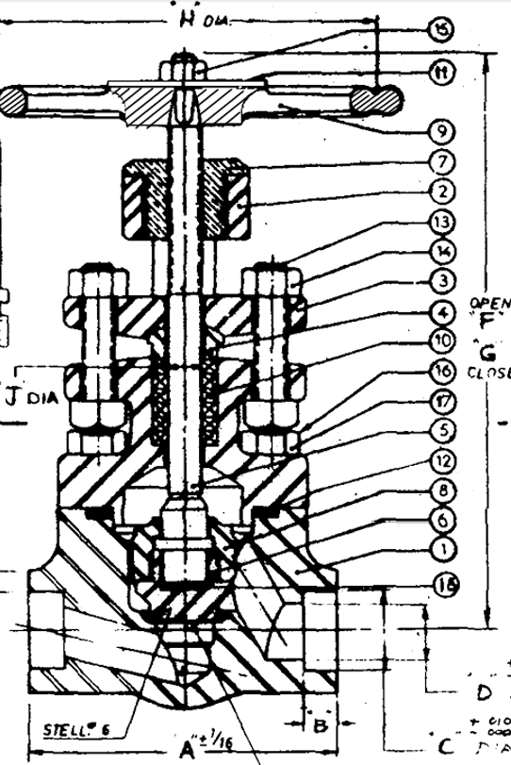
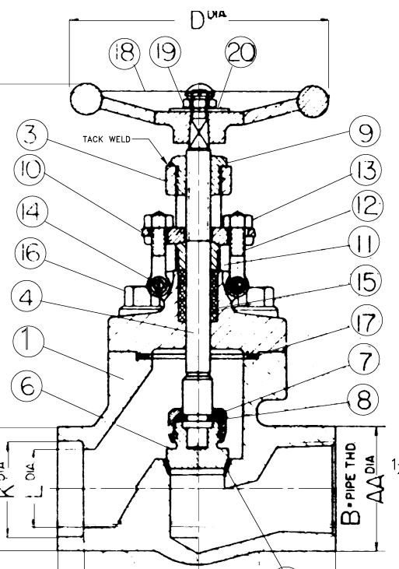
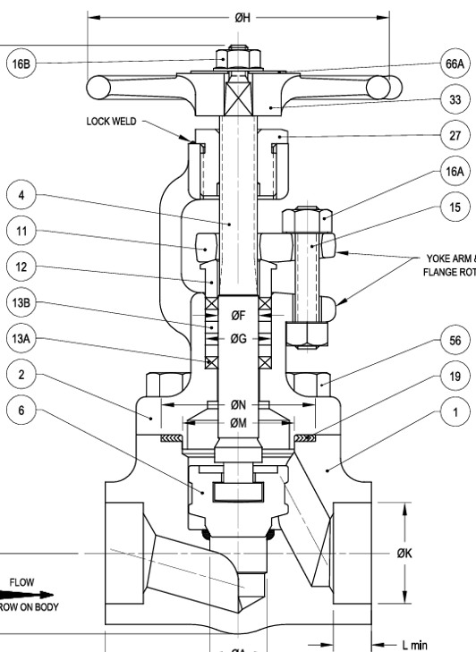
ITEM EQUIVALENCY EVALUATION

Slide 14
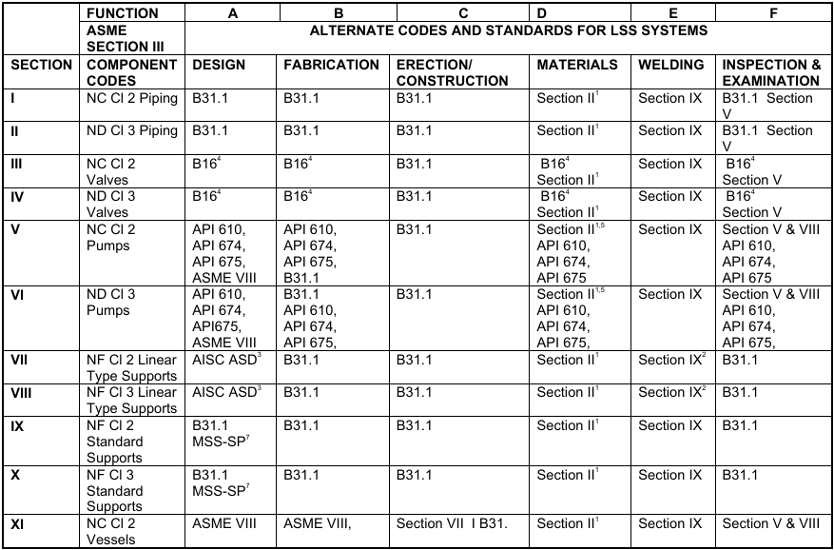
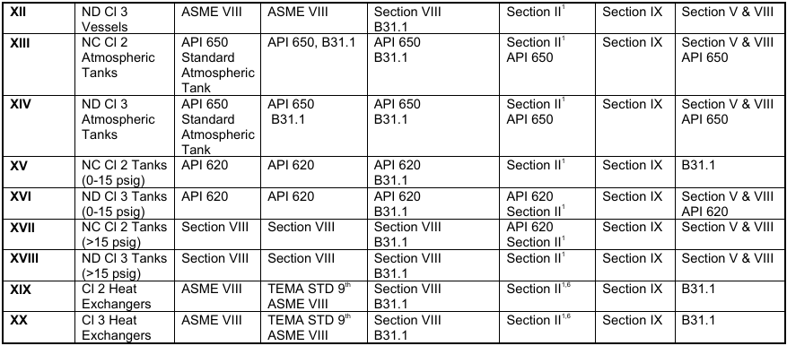
ITEM EQUIVALENCY EVALUATION
EPRI Report 1023007
  This report provides a listing of recommended alternative codes and standards (i.e. alternatives to ASME Section III) for LSS components.

Slide 15
ITEM EQUIVALENCY EVALUATION
EPRI Report 1016694 – Generic Seismic Technical Evaluations of Replacement Items for Nuclear Power Plants—Item-Specific Evaluations
  Includes G-STERI Number: M-95001
  Meeting the conditions outlined in this G-STERI provides reasonable confidence the replacement valve will remain capable of performing its safety‐related function under design basis seismic conditions.
  In some cases, this may require additional evaluation from seismic/stress design engineering

Slide 16
REVERSE ENGINEER
10 CFR 50.69 enables reverse engineering to be considered as a practical obsolescence solution for low safety-significant components by reducing unnecessary procurement and quality burdens while still requiring reasonable confidence that the replacement item will perform its design basis function.
  Engineering focuses on demonstrating Reasonable Confidence rather than Reasonable Assurance.
  Appendix B supplier requirements do not apply.
  Alternative procurement strategies become available.

Slide 17
DESIGN CHANGE
RISC-3 Design Equivalent Item
  Industrial grade items for RISC-3 applications that are not RISC-3 Like-for-Like or RISC-3 Equivalent Items but meet system design requirements.
  Design changes are often required to address obsolescence when no direct replacement is available.
  The design change will establish Reasonable Confidence the replacement will reliably perform its design basis function(s).

Slide 18
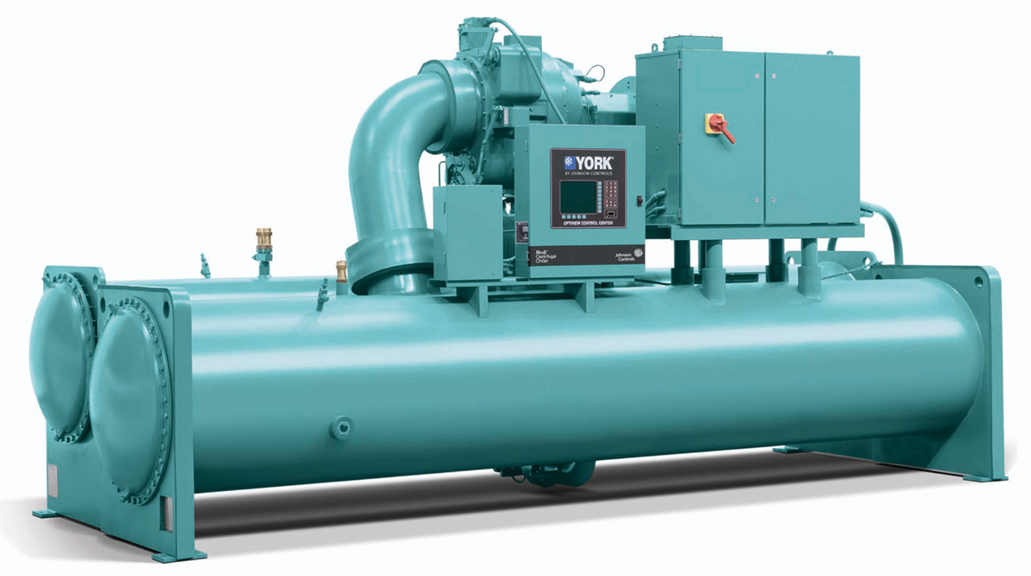
DESIGN CHANGE EXAMPLE
Hatch Drywell Chiller Replacement
  Replace existing chillers with Industrial grade chillers
  Savings of approximately $9M in procurement costs

Slide 19
SUMMARY
10 CFR 50.69 is a powerful tool to solve obsolescence
  Allows flexibility by removing costly Appendix B requirements
  Reduces Overall Costs
  Reduces Lead Times

Slide 20
Annual 50.69 Workshop Opportunity
BWROG 50.69 Committee Meeting and Workshop
    Topics: Introduction to 50.69, 50.69 Procurement in Design, Categorization, AOV/MOV Alternative Treatment Development
    Target Audience: Design, Projects, Procurement, 50.69 Implementers, AOV/MOV program owners
    In person and virtual in Boston, MA, August 17-20, 2026
    Contact Carrie Gilbreath (caself@southernco.com) for details

Slide 21
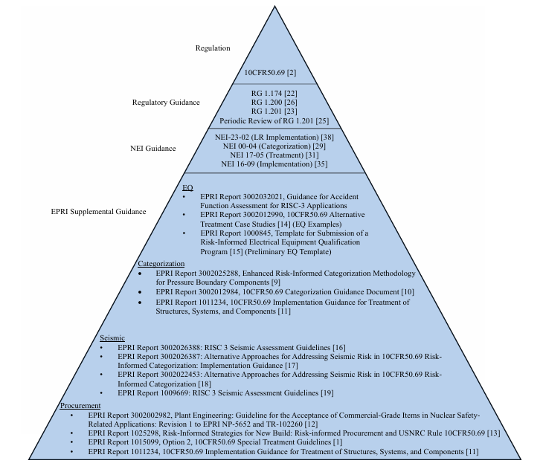
REFERENCES
Figure 5 from EPRI Report 3002032021

Slide 22


