Slide 1
AI-Driven Obsolescence Solutions
June 22, 2026
Matt Yarlett

Slide 2





The Industry Challenge
Aging plant assets → increasing obsolescence challenges
Supplier changes due to changing market conditions
Loss of experienced engineering knowledge
More frequent need for qualified replacements
Rising volume and complexity of IEEs

Slide 3


How Engineers Use AI Today
AI Assistants in the IEE Workflow
Implemented Correctly
Search & summarize large technical documents
Grounded in engineering data & procedures
Identify critical characteristics & requirements
Context-aware (understands current IEE, data, workflow)
Compare original vs. replacement components
Provides source-backed, traceable outputs
Draft structured content for engineering review
Keeps engineer in control of decisions

Slide 4



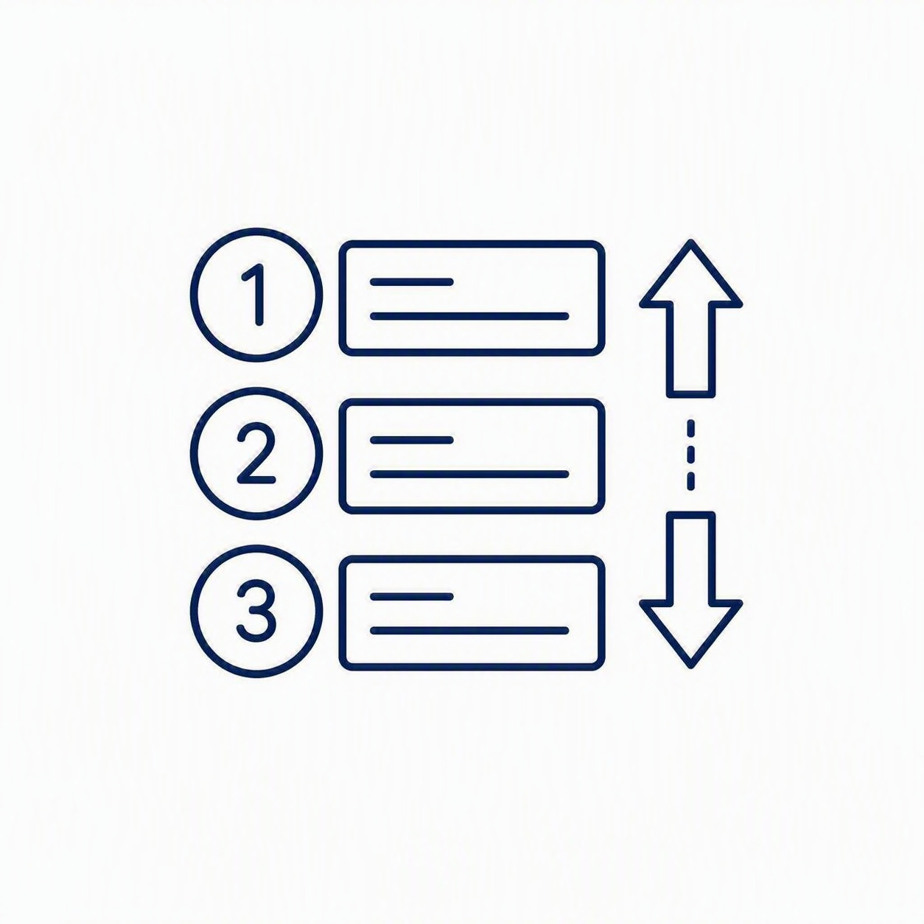

Vision for AI Usage Moving Forward
Support the Identification of Potential Solutions
Evaluate Solution Options (Surplus, IEE, Design Change)
Identify Proactive Bridging Strategies for Challenging Parts
Dynamic Prioritization of Obsolescence based on Plant Conditions
Helps Engineers Maintain Plant Documentation Accurately with High Quality
• Identify Affected Documents, including discovery of obscure references
• Ensure Procedural Alignment

Slide 5




Practical IEE Use Case
Scenario: Outage-Critical IEE Over the Weekend
Work Order identified an unexpected component failure
Emergent replacement of electrical equipment needed
Limited SME availability (weekend / off-hours)
Junior engineer assigned critical IEE
Bottom Line: Outage delays have real business impacts related to cost, labor, materials, etc. Utilities need solutions that minimize or mitigate risk.

Slide 6
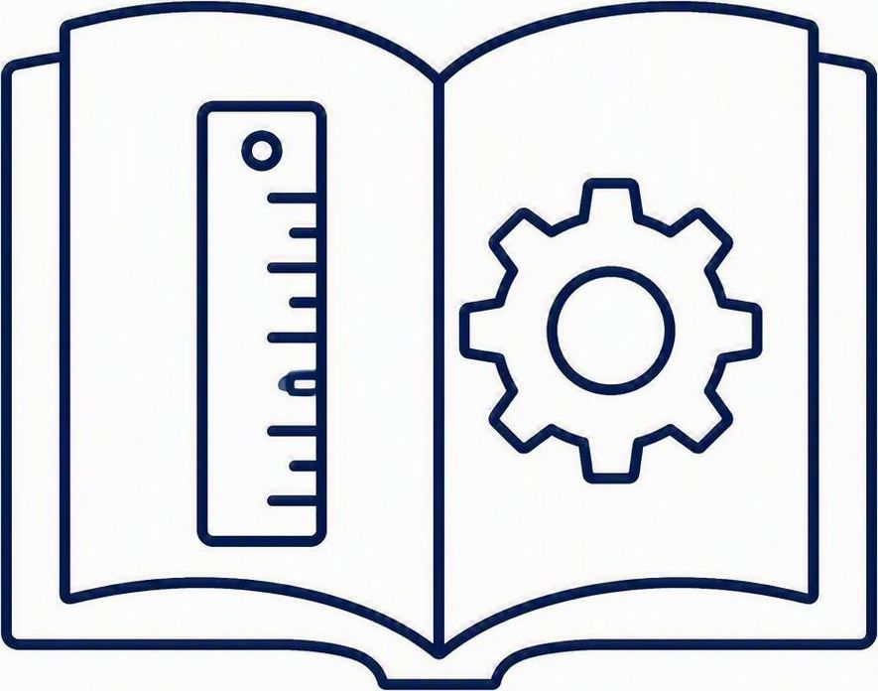




Practical IEE Use Case (Cont.)
AI-Assisted Workflow Key steps AI can assist with in an Item Equivalency Evaluation
Reference Guidelines & References
Gather & Summarize Documentation
Identify Requirements & Characteristics
Site-specific and industry guidelines and references
Vendor documentation gathered and condensed
Including drawings, calculations, and specifications
Compare Original vs. Replacement
Draft Evaluation Content
Flags options that implement fastest — lead time and effort
Prepared for engineering review

Slide 7





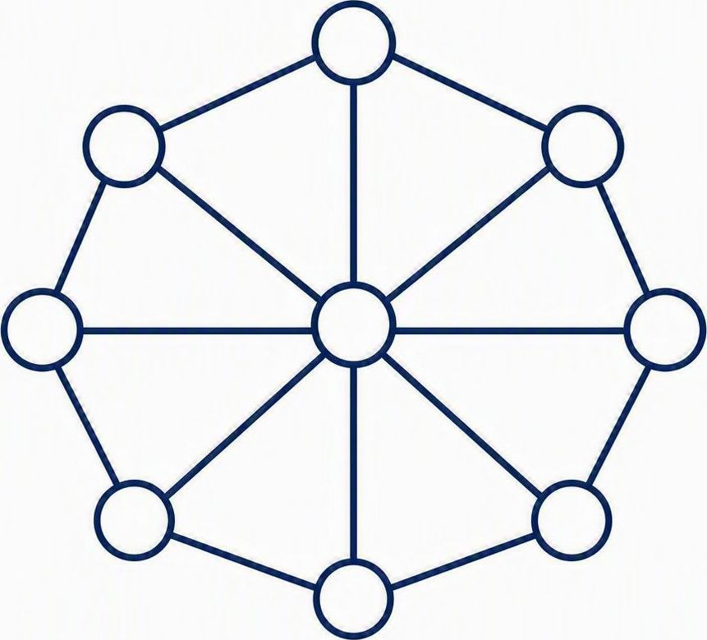
What “Good” AI Looks Like in Nuclear
The most trusted AI behaves less like a search engine and more like an engineer that shows their work.
Traceability
Context Awareness
Transparency
Shows sources and references that can be independently verified
Understands the engineering task, system, and documents in play
Explains where information came from and how conclusions formed
Accuracy Over Confidence
Collaboration
Knowledge Integrations
Admits uncertainty rather than guessing
Supports iterative dialogue instead of requiring perfect prompts
Connects information across multiple data sources

Slide 8

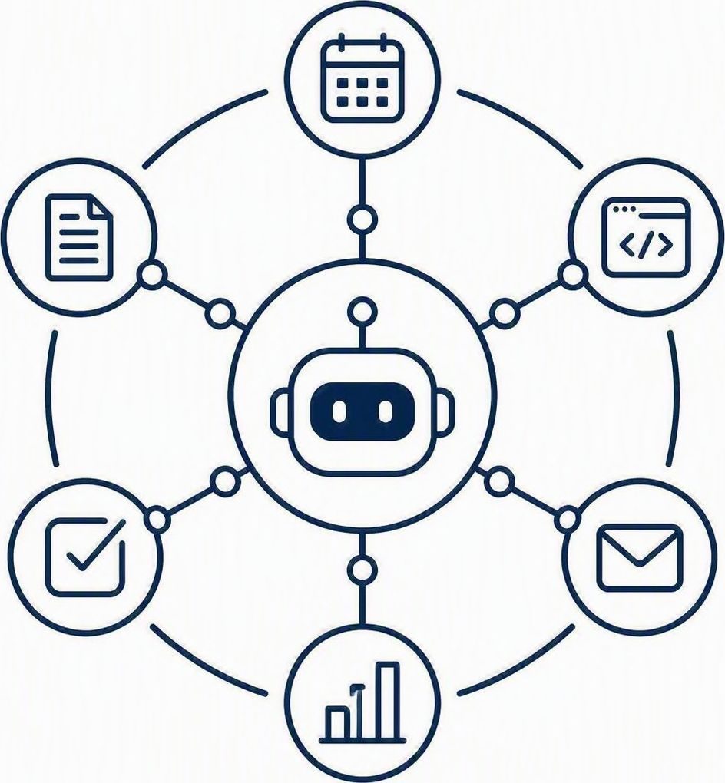
From Assistants to Agents
Chatbot Limitations
With the Right AI Foundation, Agents Can Be Built
Reactive → requires constant prompting
From answering questions → completing tasks
Engineer drives every step
From assisting → orchestrating workflows
Inconsistent outputs if poorly prompted
From reactive responses → proactive guidance

Slide 9
How an IEE Agent Works
1
2
3
4
5
Understand the Task
Break Into Steps
Select the Right Tools
Synthesize Sources
Iterate to Output
Reads the request and the engineer's input & context
Decomposes the IEE into a structured to-do list
Skill files, research, evaluation, workspace & human-in-loop
Document ingestion and deep analysis across knowledge bases
Drafts a reviewable IEE in an editable document workspace
Agent orchestrates tools to present a drafted IEE to the user.

Slide 10
Full AI-driven Obsolescence/IEE Capabilities
Full IEE Workflow
Screening
Is an IEE required?
Determine Approach
Short vs. long form
Evaluate
Characteristics & comparison
Generate
Structured IEE output
Beyond the Foundational Use Case — known original + replacement
Original Only
Multiple Options
No Replacement Yet
Generate requirements and critical characteristics to qualify a replacement
Compare candidate replacements and recommend the best fit
Search industry sources and documentation to identify viable replacement options

Slide 11




Big Picture
From Obsolescence Management to Engineering Intelligence
Engineering Data
Documents & Vendor Info
Industry OE
Enterprise Systems
AI Agent — an intelligence layer across every source
Issue Identified
Obsolescence flagged
Analyze
Data, documents & options
Identify Solution
Availability & lead time
Generate Docs
Engineering output for review
Why it matters
Faster resolution of critical issues
More consistent, high-quality evaluations
Better decisions with less effort

