Slide 1
2026 CMBG
Configuration Management Benchmarking Group
Maintaining an Effective Technical Conscience in CM
Zack Wei
Senior Evaluator
Engineering & Equipment Reliability
INPO

Slide 2
2026 Top Priorities
Recover low-performing stations.
Accelerate industry sustainability.
Operationalize new nuclear growth strategy.
Transform the National Academy for Nuclear Training (NANT).
Advance generative AI.
Execute WANO-AC membership changes.
Notes:
The INPO Top Priorities is a list of goals that INPO will concentrate on for a given year. Each year, INPO leaders comprehensively review the top priorities for the current year and upcoming year at the Senior Leadership Team (SLT) off-site planning meeting in April. These discussions are driven by input and data from industry, INPO, economic and international performance information, resource needs and impacts to the industry. As goals are met and momentum sustained, older Top Priorities are sunset and new priorities, requiring additional focus, are added. The top priorities are then displayed around the building and used to focus conversations, behaviors and actions going forward.
In today’s presentation, I will talk about priority 1, 3 & 5.

Slide 3

Recover low-performing stations.
Consequential events impact overall industry performance.
INPO is implementing actions to improve risk management
Advance plant reliability and embed proficiency-related standards across the industry.
(Ref: INPO 15-005, INPO 15-011, INPO 24-001)
Notes:
Low-performing stations remain, including some with chronic challenges. These gaps continue to drive consequential events and impact overall industry performance.
INPO is implementing actions to improve risk management, including issuance of a revision to INPO 15-011, Principles for Excellence in Integrated Risk Management, and INPO 15-005, Leadership and Team Effectiveness Attributes.
We are also working to advance plant reliability and embed proficiency-related standards across the industry.
Proficiency INPO 24-001. Proficiency – Advancing Human and Organizational Performance

Slide 4
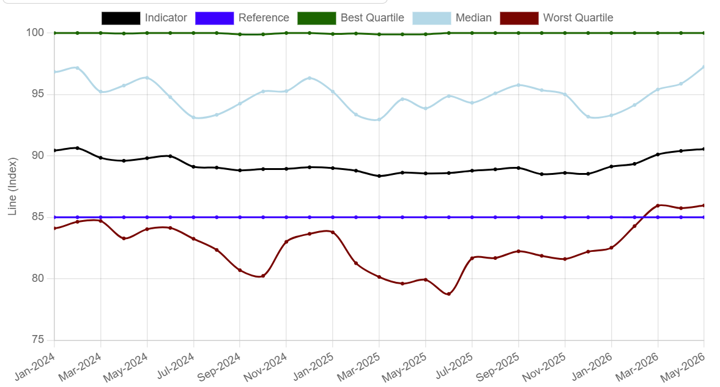
WANO Performance Indicator Index
(All WANO-AC Units)
Notes:
We are at 90.56 based on May 2026 report. Performance is improving, with the implementation INPO 24-001 proficiency, 15-001 risk management.
Industry major projects have impact to the overall performance. We will discuss more about in the Nuclear project slide.

Slide 5
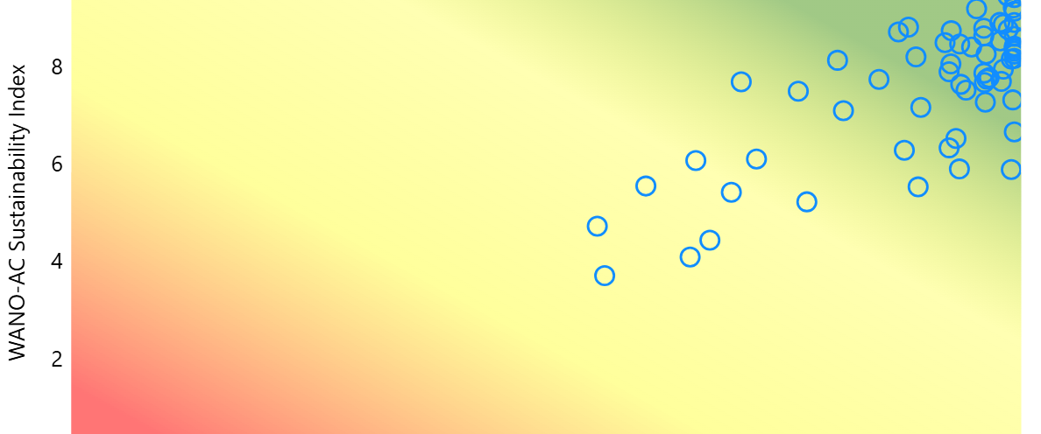
WANO-AC Heat Map
Notes:
More than half of the industry is not sustaining high performance, with cyclic performance trends continuing to challenge long-term success.
Based on the effort, majority of station is at the right upper corner.

Slide 6
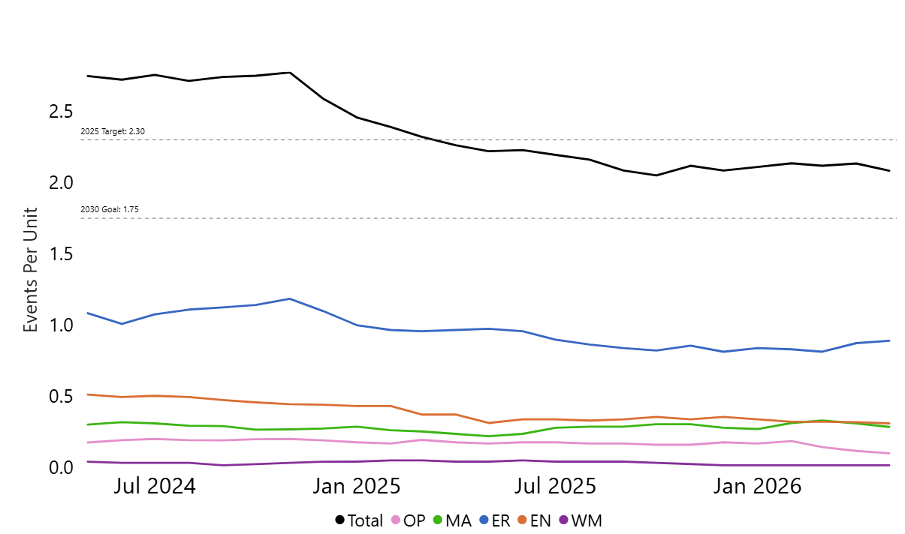

Industry Total Consequential Events
Notes:
Total index is 2.08 from May 2026 report. ER and EN are high contributing to the consequential events. Engineering consequential events rate is higher than Ops and Mtce.. Vendors collaboration, Vendor level of proficiency can cause a consequential events in engineering and design. INPO 26-001 Attributes for Effective Nuclear Supplier Performance and Utility Partnership.

Slide 7
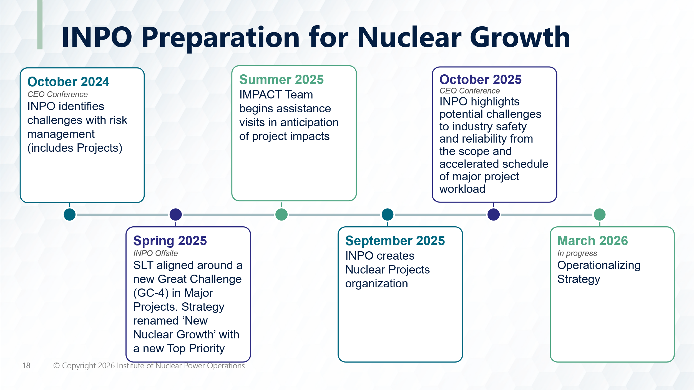
Notes:
In 2026, INPO shift focus to Operationalizing Strategy on new nuclear.

Slide 8
Operationalize new nuclear growth strategy.
Shifts role in supporting industry growth and complex project execution.
Define standards for large project execution.
Perform large project review pilots.
Apply lessons learned from recent restarts.
Execute a comprehensive communications plan on new nuclear and project management.
Notes:
With the framework for major project support established, the focus in 2026 shifts to operationalizing INPO's role in supporting industry growth and complex project execution.
This includes working with industry members to define standards for large project execution, develop onboarding methods for new reactor technologies and members, perform large project review pilots, apply lessons learned from recent restart efforts, and execute a comprehensive communications plan on new nuclear and project management.
Design phase. Conceptual design requirement-scope definition-detail design 30-60-90 review-commissioning-in service procedure-PM-OPM…

Slide 9
Major Capital Projects
Define the standards for executing large projects.
Develop a method to onboard new reactor technology.
Perform large project review.
Support new reactor licensing pathways.
Apply lessons learned from the Palisades restart to support other restarts.
Execute a thorough communications plan on new nuclear
(Ref: INPO 26-001)
Notes:
Our great challenge for major project support in the new nuclear growth strategy is in place, and we are defining the standards. Through the end of 2026, we will continue to operationalize the strategy and establish how INPO will support extended power uprates, complex digital modifications and new plant builds. As part of the operationalization, we are also aligning the roles of our technical departments, new nuclear construction and the nuclear projects group.
We support the building of a cohesive commercial nuclear community that works together to support all new entrants (owners, operators and suppliers).
INPOs operating model and workforce support achieving our mission for all commercial reactor types and their operating models.
In partnership with the industry, we engage during all phases of deployment to ensure new plants strive for the highest levels of safety, reliability, and predictable delivery.
Major capital projects are successfully executed.
INPO 26-001 Attributes for Effective Nuclear Supplier Performance and Utility Partnership -Advancing Continuous Improvement Across the Nuclear Supply Chain
Suppliers and sub-suppliers play a vital role in shaping industry performance, and the need for strong supplier-utility partnerships increases as our legacy nuclear industry ages and simultaneously undergoes recapitalization in the form of license extensions, plant restarts, power uprates, and new nuclear construction. Today, safety and reliability performance of the industry is at an all-time high. But that performance can neither be taken for granted nor has such a confluence of major projects and new construction occurred concurrently in our history. To succeed in meeting the challenges of this unprecedented future, both suppliers and utilities must embrace these principles as true strategic partners.

Slide 10

Advance generative AI.
Broaden and finalize AI governance and an associated framework for AI implementation.
Improve proficiency via role-based training and other learning capabilities.
Assess our structured and unstructured data and information for AI-readiness.
Deploy Claude and other INPO-approved large language models.
Operationalize NIVA, the nuclear industry generative AI application across WANO-AC.
Notes:
The establishment of a corporate great challenge around generative AI will bring focus to the adoption of generative AI across INPO. Currently, the workforce leverages generative AI primarily via Microsoft Copilot; however, opportunities exist to strategically leverage more advanced generative AI tools (e.g. Copilot Studio agents and higher-capability models) to optimize processes, increase efficiency and enhance collaboration with our members. Activities in 2026 will include the following:
Use Microsoft Copilot to streamline processes, identify trends or issues through unstructured data reviews.
Develop advanced AI models to help our members identify and manage risk.
Deploy predictive analytics to Continuum Viewer.
Evaluate the expansion of the nuclear industry generative AI application across WANO-AC.
Reduce workload for our staff by automating routine tasks
NIVA is main talk about

Slide 11
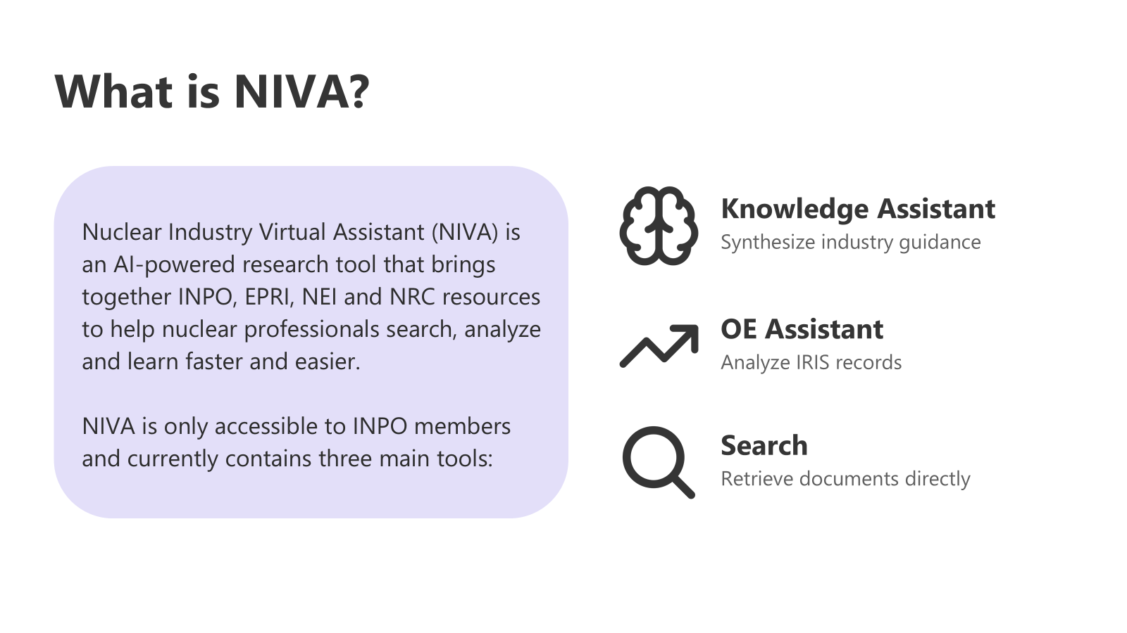
Notes:
The establishment of a corporate great challenge around generative AI will bring focus to the adoption of generative AI across INPO. Currently, the workforce leverages generative AI primarily via Microsoft Copilot; however, opportunities exist to strategically leverage more advanced generative AI tools (e.g. Copilot Studio agents and higher-capability models) to optimize processes, increase efficiency and enhance collaboration with our members. Activities in 2026 will include the following:
Use Microsoft Copilot to streamline processes, identify trends or issues through unstructured data reviews.
Develop advanced AI models to help our members identify and manage risk.
Deploy predictive analytics to Continuum Viewer.
Evaluate the expansion of the nuclear industry generative AI application across WANO-AC.
Reduce workload for our staff by automating routine tasks
NIVA is main talk about

Slide 12
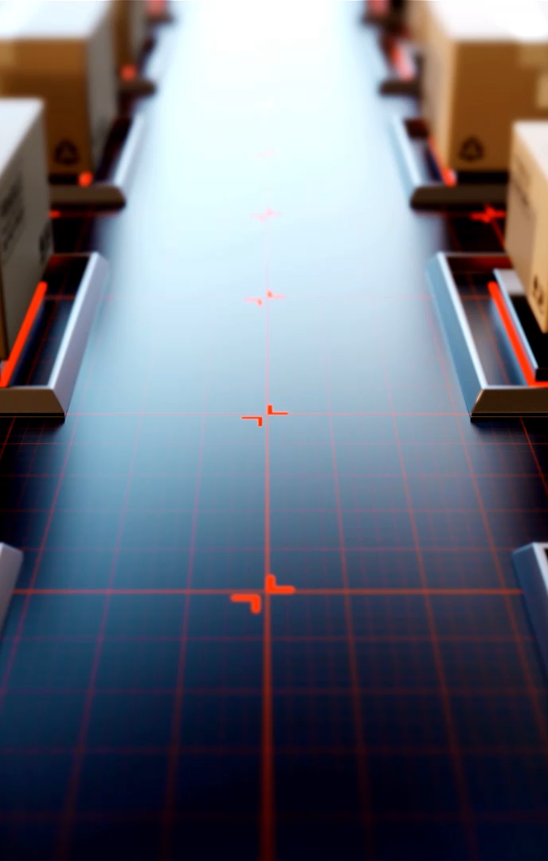
Engineering Fundamentals
Engineering personnel apply the essential knowledge, skills, behaviors and practices needed to ensure equipment performs as required, the plant is maintained within design requirements, performance trends are analyzed, margins are controlled, and the plant is operated safely and reliably.
(Ref: INPO 10-005)
Notes:
Monitoring & evaluate-monitor SSC performance. Evaluate operational data provide input to mtce and operations.
Operate, Maintain and Modify in a Controlled Manner. Maintain design basis, protect design margins, document plant modifications and deliver engineering changes.
Communicate, Advise and Advocate. Using engineering directions, engineering advise and information to support safe operation. Raising concerns and elevate issues for timely resolution.
Acquire and Maintain Expert Knowledge. Performing training and continue learning to improve knowledge and maintain codes and standards applications.
Critical Thinking, Decision-Making and Challenging; valid assumptions, verify engineering work with rigors.
INPO # 10-005. Principles for maintaining an effective Technical Conscience.

Slide 13
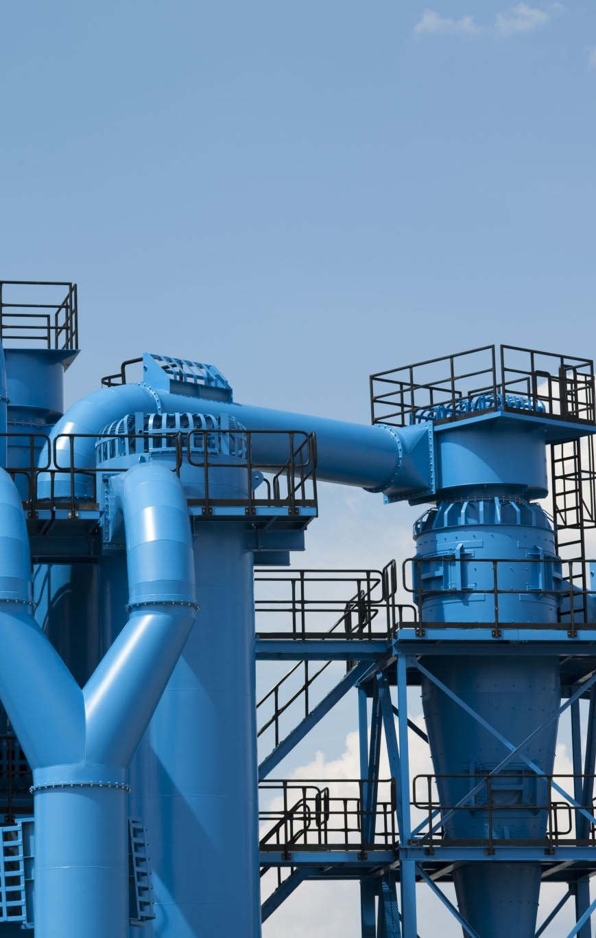
Design Change Processes
Changes to plant configuration, design and licensing bases are evaluated, controlled, tested and implemented while consistency is maintained among the physical plant configuration, design and licensing requirements, and the documented plant configuration.
(Ref: INPO 15-011)
Notes:
Risk based design change and modification processes ensure risks on nuclear safety, personnel safety, environmental safety and industry safety, production safety, equipment safety are assessed and ranked. Risk management INPO 15-011 Principles for Excellence in Integrated Risk Management

Slide 14
Recent CM Consequential Events
Design Margin
Plant Status Control
Design Equivalent Change
Design Configuration Control
Documentation and vendor oversight
Notes:
The following slides are issues identified in the peer reviews or from industry report data.
Recent CM consequential event

Slide 15
Operational Margin Control issues
Engineers did not account for aggregate system margin and component environmental
Limitations
Inadequate design limit control in design change
Reactor down power to 89 percent.
Notes:
Engineers did not account for aggregate system margin and component environmental limitations in a low-pressure heater drip pump (LPHD) transmitter replacement design change. This caused two LPHD pumps to trip offline when returned to service, resulting in a downpower to 89 percent.
Format following as strenghth

Slide 16

Plant Status Control issues
Maintenance and operations technical workers did not restore engineered safety feature following maintenance.
Maintenance failed to follow procedures
Operations failed to perform field verification
Level 2 plant status control event
Notes:
Maintenance and operations technical workers did not restore engineered safety feature (ESF) 4160-volt fuses following maintenance. This resulted in ESF 4160-volt degraded voltage relays being rendered inoperable for over a month and a level 2 plant status control event. Technicians did not follow configuration control procedures, and operators did not verify degraded voltage relays were properly restored.

Slide 17

Design Equivalent Change Issues
Engineers do not fully evaluate some design equivalent changes for adverse impacts to operation.
No fatigue prevention recommendations for weld techniques.
Extended unit shutdown for repair
Notes:
Engineers did not apply fatigue prevention recommendations for weld techniques during a design equivalent change. This resulted in a through wall leak on a weld for a unit’s safety injection tank vent line and an extended unit shutdown for repairs. Contributing, engineering managers did not ensure the potential consequences of the design were understood and communicated.

Slide 18
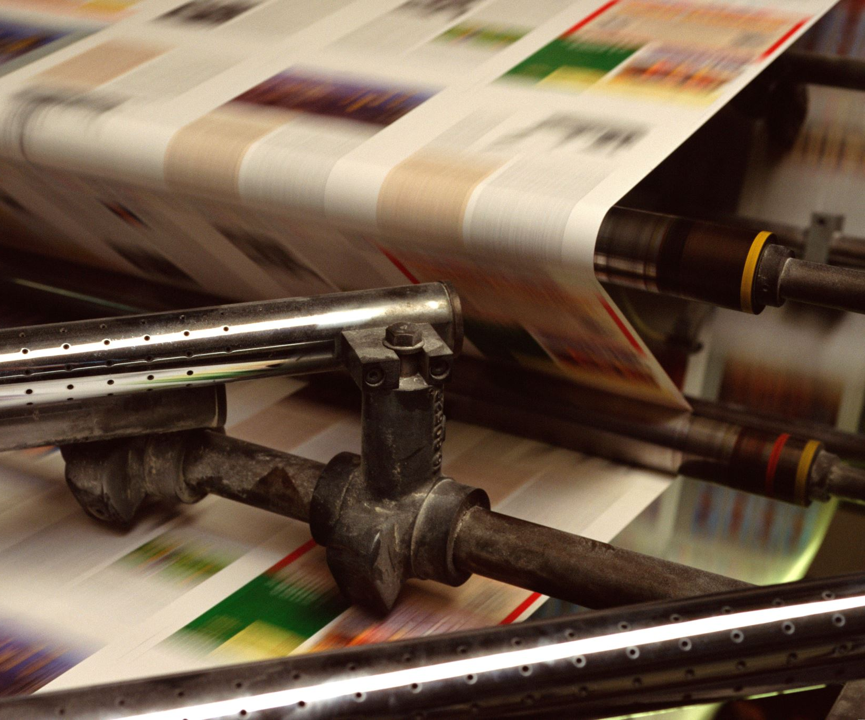
Design Equivalent Change Issues
Inadequate engineering instruction in work order
Impact to emergency diesel operability
Notes:
Engineer did not coordinate with planners and ensure precautions to tag open a pressurizer heater breaker were incorporated into work order instructions during a design equivalent change. This had the potential to impact the operability of the emergency diesel generator due to loading margin. Contributing, engineering managers did not provide oversight to ensure critical aspects of the modification were implemented.

Slide 19
Inadequate Configuration Control in Design
Design deficiency in feedwater check valve
Design deficiency in pipe layout
Excessive chattering of check valve
Locking shim enter into steam generator (SG)
SG tube leak caused by FME.
Notes:
Inadequate configuration control of the locking shim in the feedwater isolation check valves resulted in a broken shim (FME) entering into the steam generator. This caused tube leaks and shutdown the reactor. In addition, the inadequate feedwater flow profile (pipe layout) through the check valves causing excessive valve chattering and impact stresses on the valve hinge and cap screws.

Slide 20
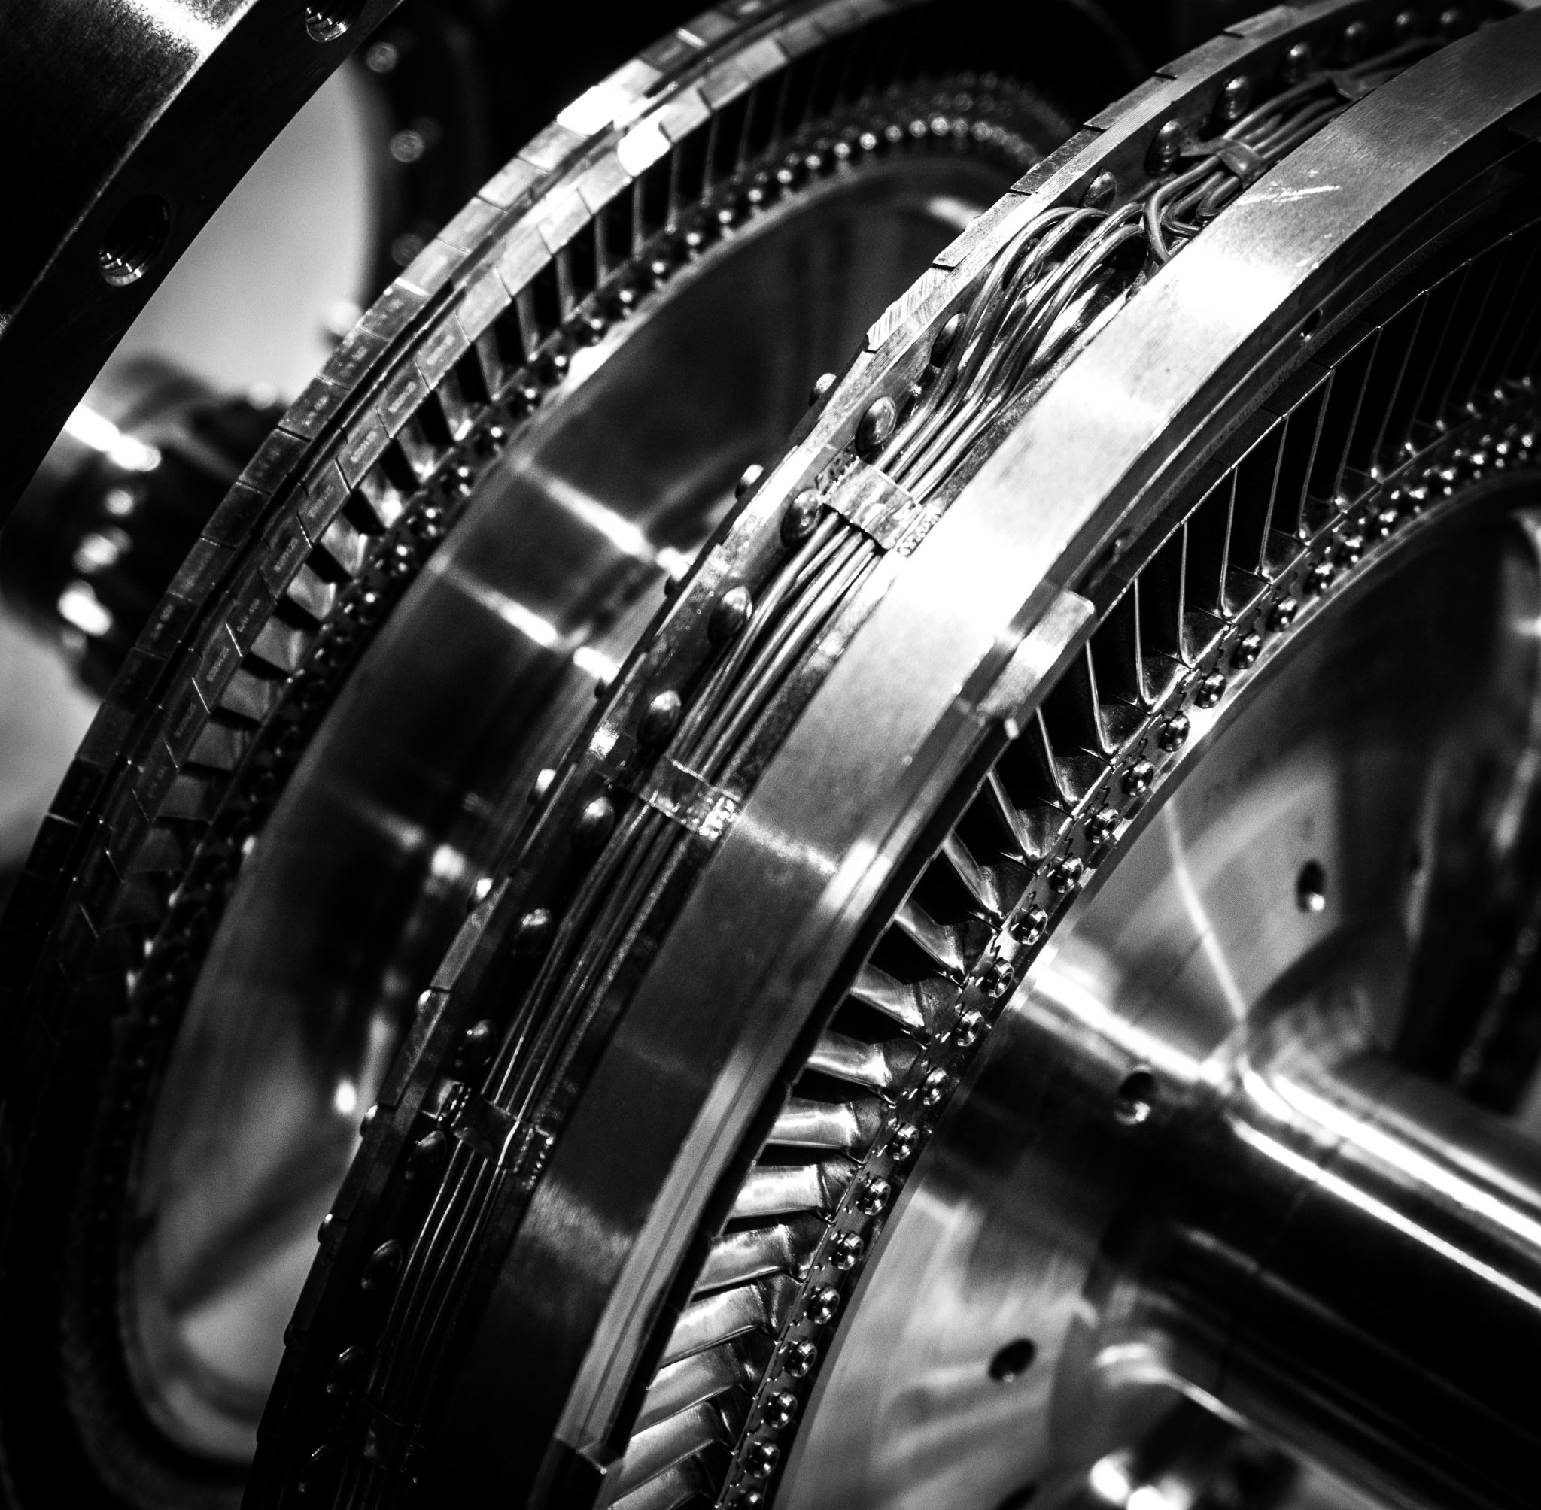
Document Management and Collaboration with Vendor
Vendor manual revised by design change but vendor controlled copy was not updated.
Thermocouple installed at the wrong location by vendor. Unintended ground path cause exciter bearing failure due to electrolysis
Reactor Manually Shutdown
Notes:
An exciter bearing failed resulted in manually removed turbine from service and manually shutdown the reactor. The bearing failure was due to electrolysis caused by an unintended ground path through a misconfigured thermocouple. A design change to eliminate this vulnerability with revising the vendor manual was incorporated in the plant-controlled copy. However, the same change was not incorporated in the vendor-controlled manual. This resulted in the bearing drain oil thermocouple was incorrectly installed by the vendor during refurbishment of the exciter.
Problem first then strenghtm
Vendor manual revised by design change but vendor controlled copy was not updated.
Thermocouple installed at the wrong location by vendor Unintended ground path cause exciter bearing failure due to electrolysis.

Slide 21
CM Industry Strength
High standards for stakeholder engagement have improved project and modification quality and plant reliability.
A corporate design guide outlines desired stakeholder engagement behaviors.
Outcomes:
0 engineering consequential errors in 2024-2025
delivered 177 design change packages
eliminated 127 single-point vulnerabilities
Notes:
Site design engineering managers and supervisors reinforce high standards for stakeholder engagement that have improved project and modification quality and plant reliability. Design quality improved from four engineering consequential errors in 2022 and 2023 to zero in 2024 and 2025, while delivering 177 design change packages and eliminating 127 single-point vulnerabilities.
A corporate design guide outlining stakeholder engagement behaviors is used by design and line managers and supervisors to reinforce these behaviors with the workforce, such as not accepting "no comments" from stakeholders involved with impact reviews.

Slide 22

CM Industry Strength
Design leaders have reinforced and maintained a zero-design document backlog for over 10 years.
Outcomes:
immediate issuance of plant configuration design document changes
eliminates manual interventions to control configuration management
Notes:
The design leadership has reinforced and maintained a zero-design document backlog for over 10 years. This allows immediate issuance of plant configuration design document changes following the implementation of a modification.
Additionally, this eliminates the need for manual interventions to control configuration management.

Slide 23

CM Industry Strength
Design engineering leaders implemented teaching and learning to improve design process proficiency.
Outcomes:
94% reduction in design product backlogs
maintained 0 overdue critical drawing updates
reduced configuration error risk and stabilized design workload
Notes:
Design engineering leaders implemented teaching and learning to improve design process proficiency, established a drafting internship program to build long-term strength, increased backlog visibility through real-time performance tracking, and improved engineering accountability behaviors. As a result, design engineers reduced design product backlogs from 519 to 33, a 94% reduction, between October 2025 and June 2026 while maintaining overdue critical drawing updates at 0 since November 2025. This reflects an improvement from carrying historically high backlogs to alignment with industry excellence, leading to reduced configuration error risk, stabilizing design workload, and allowing focus on critical station support.

Slide 24
Maintaining an Effective Technical Conscience in CM
All level of organization
Ownership and teamwork
Margin of safety in design
Rigors in technical review
Notes:
Technical conscience applies to all levels of the organization from senior corporate executives to individual contributors.
Ownership and teamwork are required on all nuclear professionals to act as a collective technical conscience for the station.
Margin of safety in design and operating limits must be included in the design requirements.
Insufficient technical reviews of plant condition, technically incorrect plant design changes, or improper justification and acceptance of degraded conditions must be eliminated.
INPO 10-005 Principles for maintain an effective technical consciences.

