Slide 1

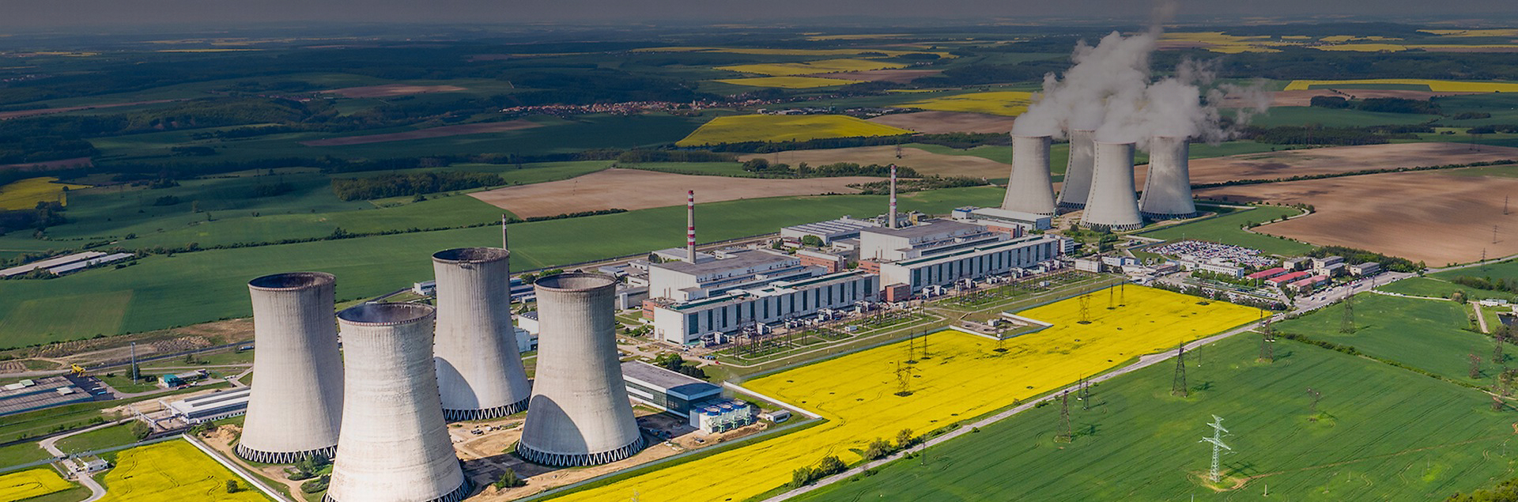
CM & CZ
Nuclear challenges and solutions
Jan Kundrlík
CM PM

Slide 2
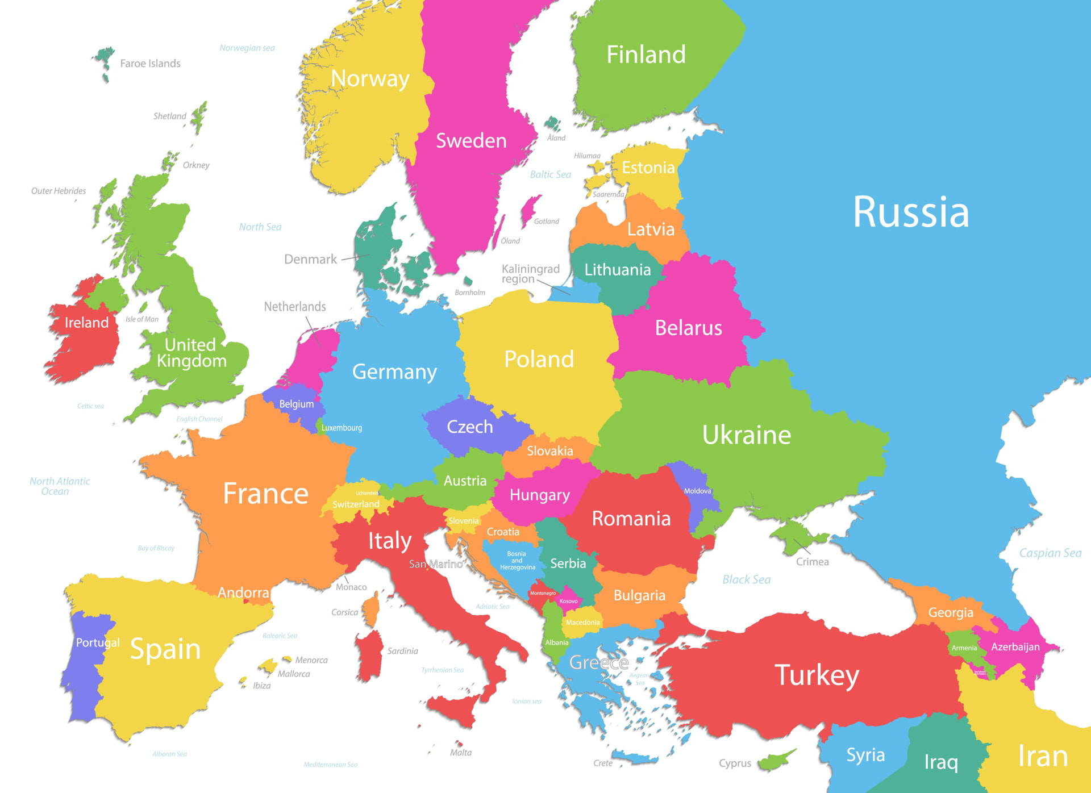

Slide 3
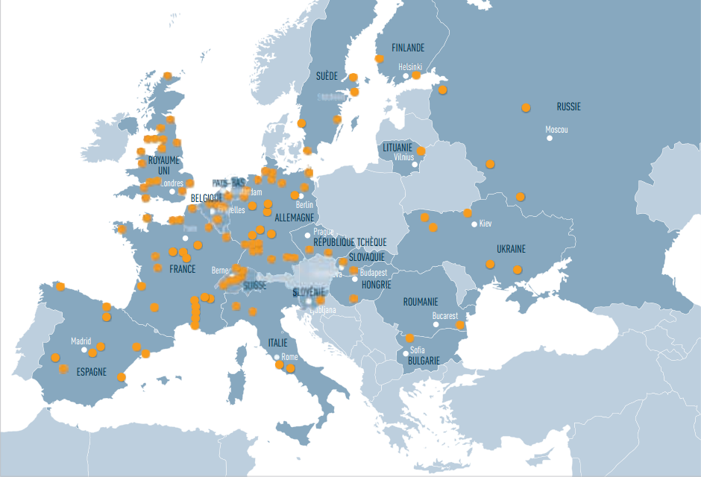

Slide 4
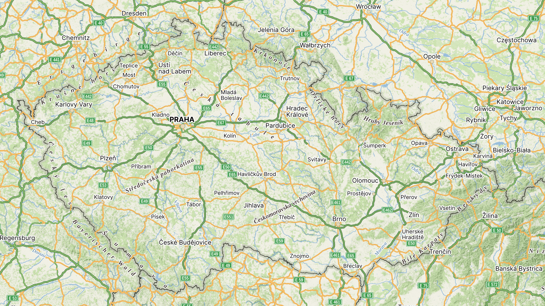

OPERATION
Temelín
PWR
2x 1100 MWe
2001 – present
Dukovany
PWR
4x 550 MWe
1985 - present

Slide 5
PLANNED
Temelín 2
APR 1000
2x 1050 MWe
2032 - 2040
Dukovany 2
APR 1000
2x 1050 MWe
2029 - 2039

Slide 6
SMR
6x 500 MWe
2034 – 2047
Tušimice
Dětmarovice
Temelín SMR
1x 500 MWe
2030 - 2037

Slide 7

TOTAL
Tušimice
Řež
Prague
Dětmarovice
Temelín
Dukovany

Slide 8
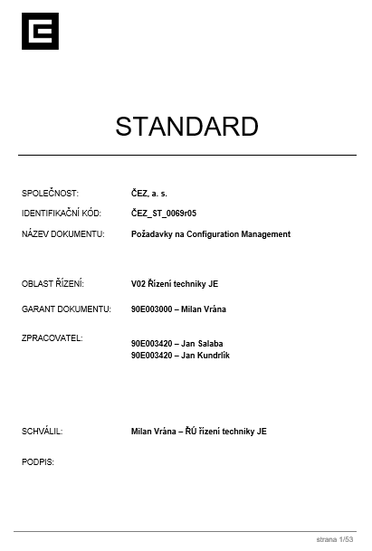
CM v ČEZ
CM

Slide 9
CM v ČEZ
Maintenance
CM
Trade
Operation
Quality
Safety
Training
Change management
Data management
Document management

Slide 10
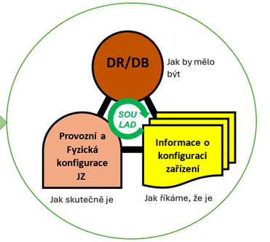
CM v ČEZ
Maintenance
CM
Trade
Operation
Quality
Safety
Training
Change management
Data management
Document management

Slide 11
Non - conformance
Assessment of the severity of the non-conformity
Temporary operation with non-conformity
Yes
No
Temporary repair
Yes
Setting criteria and time
No
Temporary configuration change
Yes
Modification
No
Permanent solution
Return to conformity.
(repair/replacement)
Permanent change
Equivalent
Document only change
Controlled defect

Slide 12
CM evolution in ČEZ
Reconstitution DBD
SW Tipom
Documentation standard
DokBot (AI) - pilot
Plant level
general designer
Plant level
historical
basic-design
System level
safety analysis
Equipment level
DBD
+
compliance with current status

Slide 13
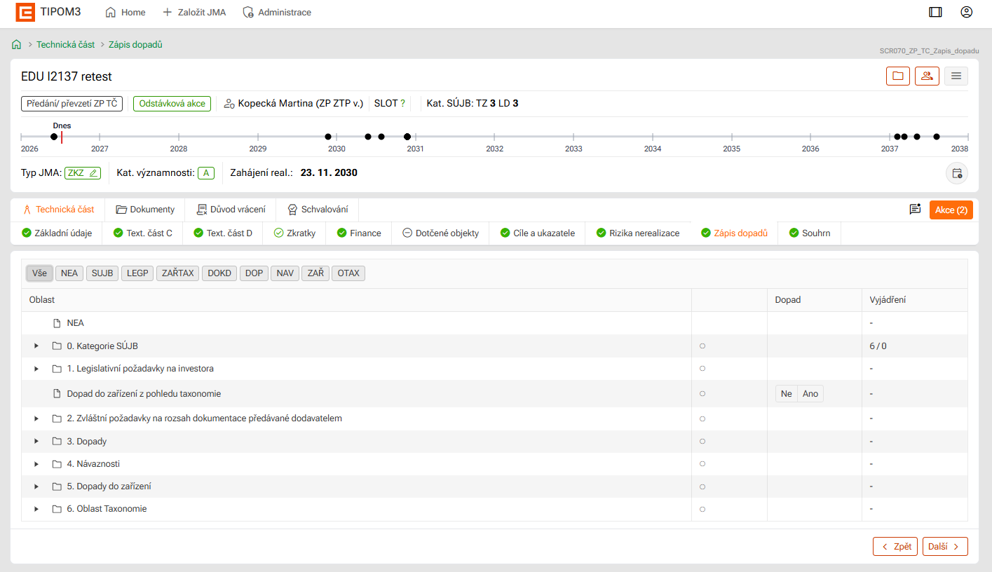
CM evolution in ČEZ
Reconstitution DBD
SW Tipom
Documentation standard
DokBot (AI) - pilot
CM
Financial management

Slide 14
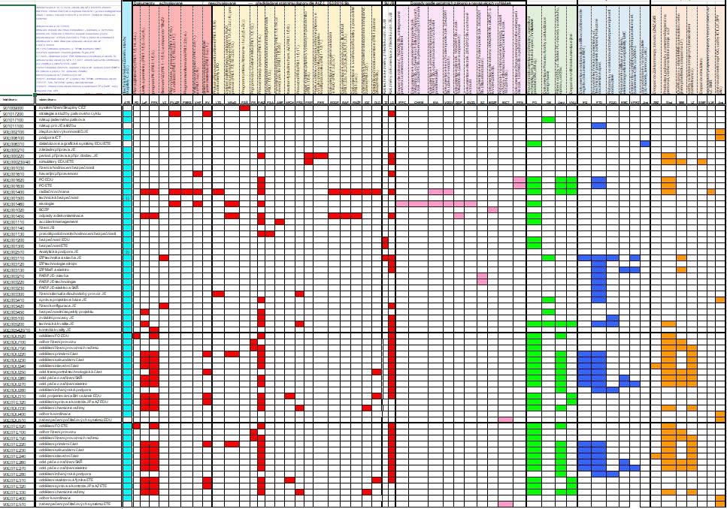
CM evolution in ČEZ
Reconstitution DBD
SW Tipom
Documentation standard
DokBot (AI) - pilot
Done by stakeholders managed by Design Change Engineer who is responsible for
conceptual design
preliminary impacts assessment
review & impact assessment comments close-out
    Comments to be implemented in Business Case (changing conceptual design)
    Comments to be implemented in other internal areas (D&D)
      Impacts to be addressed by the owner of the areas (D&D) or to be delivered by the project
    Declined or duplicate comments

Slide 15
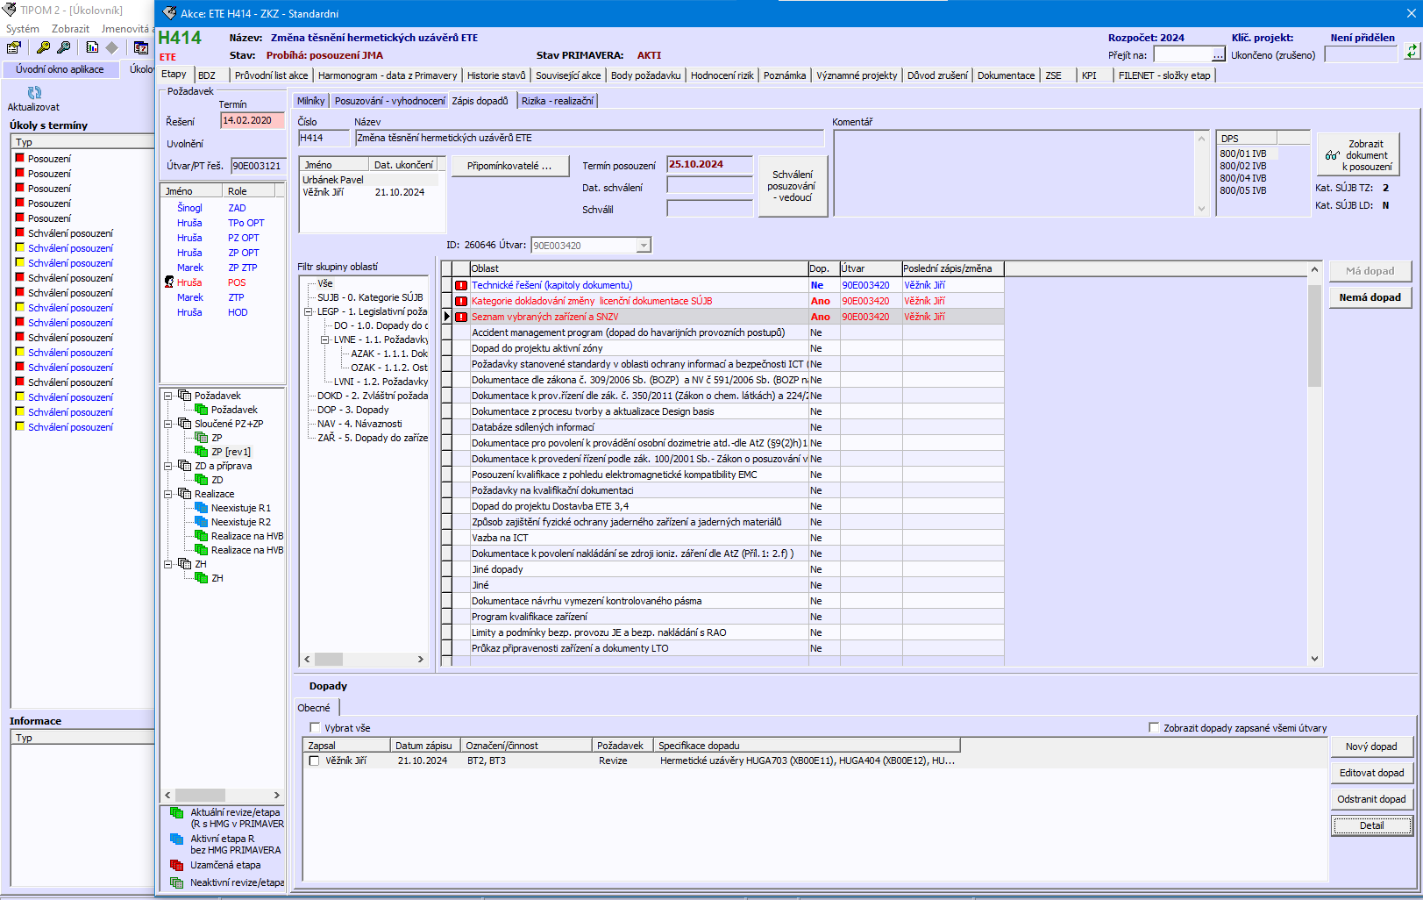
CM evolution in ČEZ
Reconstitution DBD
SW Tipom
Documentation standard
DokBot (AI) - pilot
Conceptual Design Comment?
Impact Y/N
(default: ???)
Areas to be commented on
Tasks (mods) to be reviewed
All Impacts in database form to be resolved

Slide 16
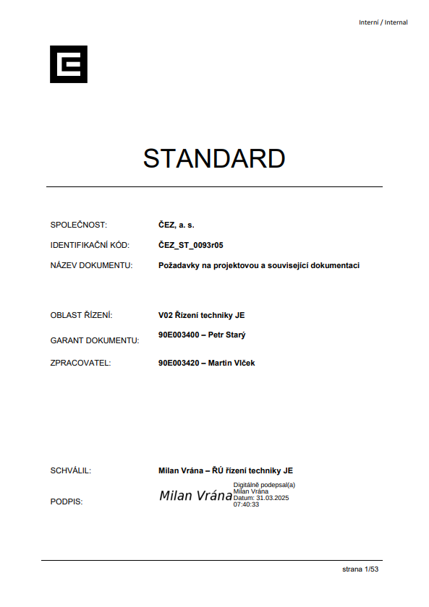
CM evolution in ČEZ
Reconstitution DBD
SW Tipom
Documentation standard
DokBot (AI) - pilot

Slide 17
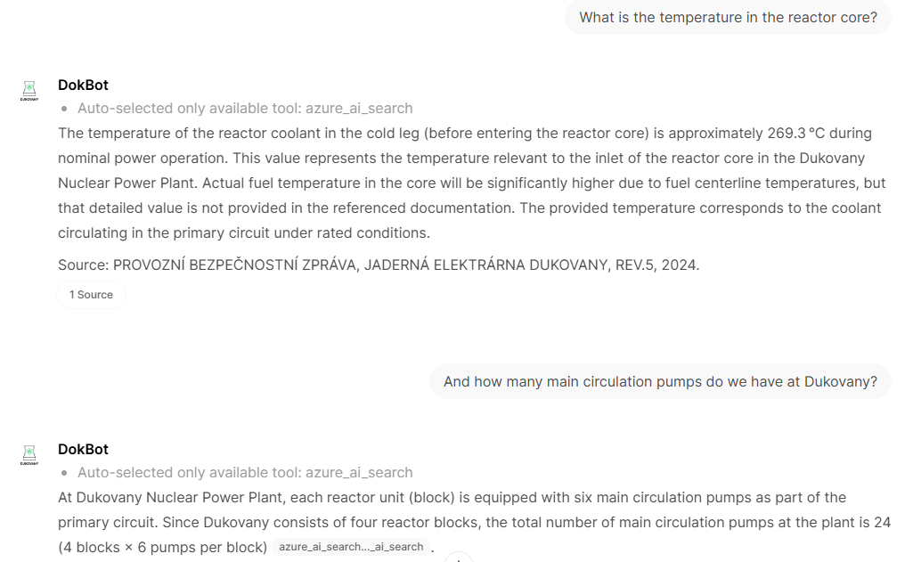
CM evolution in ČEZ
Reconstitution DBD
SW Tipom
Documentation standard
DokBot (AI) - pilot

Slide 18
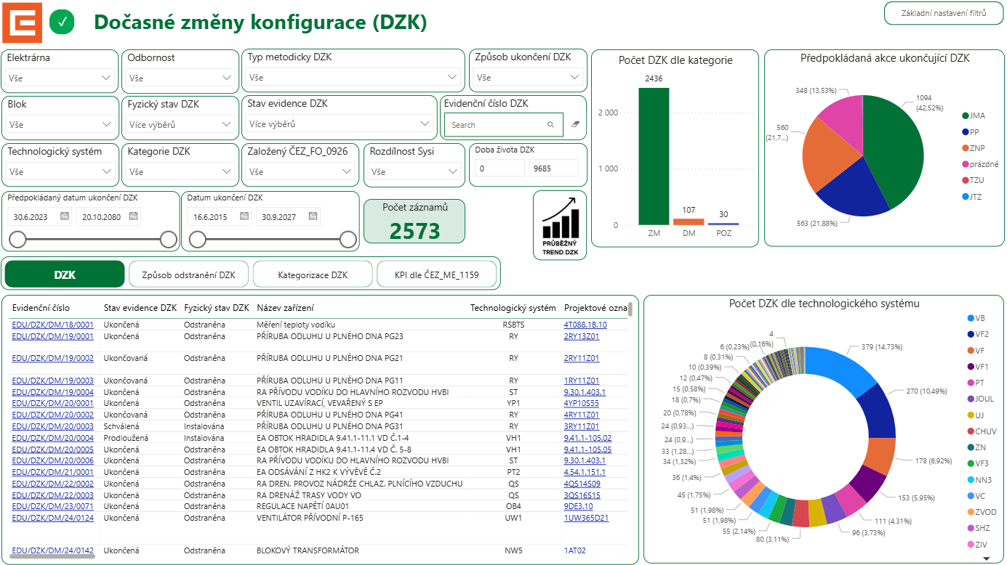
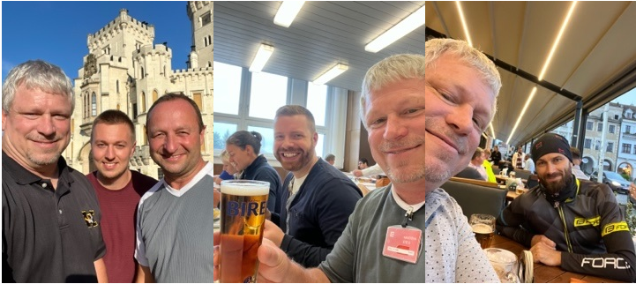
Standard
Design
Process
Gaps:
Commercial change
Critical documents
Margin management
TCC
T-mod
Responsible engineer & supervisor
Single Point Failure/
Single Point Vulnerability Review Process

Slide 19


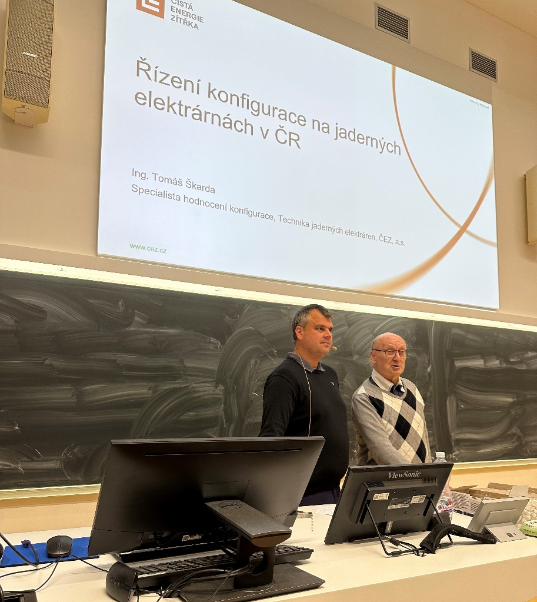
Configuration
Management
Textbook
Lectures for students
YouTube

Slide 20
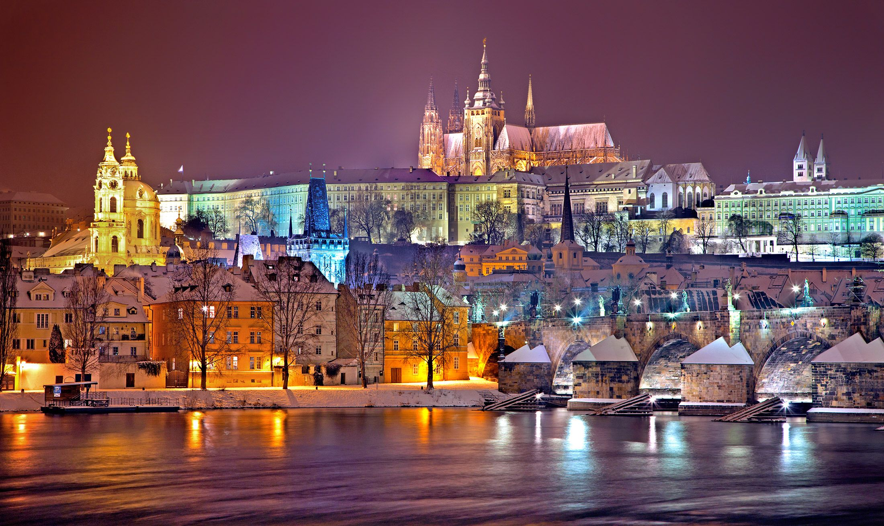
Thank you for your attention!
See you in Prague ☺

Slide 21
Back up

Slide 22
ČEZ Nuclear Division Organization Chart
Nuclear Power Division
Safety
Asset Management
Engineering
Quality Management
NPP Dukovany
NPP Temelín
Personnel Preparation
ICT Management
Engineering
Design Change Eng.
Project Management
Design Authority
Planning and Support
CM owner

Slide 23




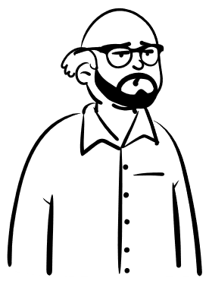

Standard for Design Documentation and Data
Another Lessons Learnt
Supplier A
Design doc
ČEZ Nuclear Division
automated D&D checks**
Supplier B
ČEZ
Standard for Design
Doc
Design doc*
Design doc
Supplier C
Design doc
* in required structure, format, with required data & metadata
** Example SW FME

Slide 24
Categories of technical changes
 | Description | Configuration change
O1 | Standard repair | No
O2 | Non-standard repair | No
O3 | Repair by changing the design documentation by changing the specific requirements for the equipment | Yes
O4 | Repair by changing the documentation - correcting errors in the documentation | No
V1 | Replacement of equipment with the same type designation | No
V2 | Replacement of equipment with an approved equivalent | Yes
M1 | Modification - reconstruction | Yes
M2 | Modification - modernization | Yes
M3 | Modification - construction modifications, superstructures, extensions, new buildings | Yes
M4 | Modification - liquidation | Yes

