Slide 1
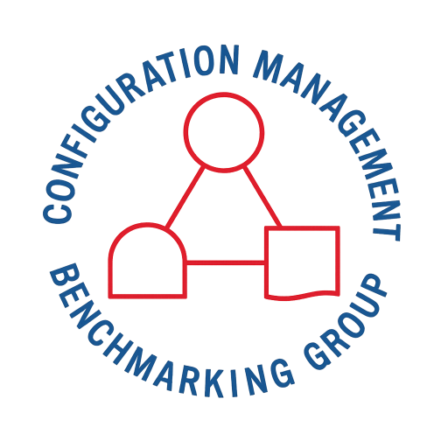
CMBG · ANNUAL CONFERENCE
2026 CMBG Panel Discussion
Configuration Management
Benchmarking Group

Slide 2

Do not edit
How to change the design
Join at slido.com
#3955635
The Slido app must be installed on every computer you’re presenting from

Slide 3
03
Design Development
These questions are general Configuration Management questions
SECTION 03 OF 05

Slide 4
What are your update requirements for critical drawings?
Join at slido.com
#3955635
Configuration Management Benchmarking Group
04

Slide 5
9
Do stations have issues with quality of Design Input; including DI with an Evaluation stating that it does not apply, having DIs to "do something" like complete an FMEA, DI that does not include a narrative value that is necessary to determine acceptability (like load)?
Join at slido.com
#3955635
Configuration Management Benchmarking Group
04

Slide 6
10
Do stations have issues with Evaluations; Evaluation not addressing everything in the DI or not addressing the DI at all. Evaluations including things that are not in the DI (possibly a missed DI), Evaluation that does not meet the DI with justification on why that is ok? Would your station consider these things acceptable?
Join at slido.com
#3955635
Configuration Management Benchmarking Group
04

Slide 7
11
Our current "issue" is Stakeholder engagement. Are other stations getting consistent, thorough, and timely Stakeholder engagement? What are stations doing to get engagement?
Join at slido.com
#3955635
Configuration Management Benchmarking Group
04

Slide 8
12
Do stations get inputs to the design from Stakeholders or mostly just impacts?
Join at slido.com
#3955635
Configuration Management Benchmarking Group
04

Slide 9
13
How do stations handle Stakeholders not attending a kickoff/conceptual/detailed/final meeting?
Join at slido.com
#3955635
Configuration Management Benchmarking Group
04

Slide 10
14
Do they have issues with Stakeholders not meeting milestones and not providing final CIRF (form 7) in timeframe requested to issue the EC?
Join at slido.com
#3955635
Configuration Management Benchmarking Group
04

Slide 11
15
Many nuclear plants struggle with disconnected data (e.g., procurement, maintenance, and engineering data). What strategies have been successful in creating a unified data environment that maintains CM control across these historically siloed departments?
Join at slido.com
#3955635
Configuration Management Benchmarking Group
04

Slide 12
16
What are some best practices for obtaining vendor information from OEMs to support design packages? Due to the amount of work ongoing in the industry, getting feedback from vendors on what seems like smaller orders aren't getting the priority needed to support the schedules that we are facing at the sites.
Join at slido.com
#3955635
Configuration Management Benchmarking Group
04

Slide 13
04
New Build
These questions are general Configuration Management questions
SECTION 04 OF 05

Slide 14
17
How are design authorities handling standard design documents that are applicable to multiple projects in multiple countries?
Join at slido.com
#3955635
Configuration Management Benchmarking Group
04

Slide 15
05
General
These questions are general Configuration Management questions
SECTION 05 OF 05

Slide 16
18
What are utilities hybrid and remote policies?
Join at slido.com
#3955635
Configuration Management Benchmarking Group
04

Slide 17
19
How do we transition the CMBG into resolving and leading the next set of industry challenges vs being reactive.
Join at slido.com
#3955635
Configuration Management Benchmarking Group
04

Slide 18
20
Number of TMODs reported through IRIS. We exclude power jumpers, leak suppression types. Do other utilities have other exclusions for TMODs reporting?
Join at slido.com
#3955635
Configuration Management Benchmarking Group
04

Slide 19
21
Monitoring Configuration Management Performance Objectives and Criteria (PO&Cs) - Industry best practices for the how - oversight/tracking? Use of AI to help?
Join at slido.com
#3955635
Configuration Management Benchmarking Group
04

Slide 20
22
How do you evaluate and correct discrepancies between as-built documentation and physical configuration to ensure alignment with Design Basis Documents?
Join at slido.com
#3955635
Configuration Management Benchmarking Group
04

Slide 21
23
How many months out from breaker-open is your "ECs Approved and issued" milestone? (PSEG's is 16 months, believed by Engineering to be unusually long, plus final interface review conflicts with staggered outages)
Join at slido.com
#3955635
Configuration Management Benchmarking Group
04

Slide 22
24
How have others approached the old 10/30/70/90/100% completion milestones relative to the SDP process.... For example, does anyone issue a rev a/b/c for partial completion prior to issue of Rev 0 as the 100% complete
Join at slido.com
#3955635
Configuration Management Benchmarking Group
04

Slide 23
25
Does anyone ( or everyone) require an EC to issue calc revisions?
Join at slido.com
#3955635
Configuration Management Benchmarking Group
04

Slide 24
26
Does anyone issue ECs with a solution statement, drawings, materials, etc for planning and scheduling development for outage milestone. Then finalize calcs as a pre-installation hold point? Or some similar example?
Join at slido.com
#3955635
Configuration Management Benchmarking Group
04

Slide 25

Completed
Configuration Management Benchmarking Group
www.cmbg.org

Slide 26
01
CM Information
These questions are general Configuration Management questions
SECTION 01 OF 05

Slide 27
1
The CMBG survival guide and other fine materials have been out for awhile, yet either people don't know about them or don't read them. How can we further disseminate this information to the upcoming nuclear workforce and mentor them through it better?
Join at slido.com
#3955635
Configuration Management Benchmarking Group
04

Slide 28
2
What is the path forward for complying with generic letter 90-03 (vendor document updates) due to the closure of Vendor Information Solutions Company?
Join at slido.com
#3955635
Configuration Management Benchmarking Group
04

Slide 29
02
Design Process Efficiencies
These questions are general Configuration Management questions
SECTION 02 OF 05

Slide 30
3
The CM project is for finding an easier (more time-effective) way to replace existing lighting with LEDs, using a different process than T-Mods for installing recorders/other monitoring equipment, and simplifying the drawing/documentation update process (make more efficient).
Join at slido.com
#3955635
Configuration Management Benchmarking Group
04

Slide 31
4
How is AI being utilized in the Configuration Management function at your utility?
Join at slido.com
#3955635
Configuration Management Benchmarking Group
04

Slide 32
5
How are others managing the configuration of 50.69 like-for-like changes and components approved with alternate treatments?
Join at slido.com
#3955635
Configuration Management Benchmarking Group
04

Slide 33
6
How is NISP-EN-04 and the EPRI DEG being implemented to capture best practices for digital modifications?
Join at slido.com
#3955635
Configuration Management Benchmarking Group
04

Slide 34
7
When providing a plant modification interfacing with a legacy system, do you bring the combined configuration up to the latest technology and design requirements?
Join at slido.com
#3955635
Configuration Management Benchmarking Group
04

Slide 35
8
DWG Change Process
Pre-Engineered Dispositions
Join at slido.com
#3955635
Configuration Management Benchmarking Group
04

Slide 36
Thank You
Configuration Management Benchmarking Group
www.cmbg.org

