Slide 1
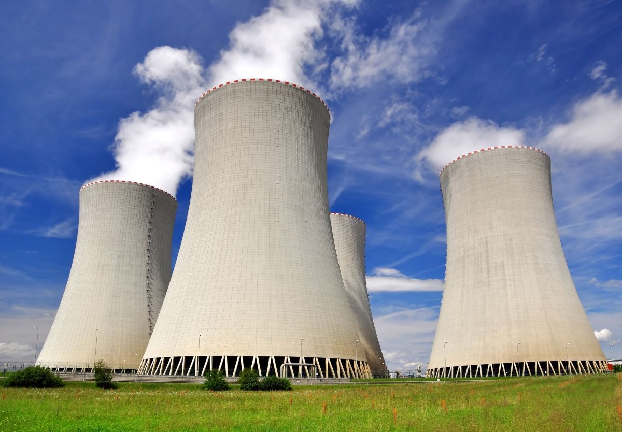
Nuclear Industry
Standard Design Process

Slide 2
Standard Design Process
Streamlined and standardized process that is intended to improve consistency, reduce costs, and maintain quality at a high level while upholding nuclear safety.
Allows for a graded approach via different package types in order to streamline project execution.
Created by the industry, for the industry, to maintain consistent configuration control.

Slide 3
Standard Design Process (SDP) Pop Quiz
What U.S. nuclear industry initiative did the SDP stem from?
Delivering the Nuclear Promise
In what year was the initial draft of the SDP created?
2016 Draft / 2017 Issued
Which four plants performed the initial pilot of the SDP?
Surry, McGuire, Vogtle, and Sequoyah
Who helps maintain the SDP Procedure IP-ENG-001?
Design Oversight Working Group (DOWG)

Slide 4
Standard Design Process (SDP) Pop Quiz
Name the eight (8) expectations for effective design changes that are necessary to support this process.
Effective Risk Management
Long Range Planning
Efficient Modification Management
Stakeholder Engagement
Vendor Engagement and Oversight
Rigorous Adherence to Configuration Management (CM) Principles
Thorough Post-Modification Testing
Effective Implementation

Slide 5
Effective Risk Management
Plant issues are thoroughly analyzed, planned and executed in accordance with the risk, importance to safety, and the potential impact to equipment reliability.
Risks should be coordinated and evaluated at the conception of the project all the way through implementation.
Risks should be tracked and discussed at all project team meetings.
All project team members should be engaged in the risk evaluation process to validate all risks are captured.

Slide 6
Long Range Planning
A proactive approach is taken for scheduling upgrades and addressing degraded conditions.
Overall goal is to avoid compromising quality and technical conscience by balancing the demand on resources including that from the vendors (both design and installers).
For complex modifications, strict adherence to modification planning milestones is crucial to project success.
When emergent modifications are required, additional measures should be implemented to address the increased risk of error.

Slide 7
Efficient Modification Management
A well-disciplined project management approach and strict adherence to milestones / objectives is applied by all involved parties.
Modification scoping is a critical phase in effective development and execution. This includes alignment with stakeholders on design, operating, and maintenance requirements.
Scope freeze is well defined and agreed upon by stakeholders and management. Early buy-in during the conceptual phase is crucial to project execution.
Modification milestones are clearly defined, communicated and agreed upon by all stakeholders, and tracked throughout project development.

Slide 8
Stakeholder Engagement
Senior Engineering Leadership should clearly communicate expectations to the organization to ensure effective and cross-functional support of the design process.
Stakeholder assignment should be based on skill sets required to provide an adequate review and identify impacts for their respective functional area. The stakeholder should be at a level sufficient in the organization to help make decisions on the scope and content of the mod.
Supporting organizations should assign personnel to ensure consistent, thorough, and timely stakeholder engagement. It is important that the same stakeholder sees the project from initiation to installation when possible.
Impact reviews are critical steps to engage stakeholder input and gain alignment on the approach. The stakeholders should leverage the key focus items listed in IP-ENG-001 when reviewing modification packages.

Slide 9
Vendor Engagement and Oversight
Utility and vendor leadership should be aligned and ensure that the interface and communication protocols are established at the beginning of the modification process. These should be monitored for effectiveness throughout implementation.
Routine communications should be conducted to facilitate open communication and understanding progress and performance.
A clear division of roles and responsibilities are established for both the utility and the vendor. This should be discussed and agreed upon at the Technical Pre-Job Brief.
Any deviations from the agreed upon plan should be communicated early and often to minimize project impact, cost, and schedule.

Slide 10
Rigorous Adherence to CM Principles
Leaders promote culture of healthy technical conscience and effective teamwork.
Responsible Engineers should understand and execute the cradle to grave concept of modification ownership.
Configuration changes are bounded by plant design requirements and applicable operating, design, and safety margins.
The design authority for all design activities is clearly defined, and interfaces are controlled to ensure coordination and clean configuration management.

Slide 11
Thorough Post-Modification Testing
Post-Mod testing is a critical final barrier to ensure changes to the plant have been designed and implemented correctly before release to operations.
Expand the scope of testing to detect modification installation errors and unintended failure modes and effects during anticipated operational modes and plant configurations.
Departments responsible for testing should select personnel based on knowledge and experience related to the complexity and risk of the mod.
Verify the testing program considers factory acceptance testing, on-site mockup testing, and post installation testing.

Slide 12
Effective Implementation
The responsible engineer should provide sufficient time in the field to ensure that the modification is implemented in accordance with the plan.
Implementers should have been involved with the modification development and the constructability reviews to ensure the modification can be effectively implemented.
Perform appropriate impact review meetings for configuration changes to allow for additional communication from stakeholders on challenges to getting the modification installed and mitigation plans in case risks are realized.

Slide 13
Process Overview Refresher

Slide 14
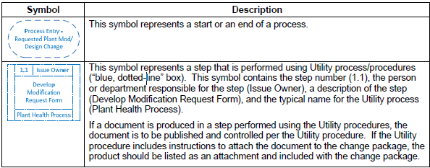
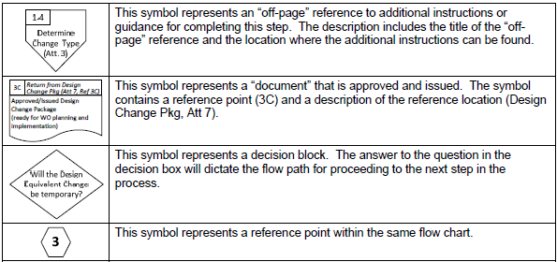
IP-ENG-001 Flowchart Conventions

Slide 15
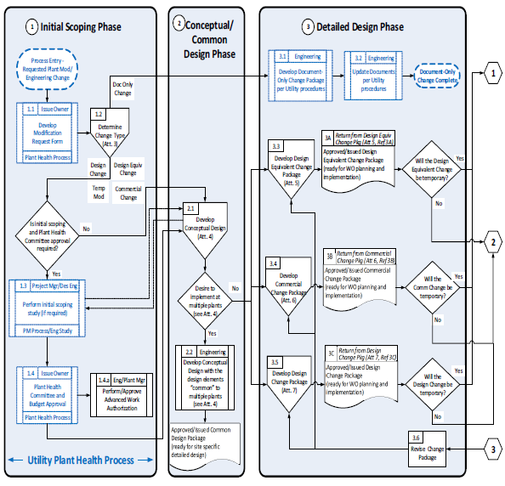
Standard Design Process Flowchart

Slide 16
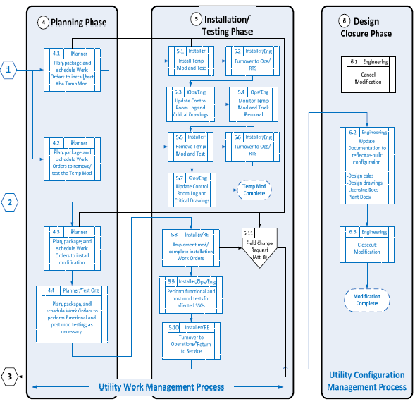
Standard Design Process Flowchart

Slide 17
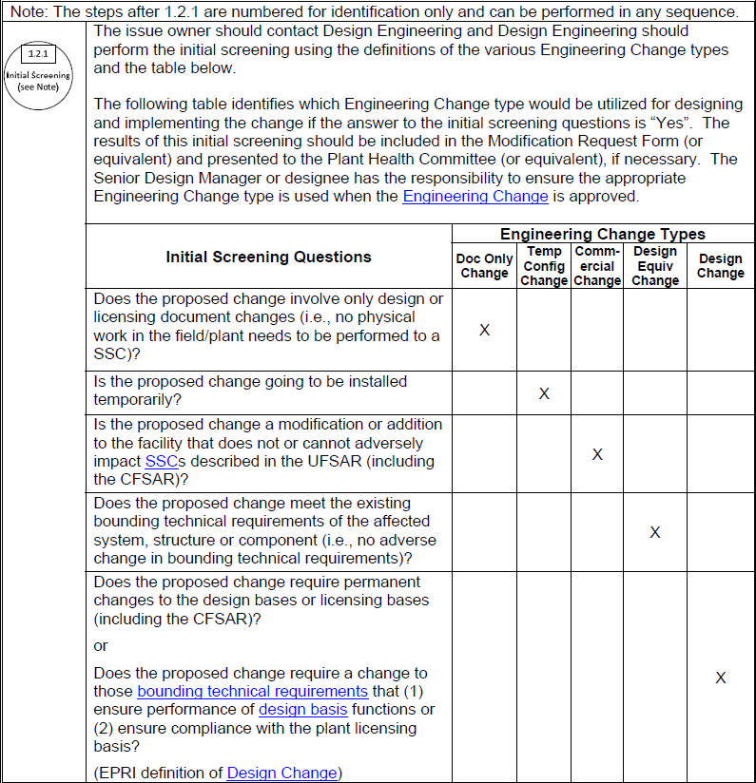
Initial Screening

Slide 18
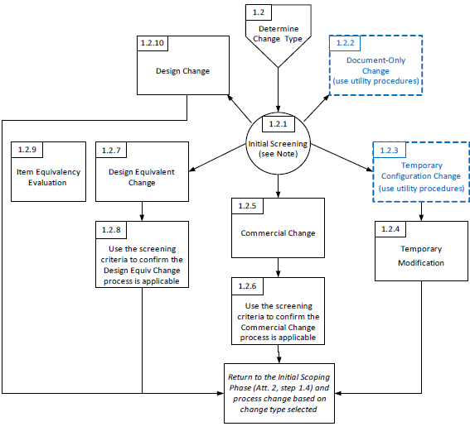
Engineering Change Types

Slide 19
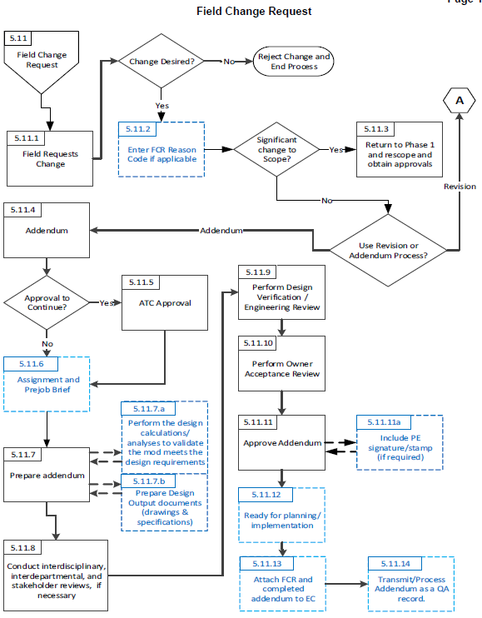
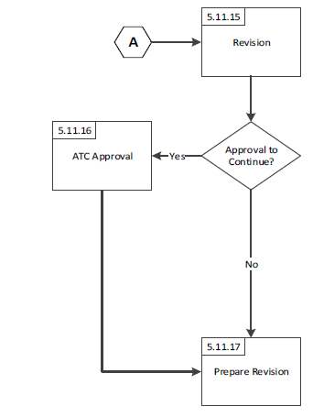
Field Change Request

Slide 20
Closing Remarks

