Slide 1
SDP – What Does Good Look Like?
Ashley Taylor
CMBG – July 2026
Notes:
If needed, the blue overlay can slide to the right to accommodate a longer title by clicking anywhere inside the shape and dragging. To avoid distorting the angle, do not stretch the shape by grabbing the handle.

Slide 2
My Background - Disclaimer
Senior Manager for TVA Sequoyah Fleet Design
Part of founding group for SDP & DOWG – Regional Conferences, Training, Change Management, Former DOWG President
What good looks like is somewhat subjective and dependent on your standards and expectations

Slide 3
Agenda
Existing Tools
Problem and Solution Statements vs Description of Change
Design & Licensing Evaluations
Parent and Child Package Concept
Open Items
Special Implementation Instructions & Testing Requirements
Attachments

Slide 4
Existing Tools
DOWG Community Page Examples
  DOWG Files -> Pilots -> 3 – Pilot Stations
Resource Manual Rev 1 (6/10/21)
  DOWG Files -> Procedures -> Latest Revisions
  May need update
CMIS Sharing Request
  Must have CMIS
  Can search for any already shared ECP
  Can request any ECP
Utility Specific Resource Manual
  Consider your own
CMBG & DOWG Network
  Ask your CMBG or DOWG rep to get examples from other utilities
  Request on DOWG Community page
  May depend on contract with EOC
  Proprietary, PII, or Safeguards info will not be shared
  Nuclear export guidelines from INPO & EPRI will be followed

Slide 5
Problem and Solution Statements
vs
Description of Change

Slide 6
Problem/Solution vs Description of Change
Problem states only the problem (section A)
  Object, Defect, Consequence
  Regulatory Requirement Change
  Obsolescence
  Plant Reliability
  Why is this ECP needed?
Solution describes only the solution
  Concise & overarching
  No UNIDs or design details
  Elevator speech to SVP
Description of Change (section B.1)
  Provide background as needed
  Solution details in statement form
  Child ECP plan
  General impacts on Stakeholders
  Critical thinking for design decisions
  50.69 discussions
  Stakeholders will read this along with special implementation instructions and then review the drawings and other attachments to understand the scope of work in its entirety

Slide 7
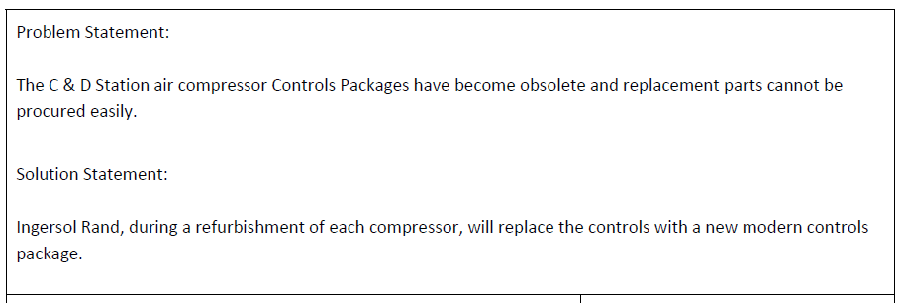
EIC Example – Station Air Compressor Replacement

Slide 8
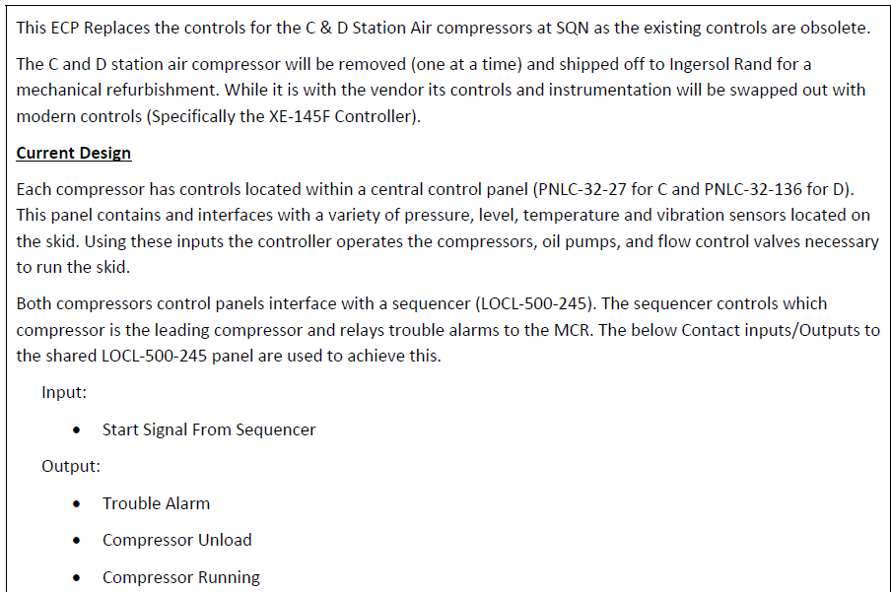
EIC Example – Station Air Compressor Replacement
Goes on to include:
Diagram
Explanation of Controls (digital) and Non-Controls changes
Physical Work Description for cabling, tubing, and mounting
Discussion of Child Package Scopes
Digital Equipment Info

Slide 9
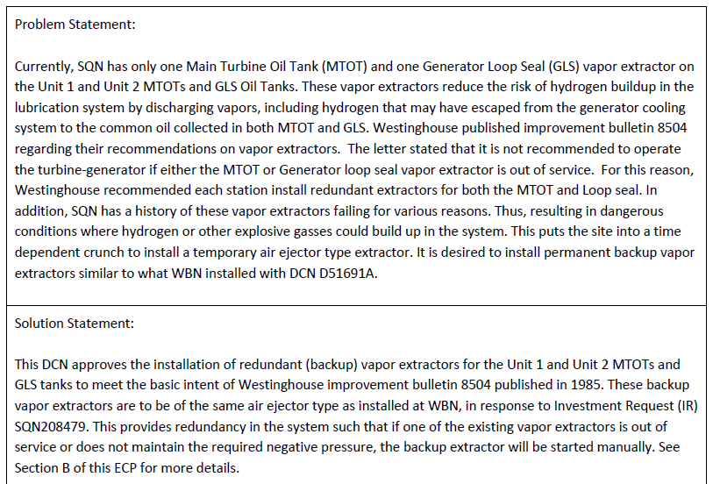
Mechanical Example – Vapor Extractors

Slide 10
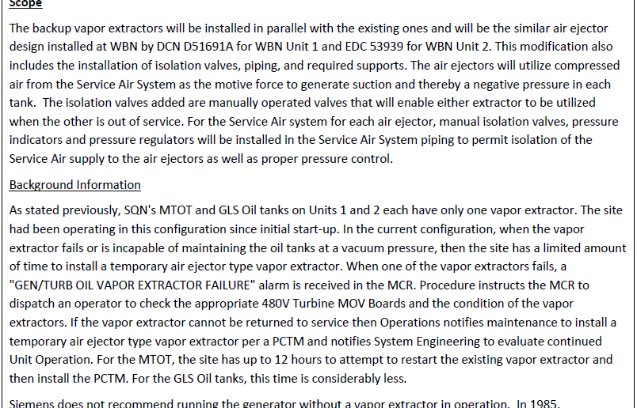
Mechanical Example – Vapor Extractors
Goes on to include:
Child Package Scopes
ECP Change Type Screening
Design Functions
Discussion on why each Stakeholder group is impacted

Slide 11
Design and Licensing Evaluations

Slide 12
Design & Licensing Evaluations
Design Evaluations (section B.4)
  State the requirements or inputs separately
  State the Reference(s) each input comes from
  Provide the critical thinking for how each one is addressed
  Include only requirements/inputs used
  Separate by disciplines, be descriptive but concise in the title
  Include diagrams, pictures, data tables as needed
Licensing Evaluations (section B.5/6)
  If it meets all the criteria for Design Equivalent, check the box and provide or attach supporting documentation (as needed)
  Otherwise, attach the 50.59 SR/SE

Slide 13
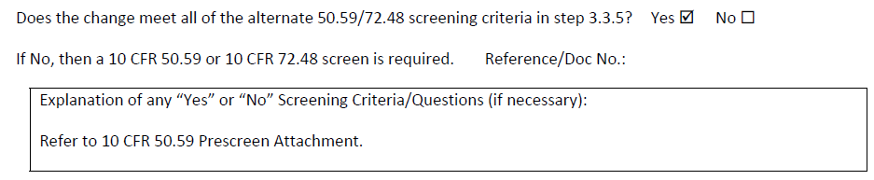
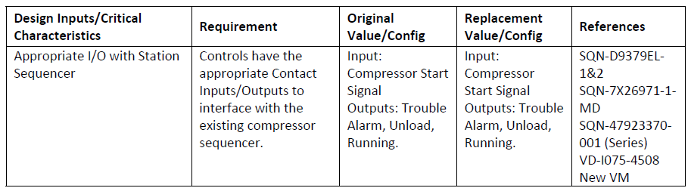
EIC Example – Station Air Compressor Replacement

Slide 14
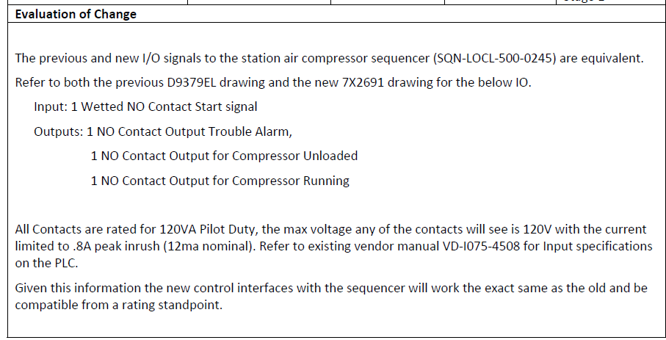
EIC Example – Station Air Compressor Replacement

Slide 15
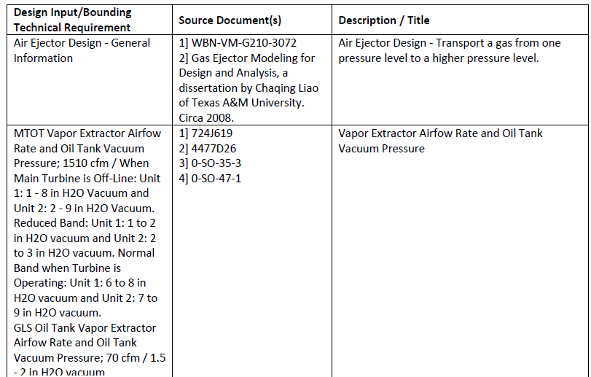
Mechanical Example – Vapor Extractors

Slide 16
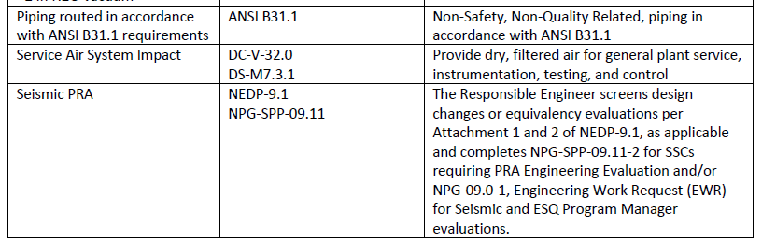
Mechanical Example – Vapor Extractors

Slide 17
Parent and Child Package Concept

Slide 18
Parent and Child Package Concept
This is how TVA uses this concept; it may differ from other utilities.
Parent:
  Includes all the common information and evaluations for an entire type of modification for one plant, can apply to multiple units at the same plant
  Typically document-only with no field work needed
  There is no Turnover, but will not Closeout until after the last Child package is implemented
Child:
  Includes everything to be implemented in one logical scope that can Turnover at once, applies to one unit
  Often says to see the Parent for details on the common information and evaluations rather than repeat it
  Differs from the Parent in Open Items, Special Implementation Instructions, Testing Requirements, Attachments, Affected Components List, Affected Documents List
  Typically has the same Stakeholders, but could have different design disciplines involved
  Linked in CMIS/ECM, but could be a different change type and/or safety classification

Slide 19
Open Items

Slide 20
Open Items
Open Items (section B.6/7)
Utility discretion is used to determine acceptance of what types, when needed, and how to track
Common types for TVA:
  Vendor Information received after ECP Issuance
  Calcs for Closure to roll in final vendor info or plant configuration
  Planned revisions or additional known scope
Turnover, Closure, Post Closeout
  May need a WO restraint for those at Turnover so work is not completed before the open item is cleared
  Post Closeout is not common at TVA
Tracking Mechanism
  CRs do not require a revision to the ECP, but are subject to go past the time needed since not linked
  Will often revise the ECP anyway to remove them, not always efficient

Slide 21
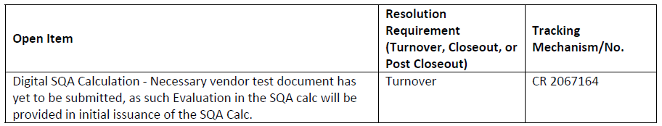
EIC Example – Station Air Compressor Replace (parent)

Slide 22
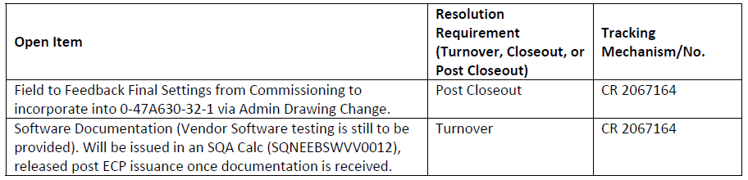
EIC Example – Station Air Compressor Replace (child)

Slide 23
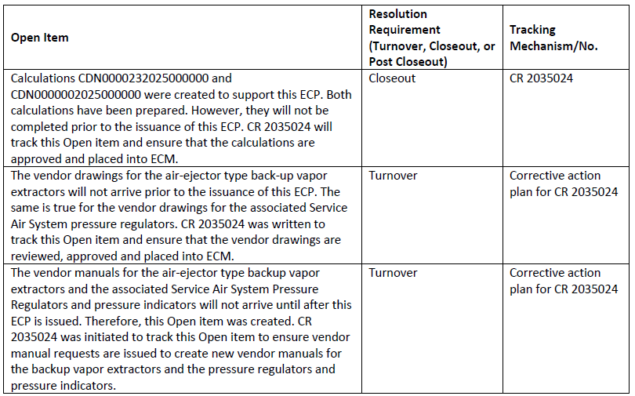
Mechanical Example – Vapor Extractors (parent)

Slide 24
Special Implementation Instructions
&
Testing Requirements

Slide 25
Special Implementation Instructions & Testing Reqmnts
What is included in these sections may be different between utilities due to proficiency/maturity of the craft and planners as well as process differences since the Turnover process is not included in the SDP.
Special Implementation Instructions (section D) for TVA typically include:
  Engineering requirements or information to return for the Planner to include in the WO
  Notes to the Implementer, like allowable commodity substitutions
  Cyber Security requirements
  Any other items needing review for completion by Engineering at Turnover
Testing Requirements (section E) for TVA typically include:
  Any testing needed in addition to normal maintenance testing of the system
  Any results needed from the field
  Any other related items needing review for completion by Engineering at Turnover

Slide 26
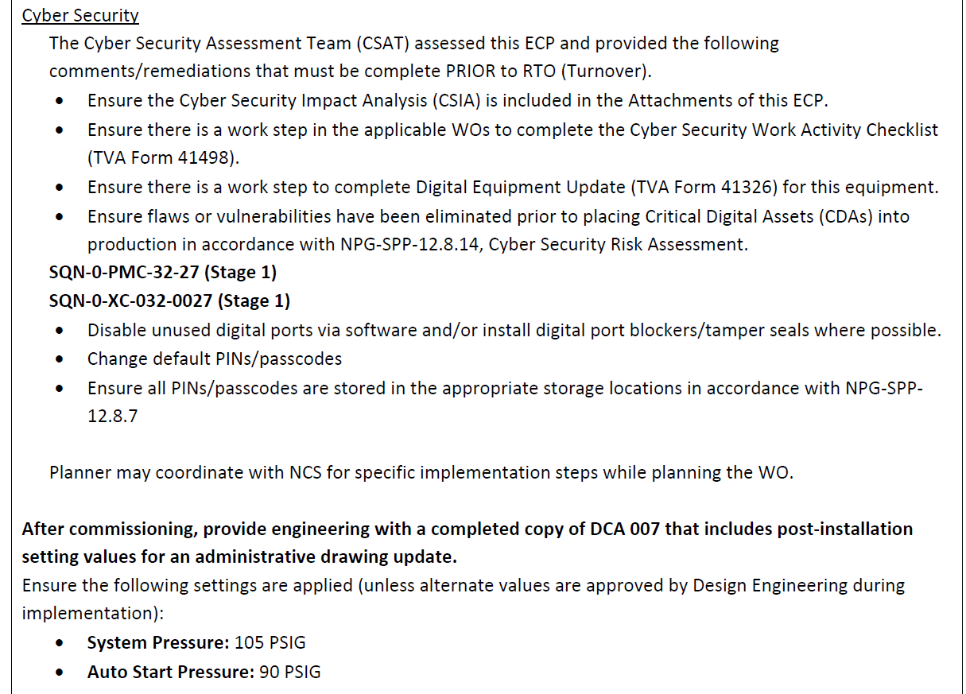
EIC Example – Station Air Compressor Replace (child)

Slide 27
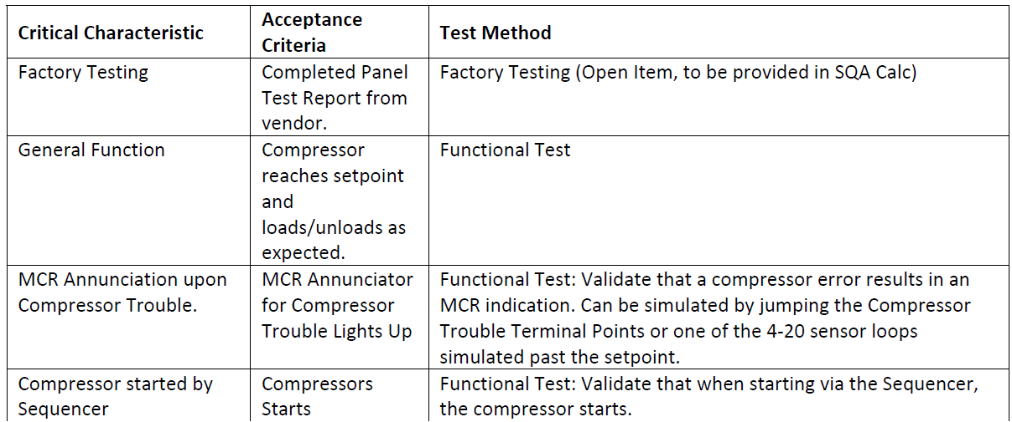
EIC Example – Station Air Compressor Replace (child)

Slide 28
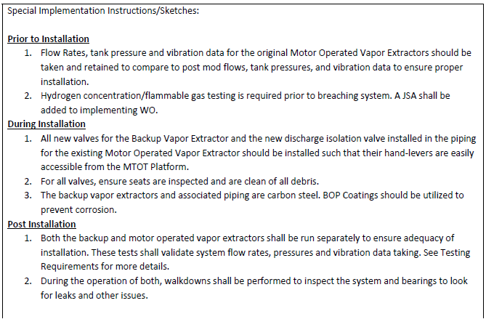
Mechanical Example – Vapor Extractors (child)

Slide 29
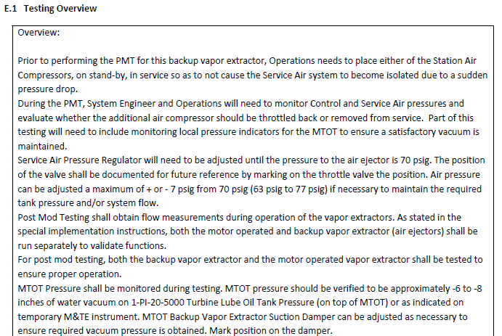
Mechanical Example – Vapor Extractors (child)

Slide 30
Attachments

Slide 31
Attachments
What is included in these sections may be different between utilities due to process differences not included in the SDP.
TVA typically attaches the following types of documents as applicable in section H:
  TPJB & Risk Reviews, ITPR Comments
  50.59/72.48 SRs and SEs
  Applicable programmatic checklists, screenings, reviews, and evaluations
  Licensing document (FSAR, TS, TRM etc.) and Design Basis (Design Criteria, System Desc, etc.) changes
  Approved Exceptions and Variances to programmatic requirements
  Vendor Manuals, Reports, Correspondence, and other Vendor Information
  Drawing Changes, Master Equipment List (MEL) Changes, Cable Routing Changes
  Walkdown Packages
  Procurement Documents

Slide 32
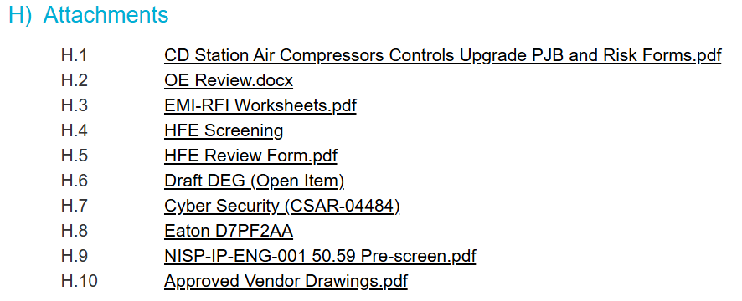
EIC Example – Station Air Compressor Replace (parent)

Slide 33
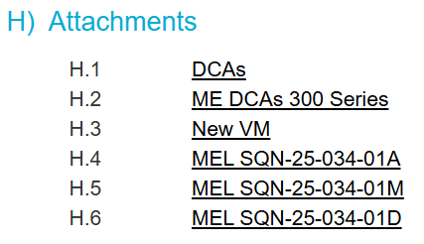
EIC Example – Station Air Compressor Replace (child)

Slide 34
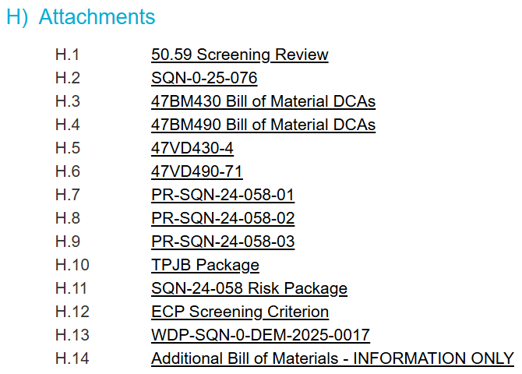
Mechanical Example – Vapor Extractors (parent)

Slide 35
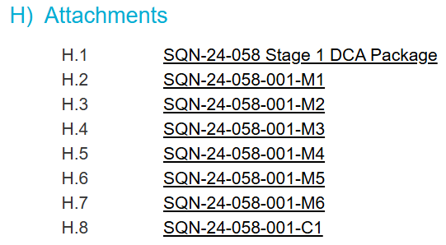
Mechanical Example – Vapor Extractors (child)

Slide 36
Questions?
What good looks like is somewhat subjective and dependent on your utility standards and expectations
SDP is flexible on purpose to allow for requirements to be met while maximizing efficiency

