Slide 1
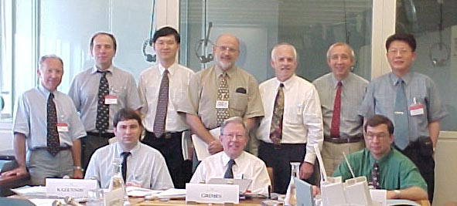
June 19-23, 2000, Vienna, Austria

Slide 2
December 3-7, 2000, Pusan, Korea

Slide 3
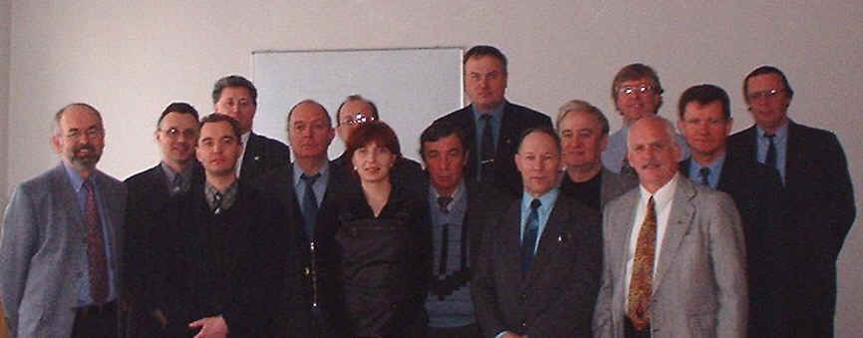
March 26-30, 2001, Moscow, Russia

Slide 4
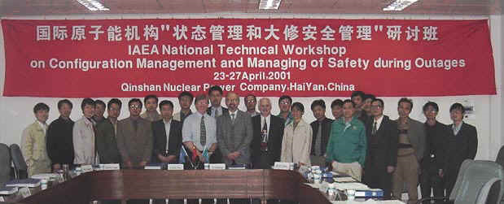
April 23-27, 2001, Hai Yan, China

Slide 5
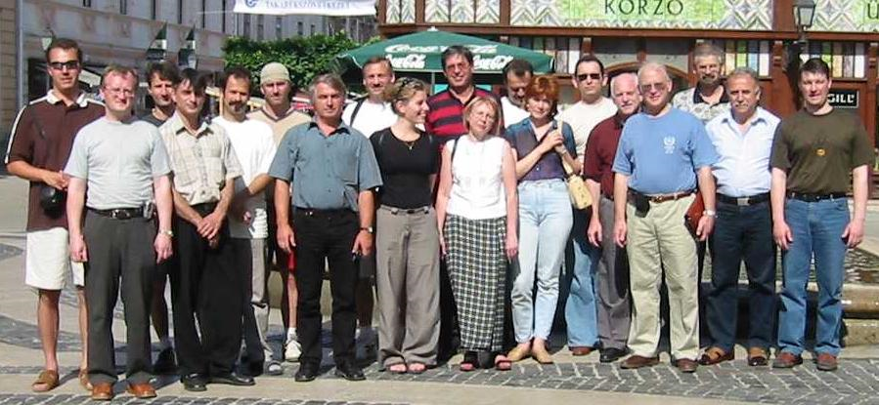
June 23-27, 2003, Paks, Hungary

Slide 6
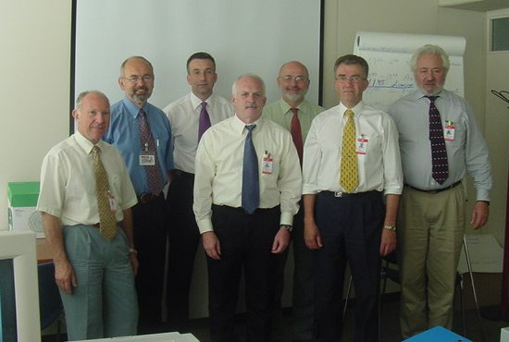
IAEA Safety Report Meeting - June 2002

Slide 7
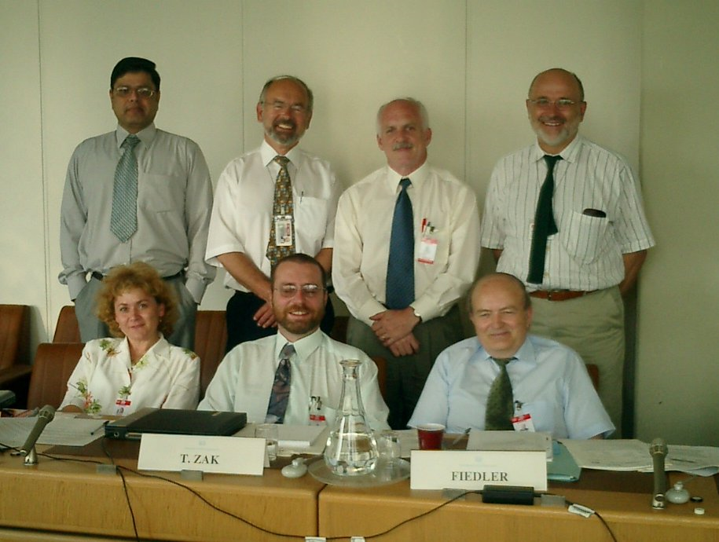
IAEA Safety Report Meeting - June 2003

